Slide 1
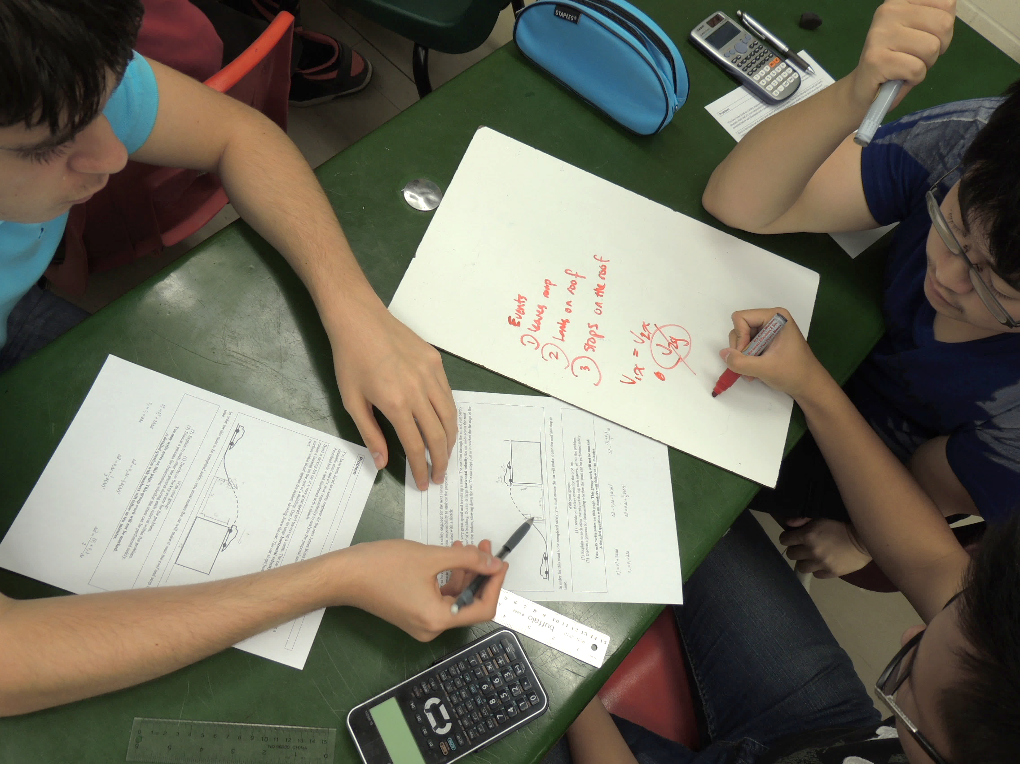
A Scientific Model for Learning
Chris Meyer
York Mills C. I., Toronto District School Board
www.meyercreations.com/physics

Slide 2

A
PHYSICIST
(and a high school teacher!)

Slide 3

You just finished your academic training …

Slide 4
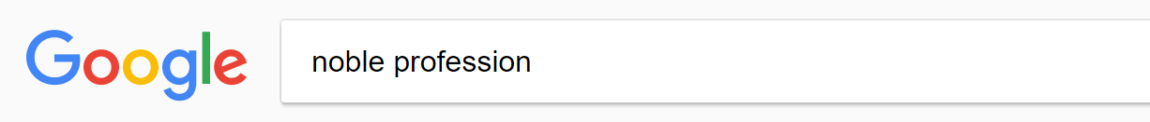

Slide 5
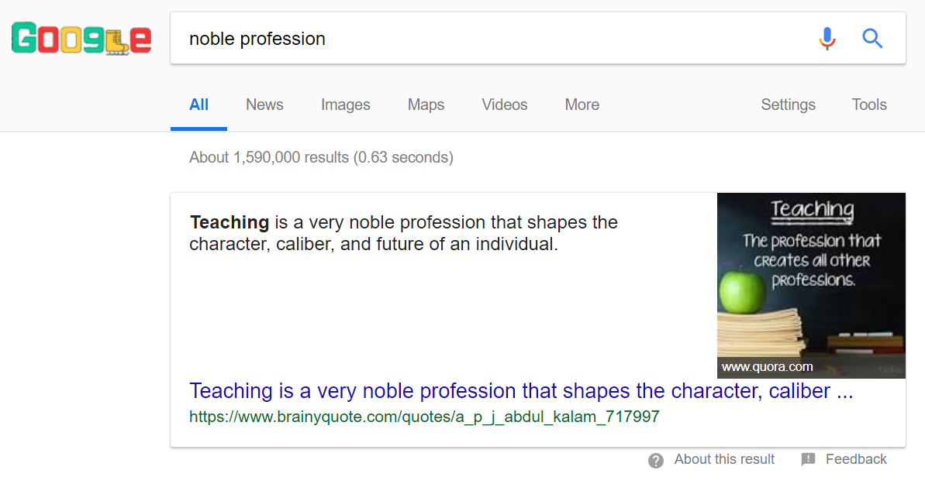

Slide 6
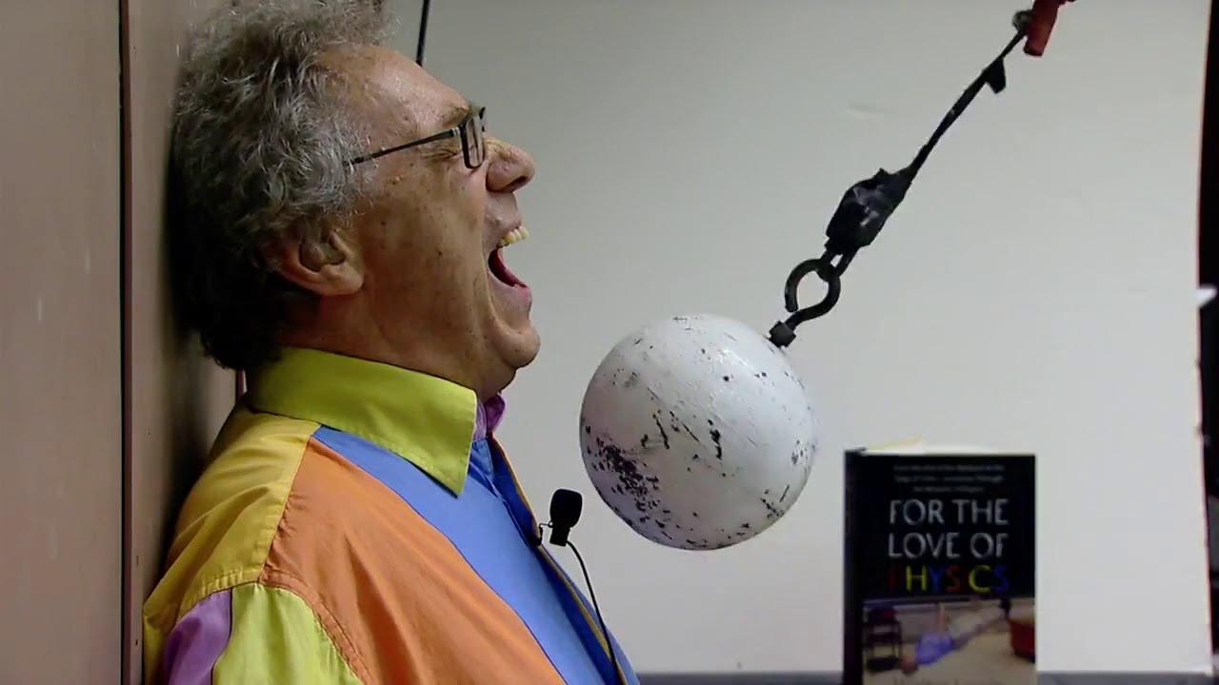
“The Noble Profession”: Teaching
Notes:
How about teaching? This is the bread and butter for many of us.

Slide 7

Great Teachers
Notes:
Some teachers also have a mystical ability to spellbind and enthrall. To dazzle and inspire and make a deep emotional connection with people. Some have a great ability to …

Slide 8
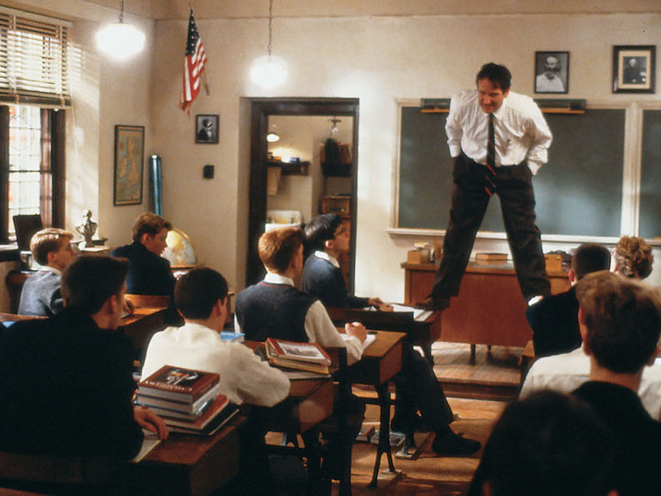
Great Teachers
Notes:
stand on tables. You know someone’s really teaching when …
But wherein lies their power? How far does the power of the charismatic teacher extend?

Slide 9
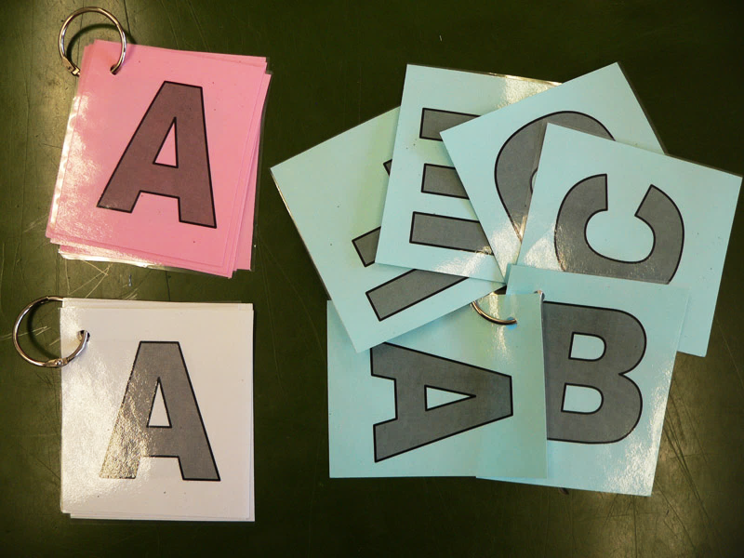

Slide 10
What is your main teaching experience?
(A) University teaching assistant
(B) Private tutor
(C) DEEP instructor
(D) Other kind of teacher
(E) I’ve watched a lot of Bill Nye

Slide 11
What is your academic background?
(A) Engineering
(B) Physics
(C) Math
(D) Some other kind of “science”

Slide 12
What are we going to do today?
Explore the science of learning
Generate ideas to help your DEEP teaching
And try to take over the world

Slide 13
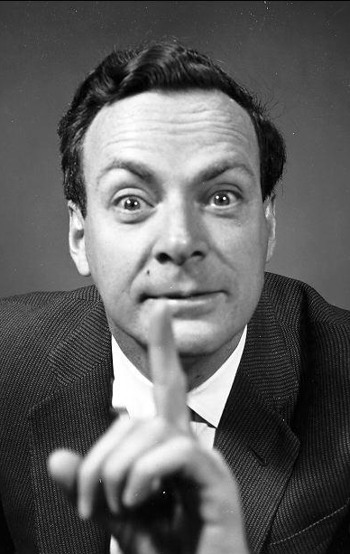
My
Old
Teaching
Hero
Richard Feynman

Slide 14
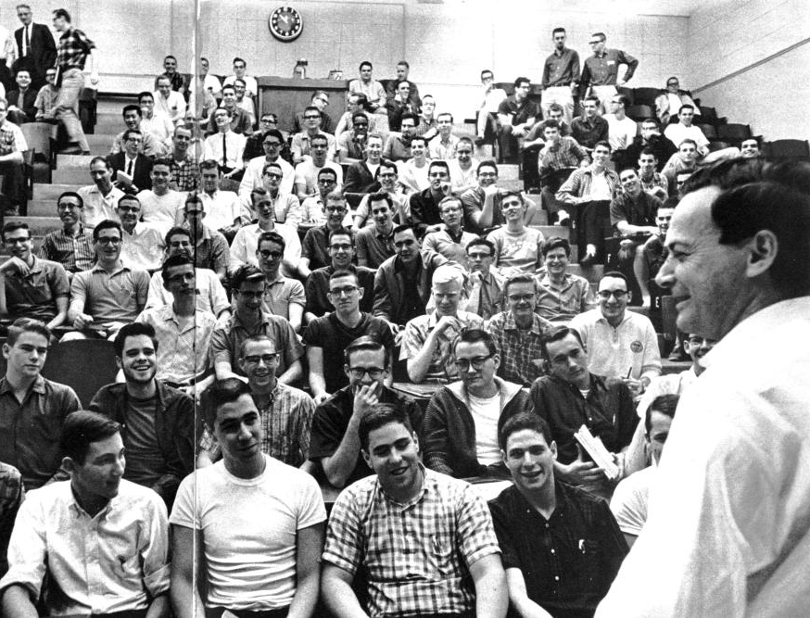
Feynman at Caltech
Notes:
Richard Feynman is widely regarded as having been an extraordinary teacher. His lecture halls at Caltech when he taught introductory physics were packed

Slide 15
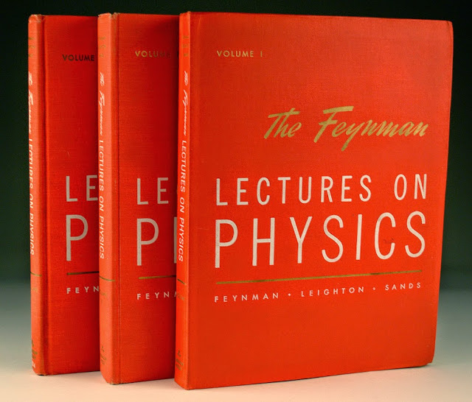
Notes:
and his lectures have become legend. But Feynman was confronted with the limits of his Magical powers. As many of you might well know, reality cuts deepest when reviewing final exam results. He remarked that amongst the many disappointing exam papers:

Slide 16
“… When I look at the examinations,
I think that
the system is a failure.”

Slide 17
“… there were
one or two dozen students who—very surprisingly—understood almost everything … and they are, after all, the ones I was trying to get at.”

Slide 18
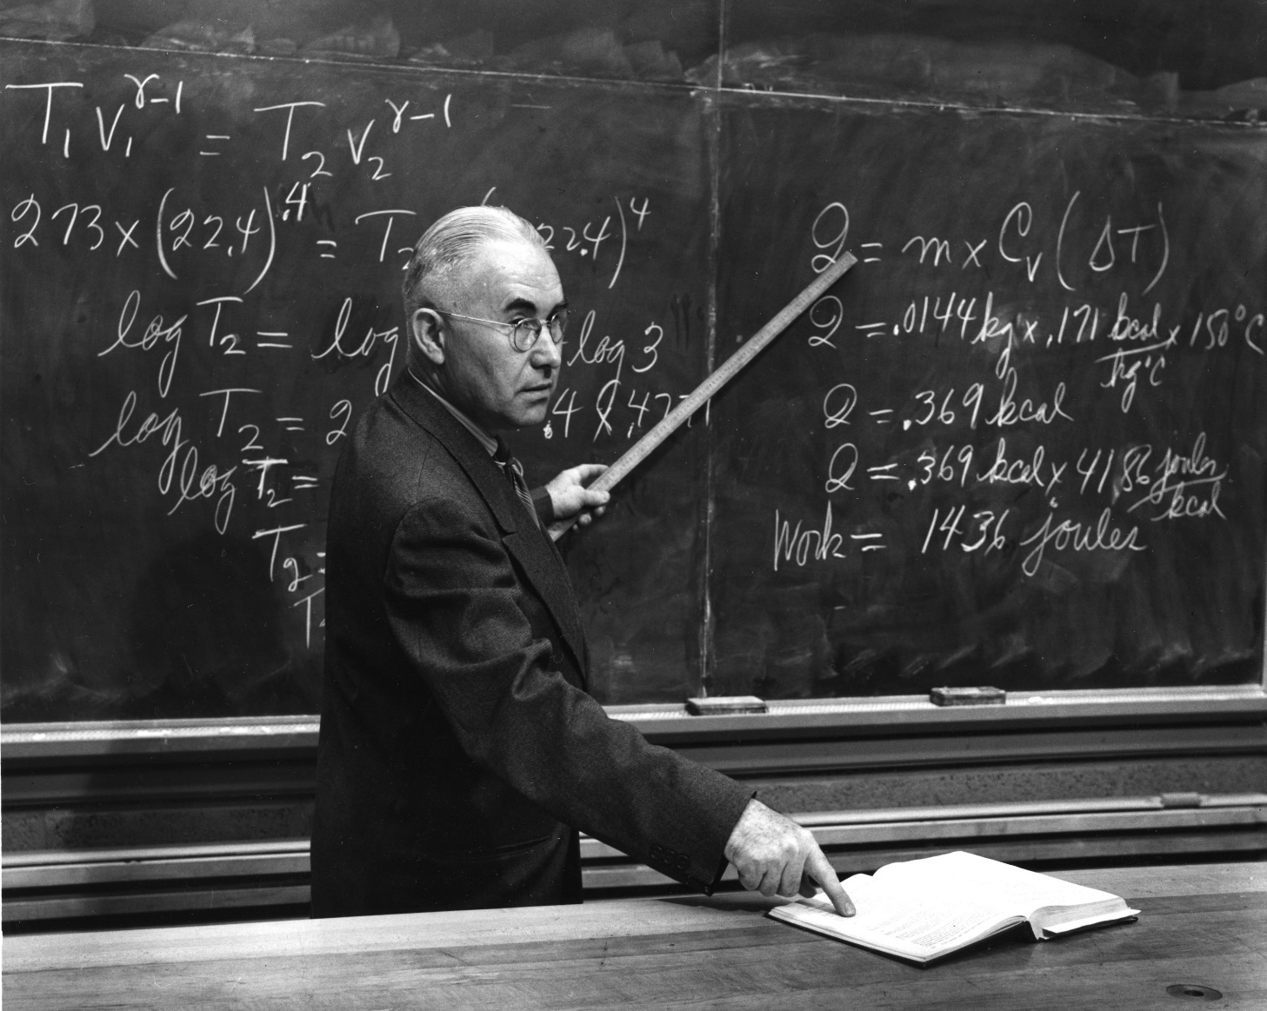
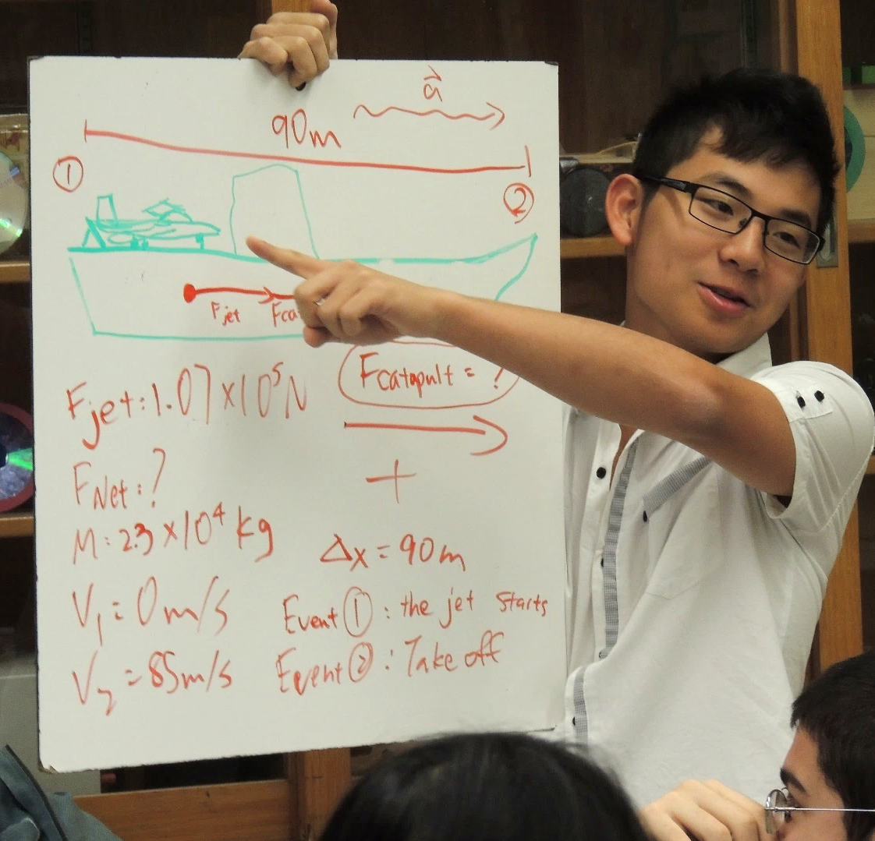
Good Teaching?
How well is the material presented?
How well are students learning?
Internal logic = Aristotelian
Empirical results = Galilean

Slide 19
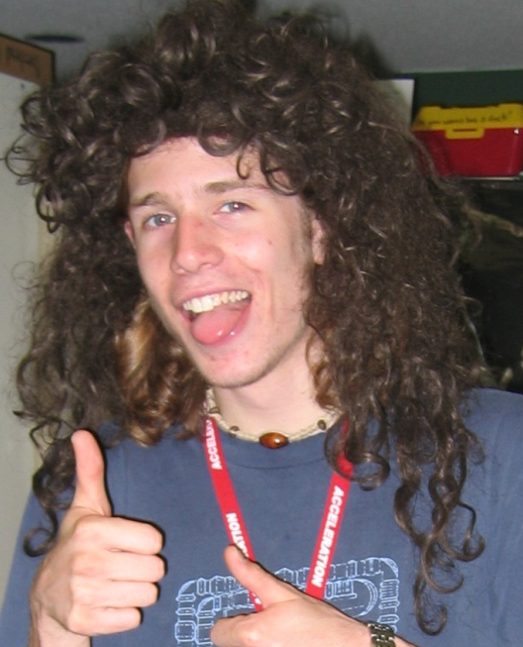
Distilled Wisdom
?
Typical Student
Notes:
Let’s take a moment to think about what this question means. Take your typical physics student. When we do our best to share our hard-earned physics wisdom, and the question is: how much makes it in there? How do we figure this out?

Slide 20
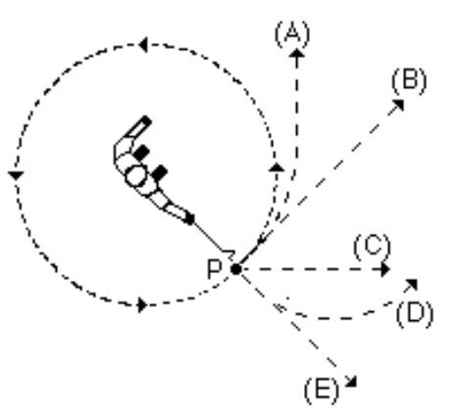
Question Time!
A ball on a string is swung in a horizontal circle.
At point P, the string breaks.
Which path would the ball most closely follow, observed from above?
A
B
C
D
E
Hestenes, D., Wells, M., & Swackhamer, G. (1992). Force concept inventory. The physics teacher, 30(3), 141-158.
Notes:
By creating an empirical test. The Force Concept Inventory …
The hallmark of these questions is that they do not involve any math.

Slide 21
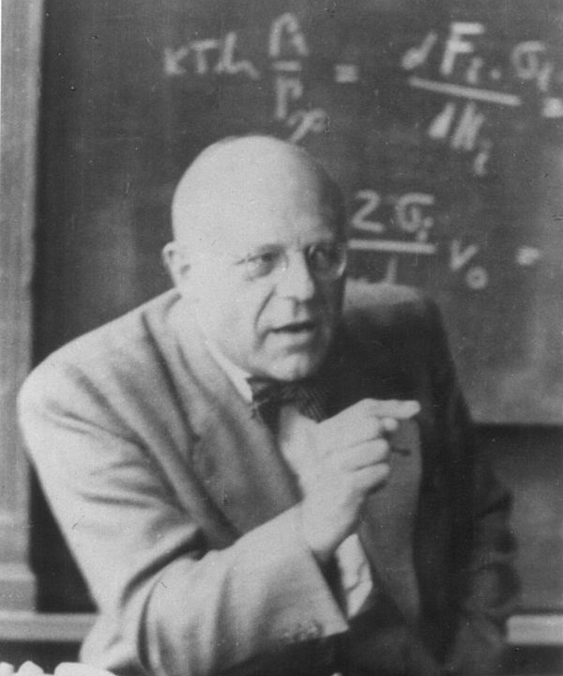
Way too easy!
Harrumph!
Notes:
And if you give them to a cranky expert, they will growl with disdain:
But they provide a revolutionary window into our students understanding and the effectiveness of our instruction.

Slide 22
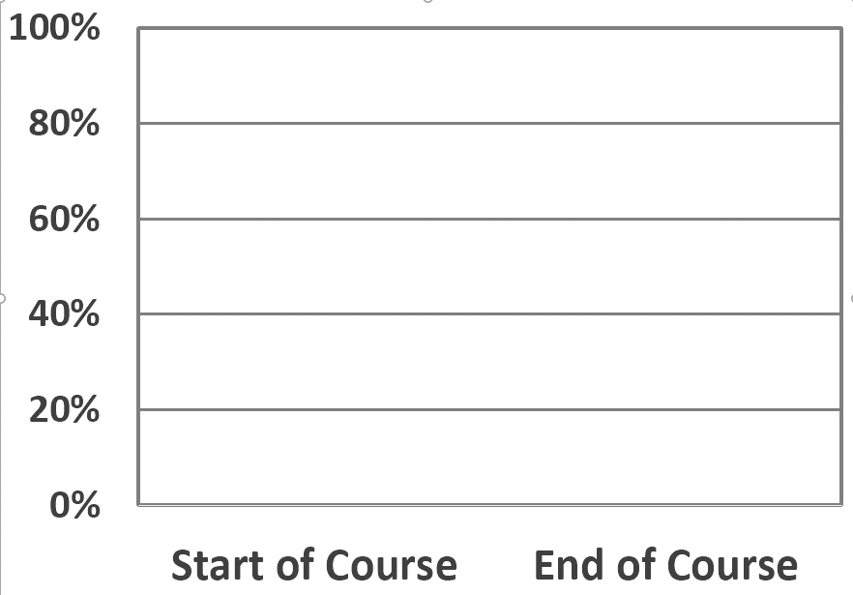
Force Concept Inventory Scores
Gain:
12.7% ₌
55%
Room for improvement:
55%
23%
12.7%
Test Score 57.7%
Test Score 45%

Slide 23
Distilled Wisdom
23%
77% Scattered
Hake, Richard R. "Interactive-engagement versus traditional methods: A six-thousand-student survey of mechanics test data for introductory physics courses." American journal of Physics 66.1 (1998): 64-74.
Typical Student
Notes:
So now we have an answer: how much do students improve under the benefit of out wisdom?
And what happens to the rest? Why didn’t our carefully crafted wisdom stick?

Slide 24
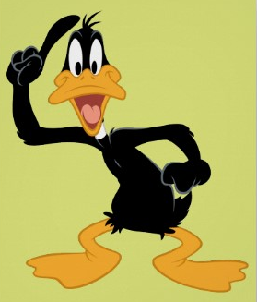

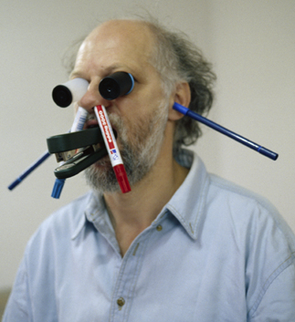
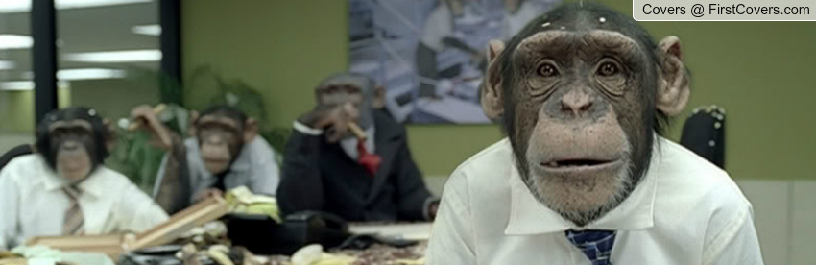
Best Lesson Ever
Notes:
All of us teachers have long sensed that this was the case. We have all had the experience …

Slide 25
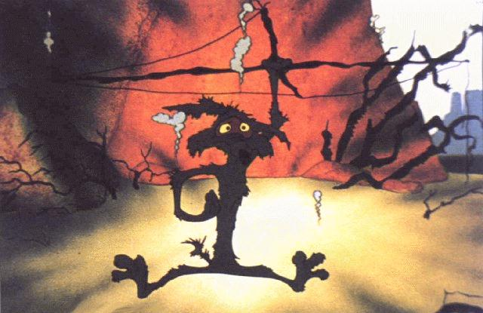

Slide 26
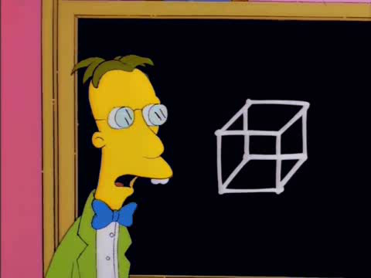
Teacher Doesn’t Matter

Slide 27
Teacher Doesn’t Matter
23%
Notes:
It’s like the cocktail party right?

Slide 28
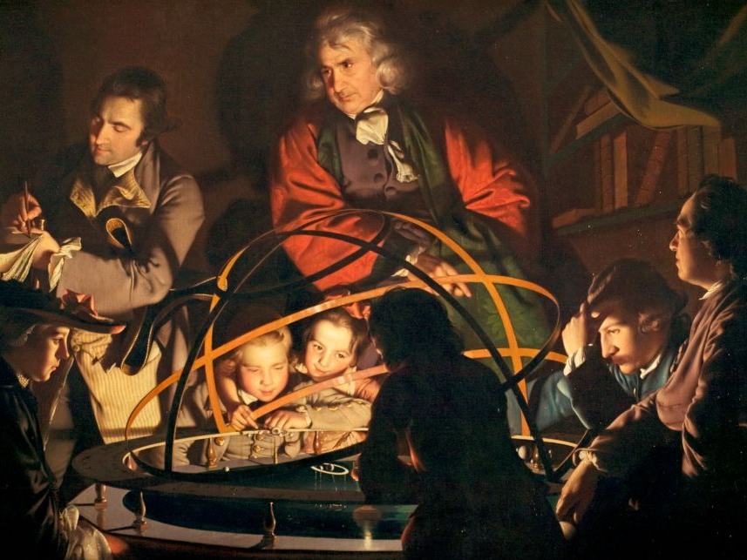
A Scientific Revolution for Teaching
A Philosopher giving a Lecture on the Orrery in which a lamp is put in place of the Sun,
Joseph Wright of Derby, 1766
Notes:
The FCI was part of the early wave of research that began to transform teaching into an empirical science. Almost thirty years later, we are in the midst of a full scientific revolution for teaching. The excitement and great potential of this is what brings me here today. When we harness the powers of science, we can replace our instinctual reactions to our students’ learning difficulties:

Slide 29
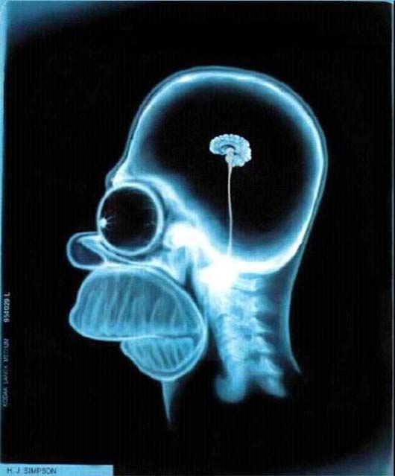
What happens in students’ brains when they learn?

Slide 30
My Proposal:
Scientific
Model of Learning
Neuroscience
+
Cognitive Psychology
+
Physics Education Research
+
Classroom Practice

Slide 31
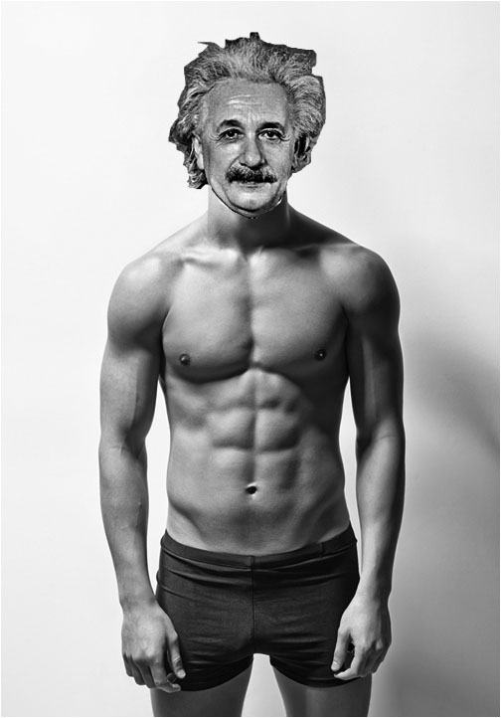

Models: A framework of ideas to help explain and predict phenomena,
now covering learning!

Slide 32
Physical
Workings
Scientific
Model of Learning

Slide 33
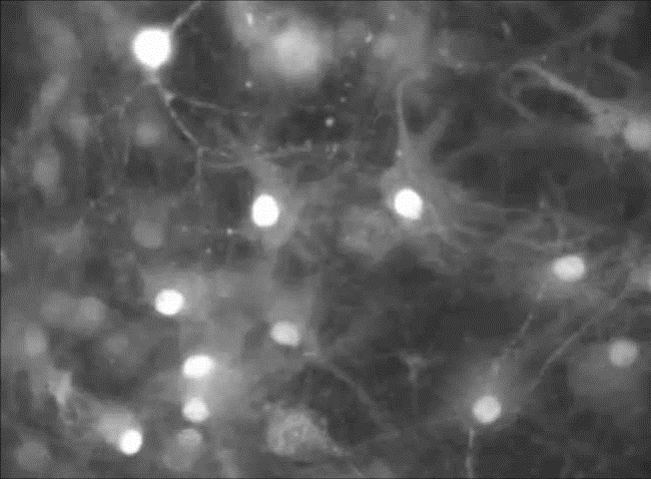
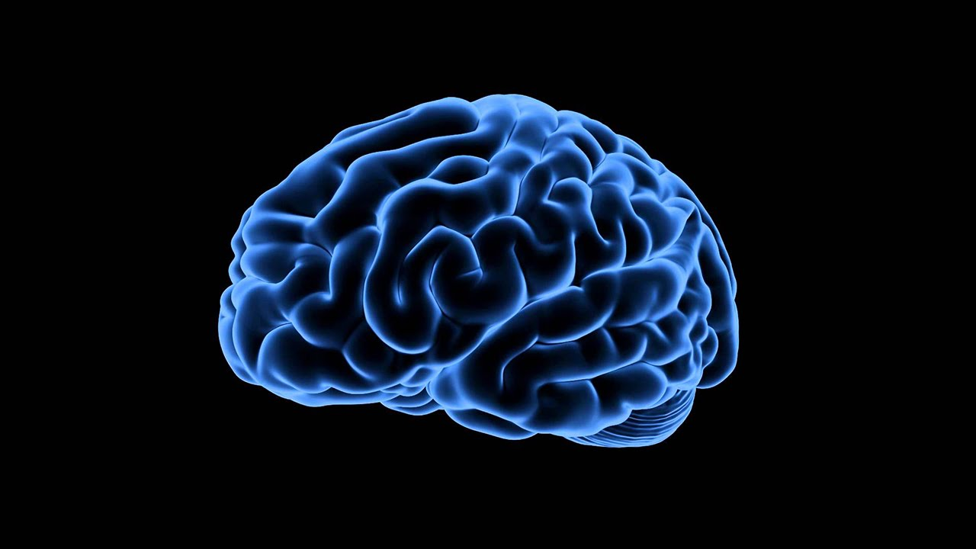
Notes:
Billions of neurons
10 000 connections per neuron
Learning takes place when neurons repeatedly fire together
Connections strengthen

Slide 34
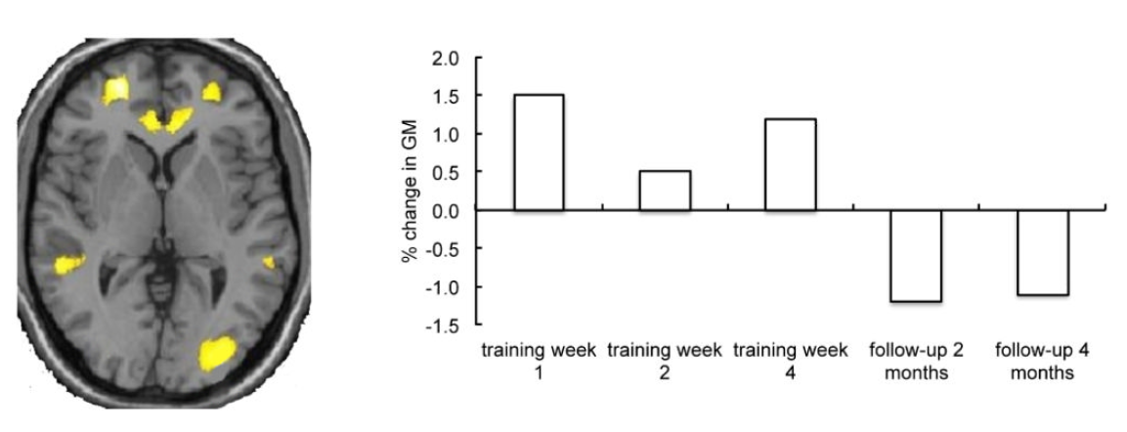
Grey Matter Grows with Learning
Zatorre, R. J., Fields, R. D., & Johansen-Berg, H. (2012). Plasticity in gray and white: neuroimaging changes in brain structure during learning. Nature neuroscience, 15(4), 528-536.

Slide 35
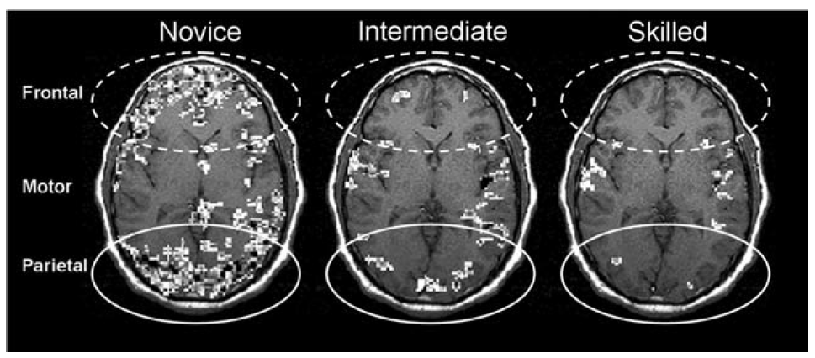
Watch the Brain Learn
Regions of higher-than-normal blood flow / energy use
What is happening in the brain?
How does this feel to the owner?
Hill, N. M., & Schneider, W. (2006). Brain changes in the development of expertise: Neurological evidence on skill-based adaptations. From: The Cambridge handbook of expertise and expert performance (pp. 653-683).

Slide 36
Watch the Brain Learn
Learning something new is
energy intensive and tiring
60 minutes
later!
Hill, N. M., & Schneider, W. (2006). Brain changes in the development of expertise: Neurological evidence on skill-based adaptations. In Cambridge handbook of expertise and expert performance (pp. 653-683).

Slide 37
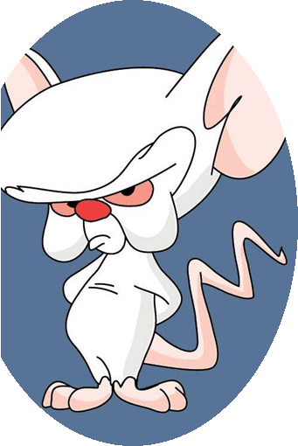
The Skilled Expert
Fluent
Skills invisible and automatic

Slide 38
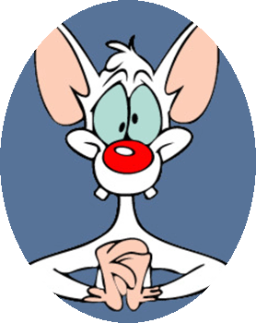
The Novice
Lack Fluency
Skills are effortful and slow

Slide 39


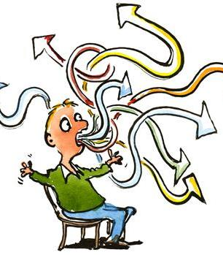
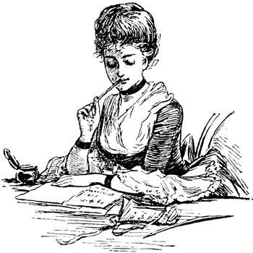
Structured Groups
Manager:
Lead and organize group
Recorder:
Writes on whiteboard
Checks group’s written work
Speaker:
Speaks on behalf of group Reads questions
Motivator:
Encourage the group!

Slide 40
Implications for Teaching
How can we use these ideas to help our students learn?
Choose your roles
Record ideas on your whiteboard (maximum 10 words per idea!)
When we are done, take a photo of your whiteboard

Slide 41
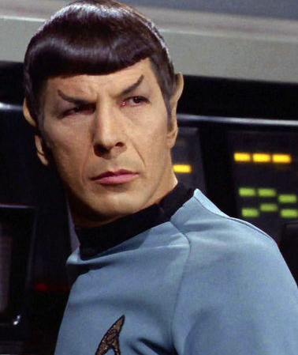
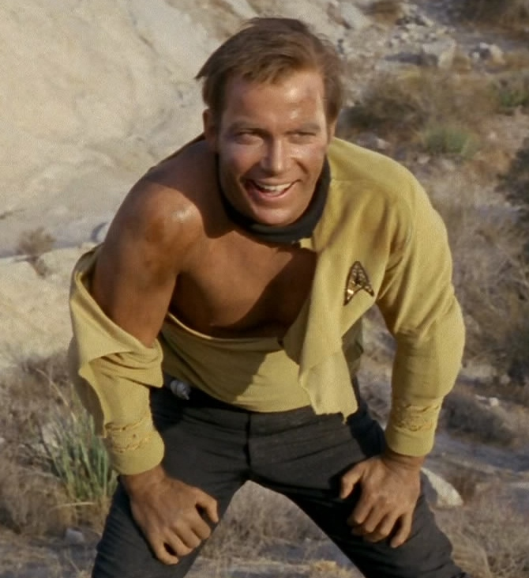
Who is our student?

Slide 42
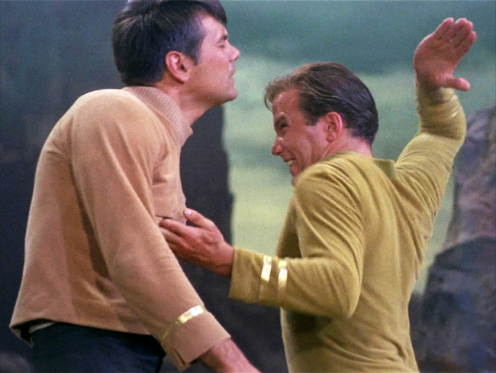
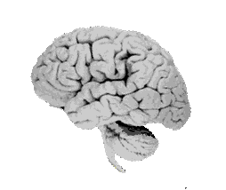
We get the humans

Slide 43
Survivor
What are the brain’s main strategies for survival?

Slide 44
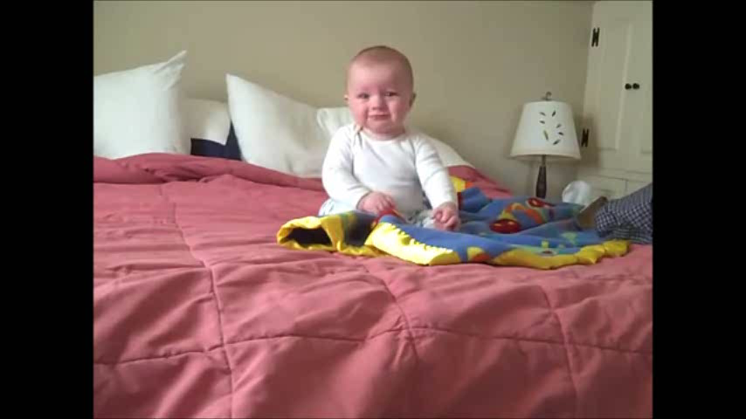
Control its Body

Slide 45
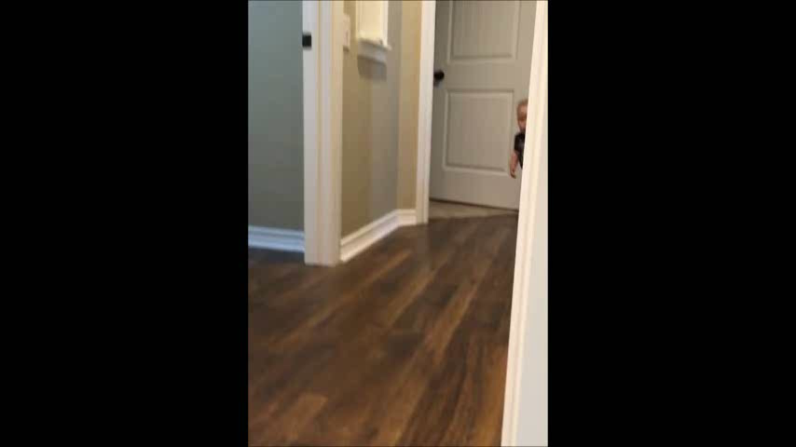
Avoid Danger

Slide 46
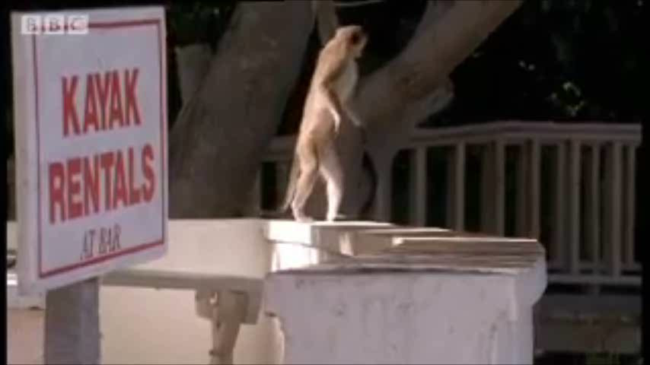
Find Pleasurable Things

Slide 47
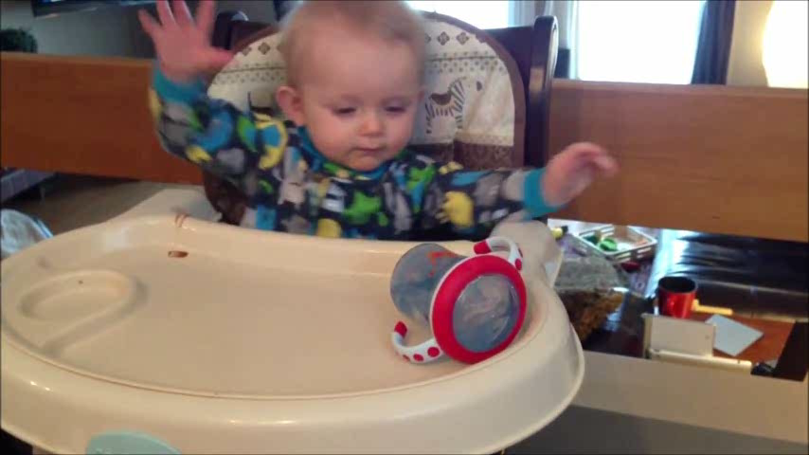
Understand its Environment

Slide 48
Understand its environment
Control body’s actions
Avoid danger
Find pleasurable things
Zull, J. The Art of Changing the Brain. 2002

Slide 49
learning
control
survival
fear
pleasure
Zull, J. The Art of Changing the Brain. 2002

Slide 50
Deeply Wired
Learning
Control
Pleasure
Fear
Strong Emotional Response

Slide 51
Physical Workings
Emotion
Scientific
Model of Learning

Slide 52
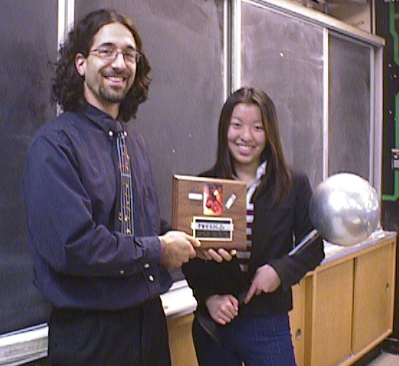
This guy would say …

Slide 53


Slide 54

Learning in Action

Slide 55
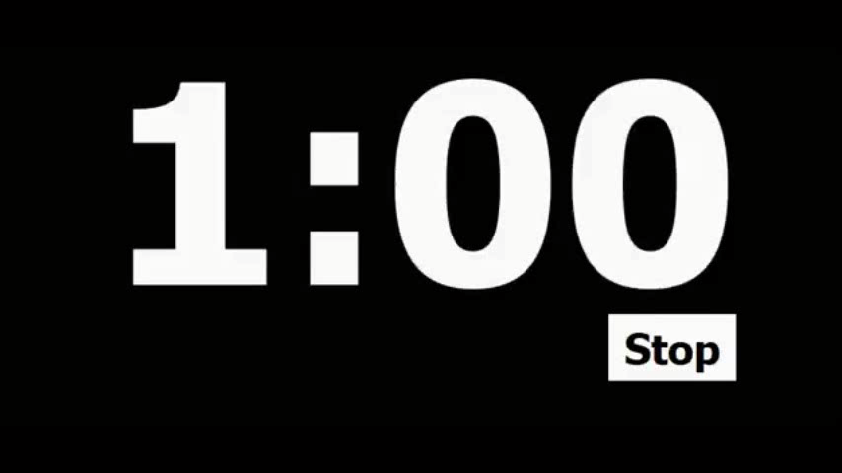
Why that response?
Students have a strong emotional reaction at the end of the task.
Why?
Quick group discussion

Slide 56
Prefrontal
Cortex
Dopamine
Hit
Zull, J. The Art of Changing the Brain. 2002
Notes:
Based on perception-cycle that brainy organisms use to interact with their environment.
When this cycle operates well, the brain makes rich sets of connections.

Slide 57
Pleasure!

Slide 58
Fundamental Rule of Neuroscience
Neurons that fire together, wire together

Slide 59
Doing Science
Pleasurable results

Slide 60
Implications for Teaching
How can we use our understanding of emotion to help our students learn?
Change your roles
Record ideas on your whiteboard (maximum 10 words per idea!)
When we are done, take a photo of your whiteboard

Slide 61
Skill-Testing Question
Compare the size:
4 8
<
?

Slide 62
Skill-Testing Question
Compare the size:
1 1
4 8
?
<
Why does this happen?

Slide 63
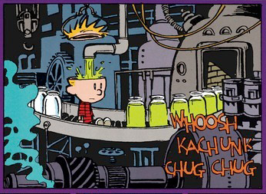
Empty Vessel Model
WholesomeKnowledge
Tight Seal
False

Slide 64
Knowledge is built from primitive pieces
Less than,
greater than
Numbers indicate size
Fractions = part of a whole
DiSessa, A. A. (1993). Toward an epistemology of physics. Cognition and instruction, 10(2-3), 105-225.

Slide 65
As we learn, connections grow
Less than, greater than
Numbers indicate size
Fractions = part of a whole

Slide 66
Networks of knowledge resources form
Larger number = more
Counting numbers
More = better!
Division
Less, greater
1 / big = small
Number = size
Numerator / denom
Fractions = parts
Rational numbers
Pizza slices

Slide 67
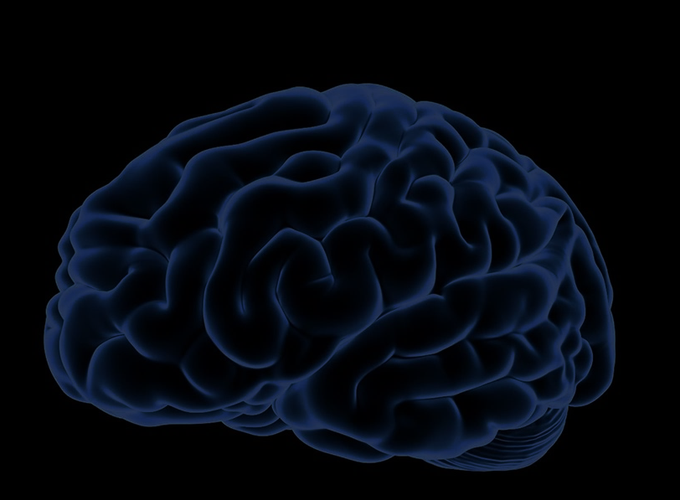
Prior Knowledge
is the collection of knowledge resources that students bring into our classroom.

Slide 68
Brain Workings
Emotion
Scientific
Model of Learning
Prior Knowledge

Slide 69
Prior Knowledge
When we recall,
we activate networks of resources to reconstruct knowledge.

Slide 70
You want this network to activate
Larger number = more
Counting numbers
More = better!
Division
Less, greater
1 / big = small
Number = size
Numerator / denom
Fractions = parts
Rational numbers
Pizza slices

Slide 71
Instead, this one is activated!
Larger number = more
Counting numbers
More = better
Division
Less, greater
1 / big = small
Number = size
Numerator / denom
Fractions = parts
Rational numbers
Pizza slices

Slide 72
Both are in there!
Stronger connections more likely to activate
Larger number = more
Counting numbers
More = better!
Division
Less, greater
1 / big = small
Number = size
Numerator / denom
Fractions = parts
Rational numbers
Pizza slices

Slide 73
Prior Knowledge
Strongly connected
prior knowledge
can conflict with
new knowledge for
a surprisingly long
period of time.

Slide 74
The Expert
Fluent
Skills invisible and automatic
Consistent
Strong, stable connections

Slide 75
The Novice
Lack Fluency
Skills are effortful and slow
Inconsistent
Weak, unstable connections

Slide 76
Learning = connecting new ideas to our prior knowledge
Partial Differential Equations!
Counting numbers
More = better!
Division
Less, greater
1 / big = small
Number = size
Numerator / denom
Fractions = parts
Rational numbers
Pizza slices

Slide 77
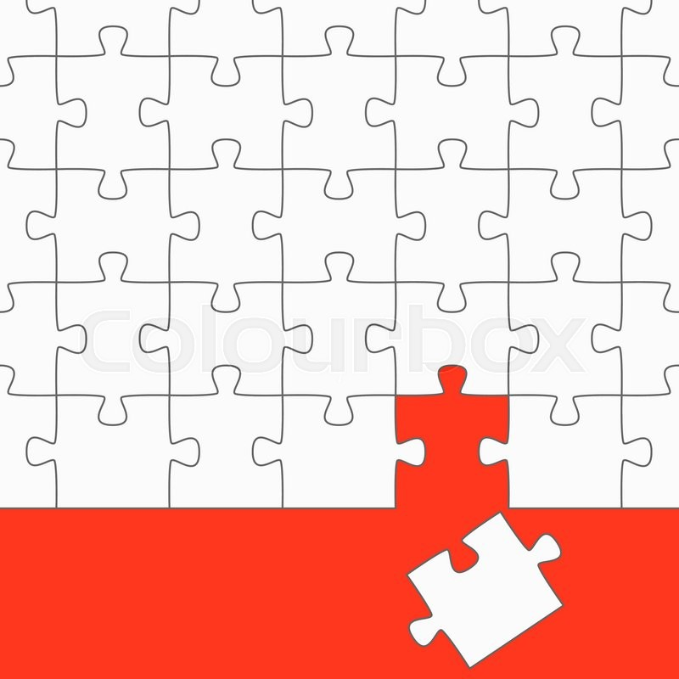
Prior Knowledge
If prior knowledge
is not ready, students
cannot make use
of expert knowledge.

Slide 78
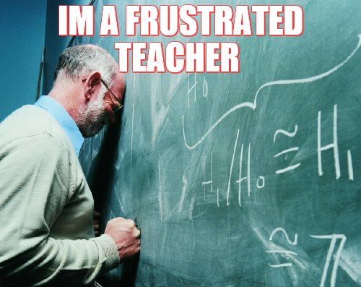

Slide 79
Math Problem!
Find the current
through the 2 ohm resistor and the potential difference between point a and b.
75%
Average =
Notes:
A few examples to help us compare the explanatory power of these two models.

Slide 80
Math Problem?
When the switch is closed,
what happens to:
(a) the current through the battery
(b) the brightness of the bulbs
40%
Average =
Weak connections hidden by math
Notes:
We cover this material …. Why does this happen.

Slide 81
Time for a test!

Slide 82
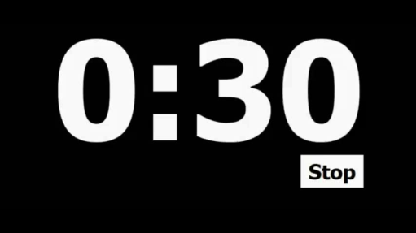
Learn This!
= 1
= 2
= 3
= 4
= 5
= 6
= 7
= 8
= 9
= 0

Slide 83
Test Time!
38
27
40

Slide 84
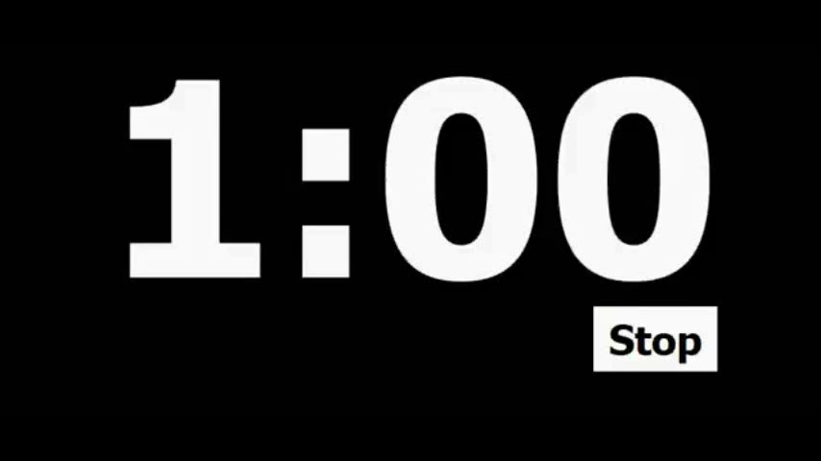
Discuss!
= 1
= 2
= 3
= 4
= 5
= 6
= 7
= 8
= 9
= 0
Discuss any patterns you find amongst the numbers and shapes.

Slide 85
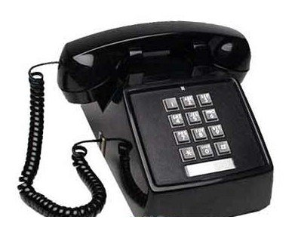

Slide 86
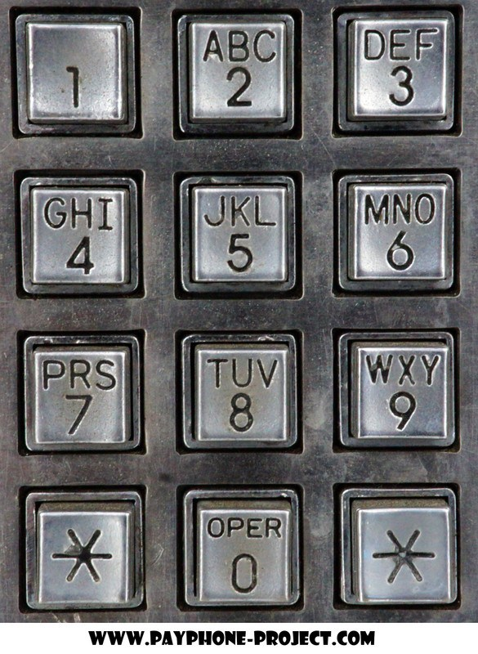

Slide 87
1 | 2 | 3
4 | 5 | 6
7 | 8 | 9

Slide 88
1 | 2 | 3
4 | 5 | 6
7 | 8 | 9
= 1
= 2
= 3
= 4
= 5
= 6
= 7
= 8
= 9
= 0

Slide 89
Test Time!
23
48
15

Slide 90
Prior Knowledge
Activating helpful
prior knowledge
can assist
the learning
of new ideas.

Slide 91
Implications for Teaching
How can we use our understanding of prior knowledge to help our students learn?
Change your roles
Record ideas on your whiteboard (maximum 10 words per idea!)
When we are done, take a photo of your whiteboard

Slide 92
Teaching is a Wiring Problem
Force spins
Force deflects
Heavy things resist
R ↑, motion ↓
Motion dies away
Opposites cancel
F → motion
Change takes time
Stronger wins
Objects squish with force
More effort = more resistance
Notes:
At a deeper level, or educational goal translated into wiring – we want to rewire or students brains!

Slide 93
How to make connections?
Force spins
Force deflects
Heavy things resist
R ↑, motion ↓
Motion dies away
Opposites cancel
F ∴ motion
Change takes time
Stronger wins
Objects squish with force
More effort = more resistance

Slide 94
Cognitive Learning Cycle
Premotor and Motor
Do,
Test
Sensory and Postsensory
Input
Frontal Integrative Cortex
Plan
Temporal Integrative Cortex
Assign Meaning
Zull, J. The Art of Changing the Brain. 2002
Notes:
Based on perception-cycle that brainy organisms use to interact with their environment.
When this cycle operates well, the brain makes rich sets of connections.

Slide 95
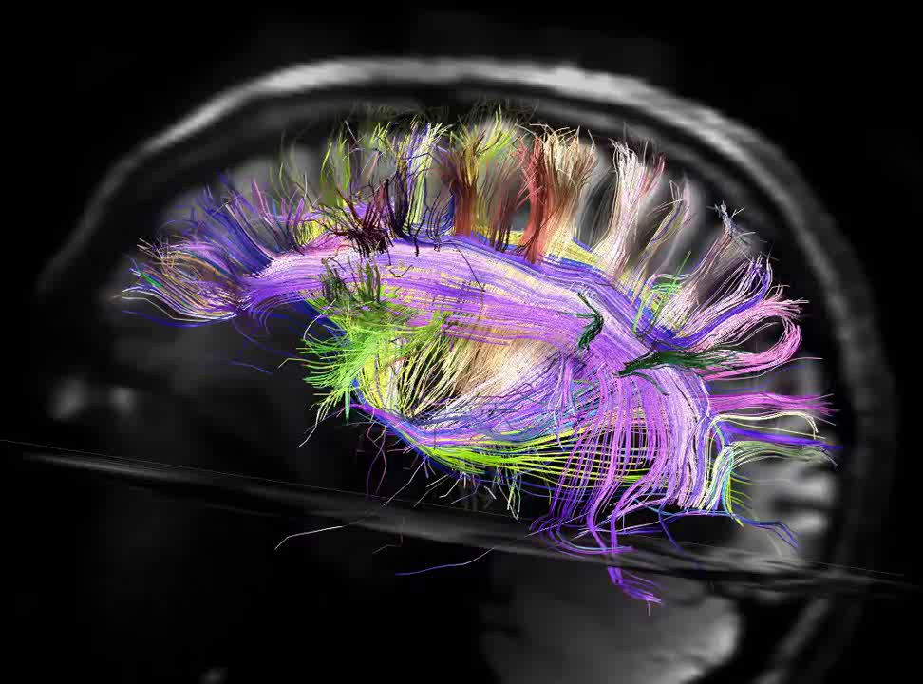
Brain’s Learning Engine
How the brain is hardwired to learn
The Connectome Project, NIH 2012

Slide 96
Brain Workings
Emotion
Science
of Learning
Prior Knowledge
Cognitive Learning Cycle

Slide 97
In which part of this cycle can teachers participate?
Sample Circuits
Do,
Test
Electric Concepts
Input
Strategies/Tips
Plan
Assign Meaning
Zull, J. The Art of Changing the Brain. 2002
Notes:
Their brains want to do the cycle!
If you try to provide them with 20 years of science teaching wisdom, you are just providing more input that they don’t have the opportunity to process and sort out. This is why learning is so complex! The more “wisdom” we give, the less time students have to sort it out.

Slide 98
In which part of this cycle can teachers participate?
Do,
Test
Little Active Testing
Input
Lots of Input!
Plan
Move info around,
math
Little Reflection to Assign Meaning
Assign Meaning
Zull, J. The Art of Changing the Brain. 2002
Notes:
Really messing with our students brains! Hitting the gas and putting on the brake at the same time! Their brains want to do the cycle!
Can I do anything useful with this information (other than pass a test)?

Slide 99
Only students can connect!
Do,
Test
Teacher
Student
Student
Input
Predict, Plan
Student
Student
Assign Meaning
Zull, J. The Art of Changing the Brain. 2002

Slide 100

Do, Test

Slide 101

Scientific Model:
Teachers can only help ↓
Students must
work through the full cognitive learning cycle
Notes:
Now we can ask the question: “What should our instruction accomplish?” What type of experiences promote the re-wiring our students’ need?

Slide 102
Implications for Teaching
How can we use our understanding of the cognitive learning cycle to help our students learn?
Change your roles
Record ideas on your whiteboard (maximum 10 words per idea!)
When we are done, take a photo of your whiteboard

Slide 103
Oomph!

Slide 104
Oomph!
Use the scientific model of learning to explain how it is designed.
Reverse engineer this lesson!
Change your roles
Record ideas on your whiteboard (maximum 10 words per idea!)

Slide 105
Brain Workings
Emotion
Science
of Learning
Prior Knowledge
Cognitive Learning Cycle

Slide 106
Pedagogy: Constructivism
First: explore ideas
Second: sense-making tools
Third: formalism / math
Fourth: meaningful tests
Works!
Follows cognitive learning cycle

Slide 107

Active Learning
Emphasizes
discussion
higher-order thinking
and often involves
group work.
Freeman, Scott, et al. "Active learning increases student performance in science, engineering, and mathematics." Proceedings of the National Academy of Sciences (2014): 201319030.
Notes:
This is the game changer!

Slide 108

Active Learning Reduces Failures
Freeman, Scott, et al. "Active learning increases student performance in science, engineering, and mathematics." Proceedings of the National Academy of Sciences (2014): 201319030.

Slide 109

Improves Student Performance

Slide 110
Force Concept Inventory Scores
York Mills Gain: 57%
Room for improvement:
42%
Test Score 82%
24%
Test Score 58%

Slide 111

Good Teaching?
How well is the material presented?
How well are students learning!
✓
X

Slide 112

Why is this Important?
What kind of people can do STEM?
Notes:
This reputation and other factors has led people to construct a very narrow view of the strange and magical “people who can do physics”.

Slide 113
The “Brilliance” Stereotype
Percentage of U.S. Ph.D.’s who are female
Leslie, Sarah-Jane, et al. "Expectations of brilliance underlie gender distributions across academic disciplines." Science 347.6219 (2015): 262-265.

Slide 114

Ontario Association of Physics Teachers

Slide 115
Teaching is an
Engineering Design Problem

Slide 116
Design Specifications:
Help students understand how their brains work
Plan lessons around emotion – find success!
Help students make connections to their prior knowledge – not empty vessels!
Quality learning uses the full cognitive learning cycle!
www.meyercreations.com/physics
chris@meyercreations.com

