Slide 1
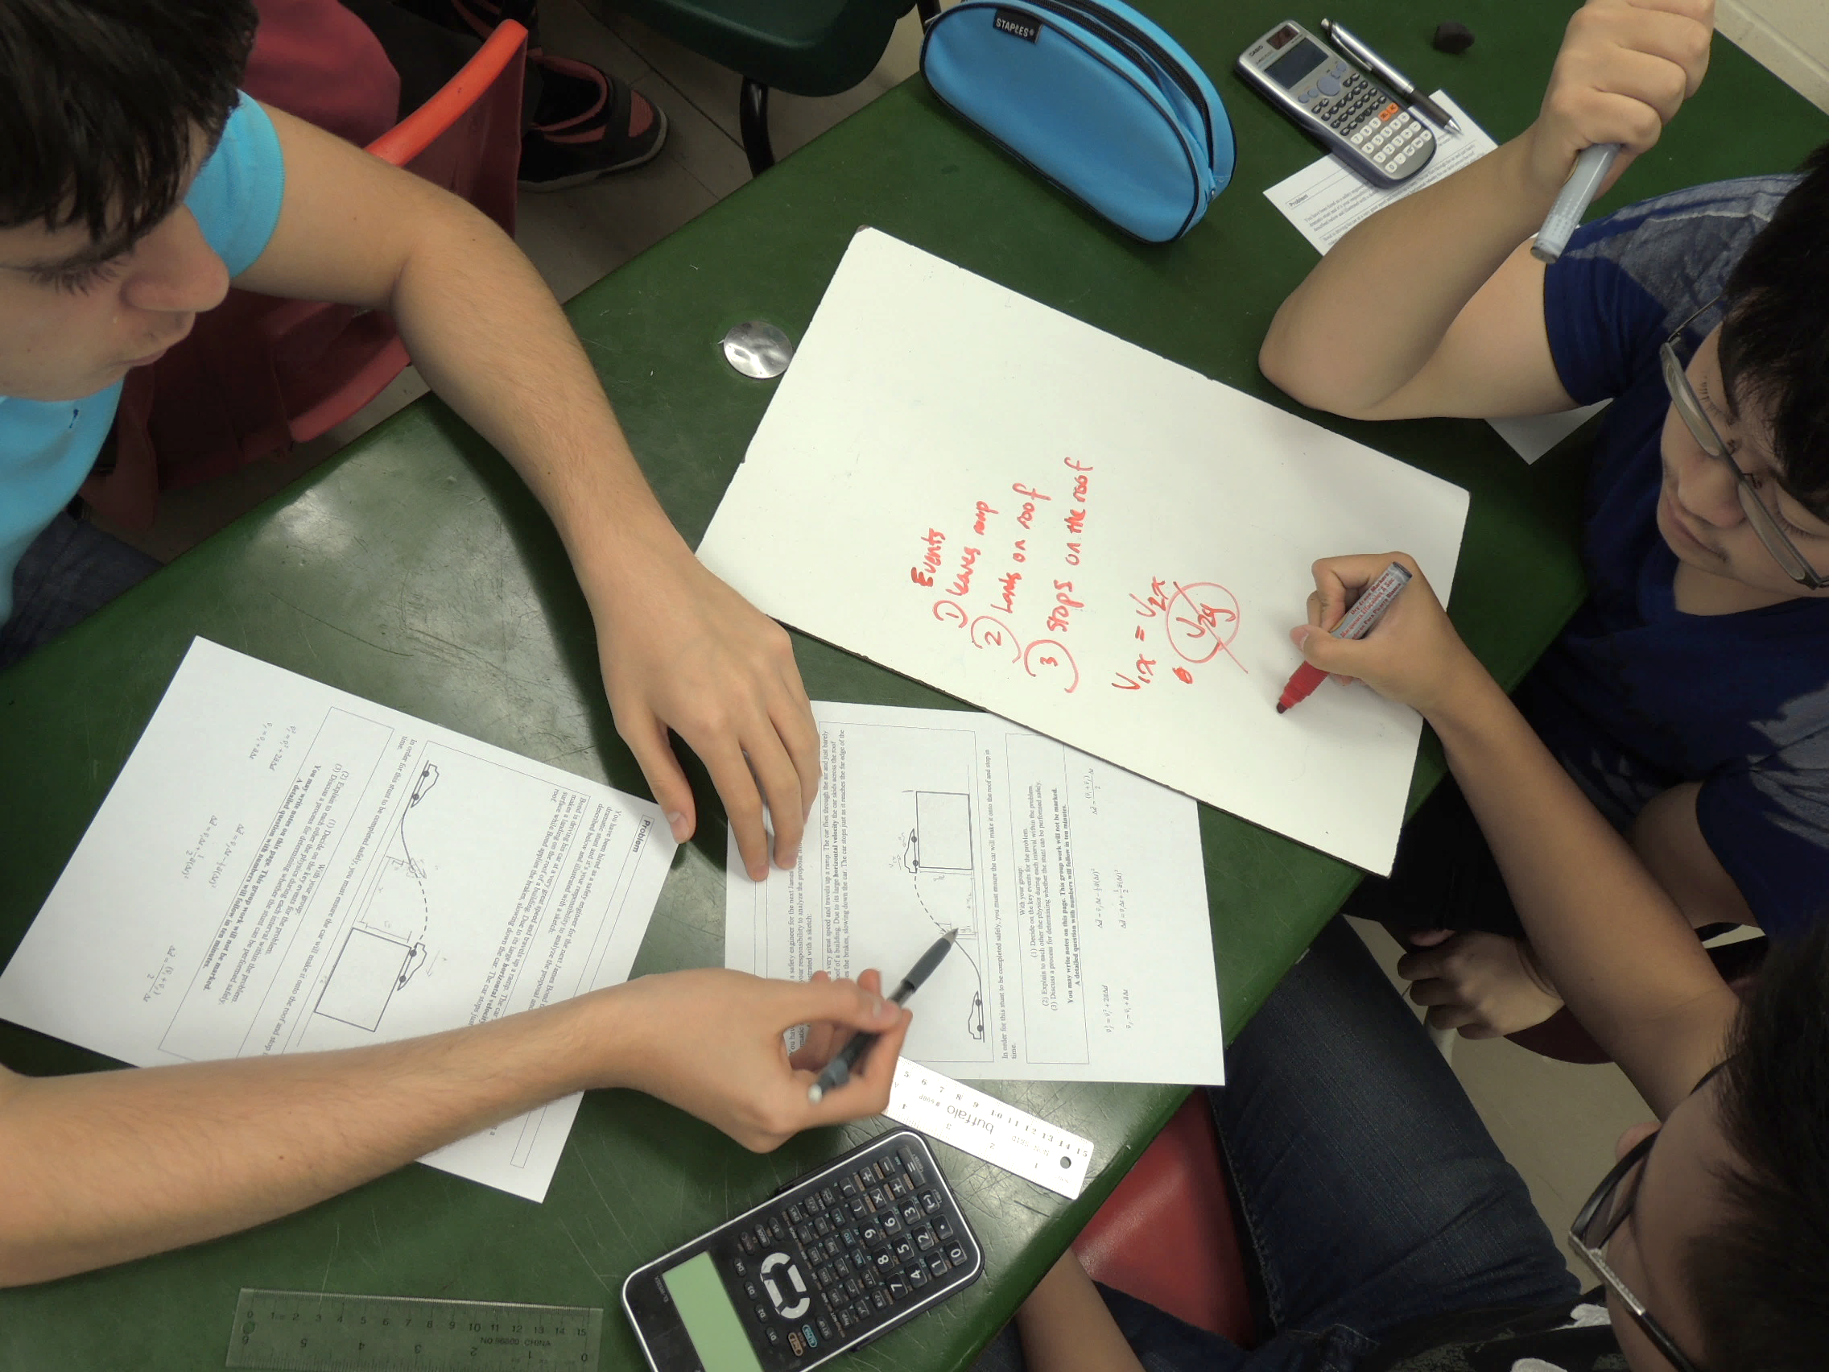
A Scientific Model for Learning
Chris Meyer
York Mills C. I., Toronto
www.meyercreations.com/physics

Slide 2
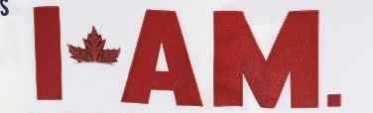
A
PHYSICIST

Slide 3
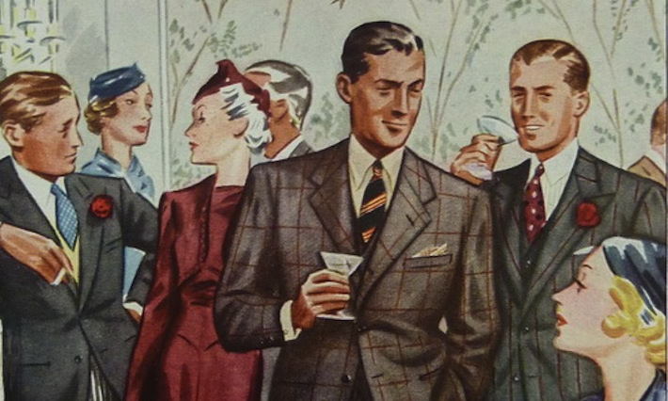
The Cocktail Party
Wow, physics, eh?
Hated it.
My worst subject.
Oh, physics was interesting.
But I did very badly.

Slide 4
The Cocktail Party
Physics is awesome!

Slide 5
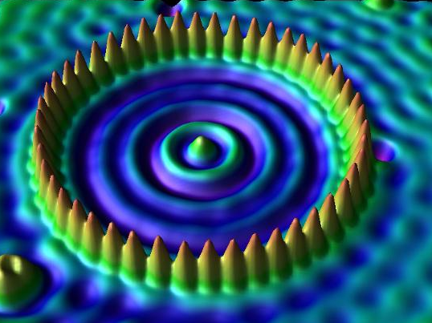
“Quantum Corral”: Iron atoms on copper surface,
1993, Don Eigler, IBM Almaden Research Center

Slide 6
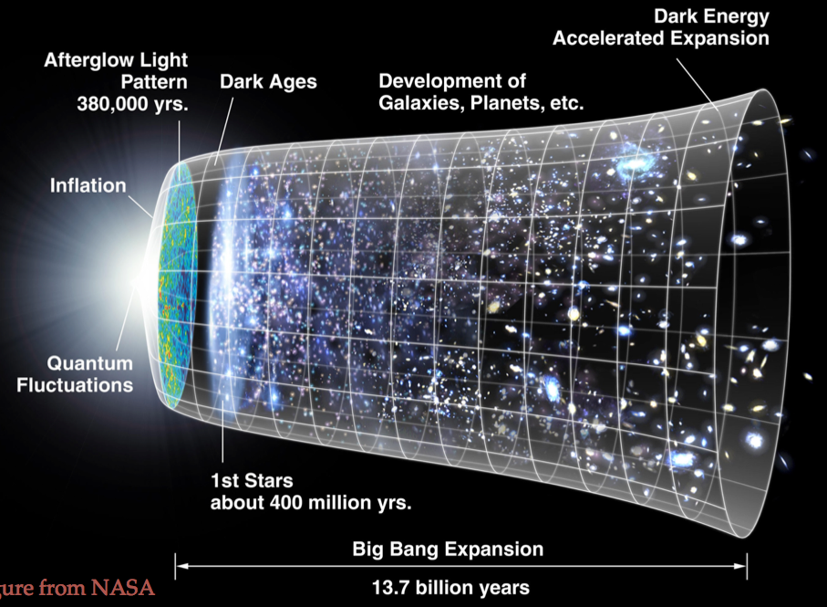
JPL Infographics

Slide 7
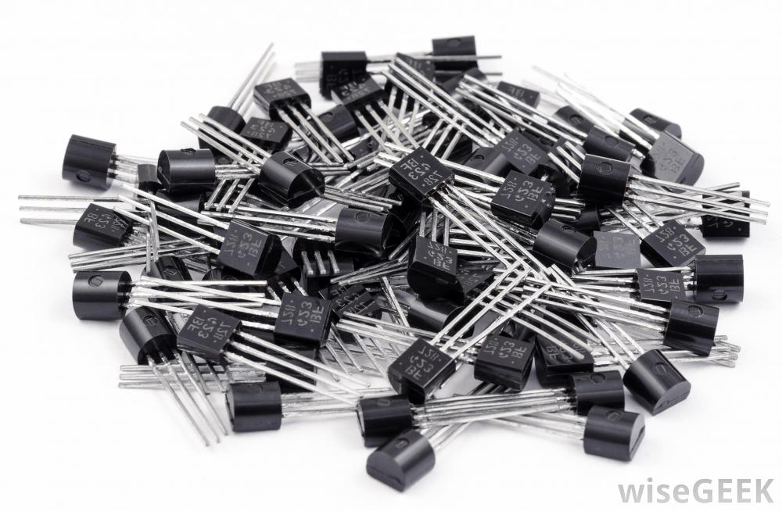
Random transistors

Slide 8
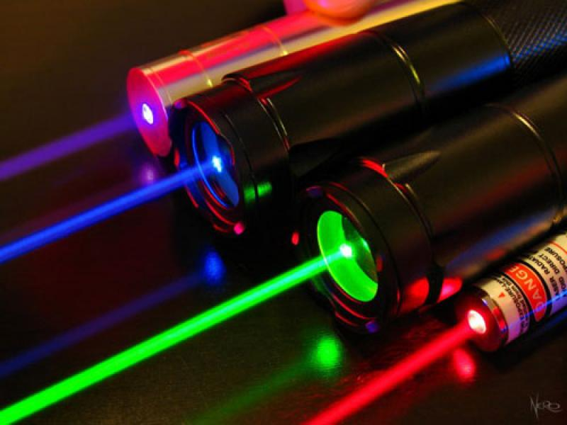
Cooperating light

Slide 9
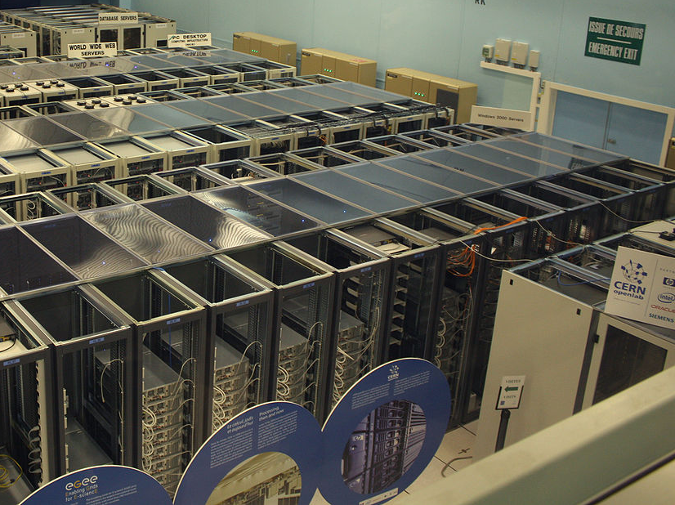
World wide web

Slide 10
What about teaching?

Slide 11
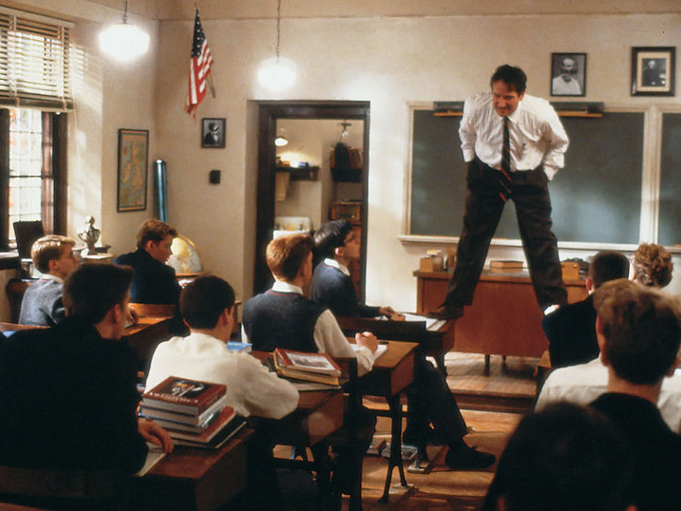
Probably not this
Notes:
stand on tables. You know someone’s really teaching when …
But wherein lies their power? How far does the power of the charismatic teacher extend?

Slide 12
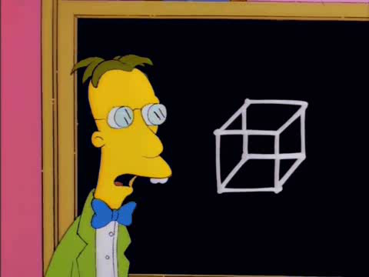
You’re thinking this

Slide 13

We think this!
Notes:
It’s like the cocktail party right?

Slide 14
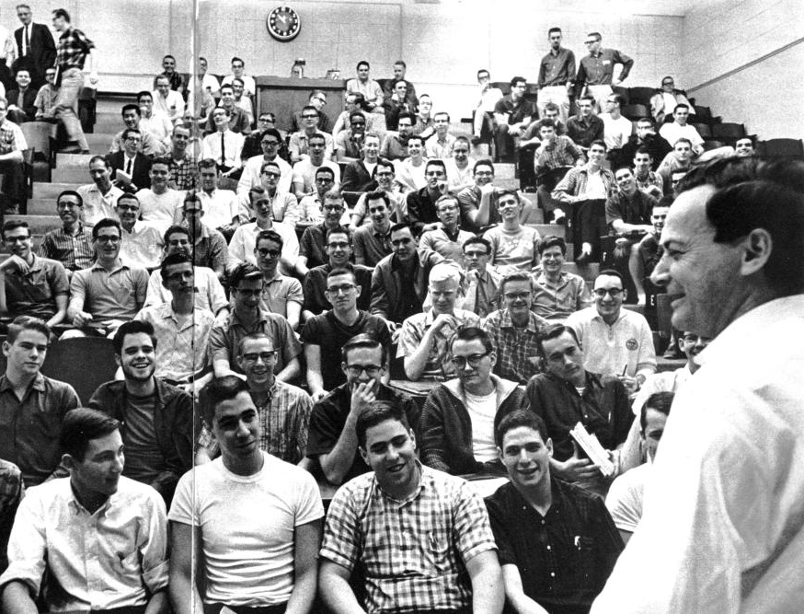
Feynman at Caltech
Notes:
Richard Feynman is widely regarded as having been an extraordinary teacher. His lecture halls at Caltech when he taught introductory physics were packed

Slide 15
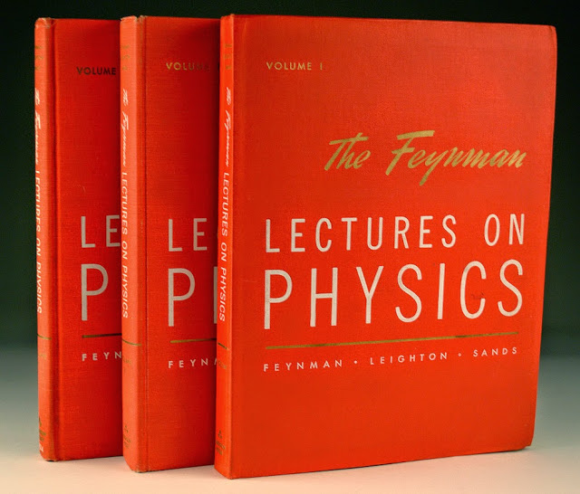
Notes:
and his lectures have become legend. But Feynman was confronted with the limits of his Magical powers. As many of you might well know, reality cuts deepest when reviewing final exam results. He remarked that amongst the many disappointing exam papers:

Slide 16
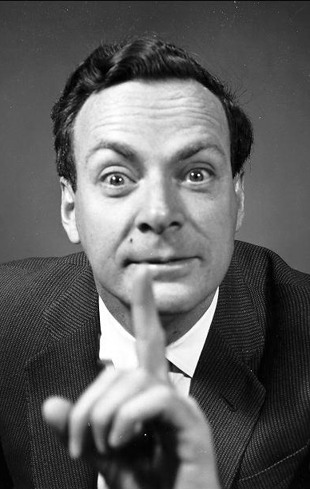
“… When I look at the examinations,
I think that
the system is a failure.”

Slide 17
“… there were
one or two dozen students who—very surprisingly—understood almost everything …
and they are, after all, the ones I was trying to get at.”

Slide 18
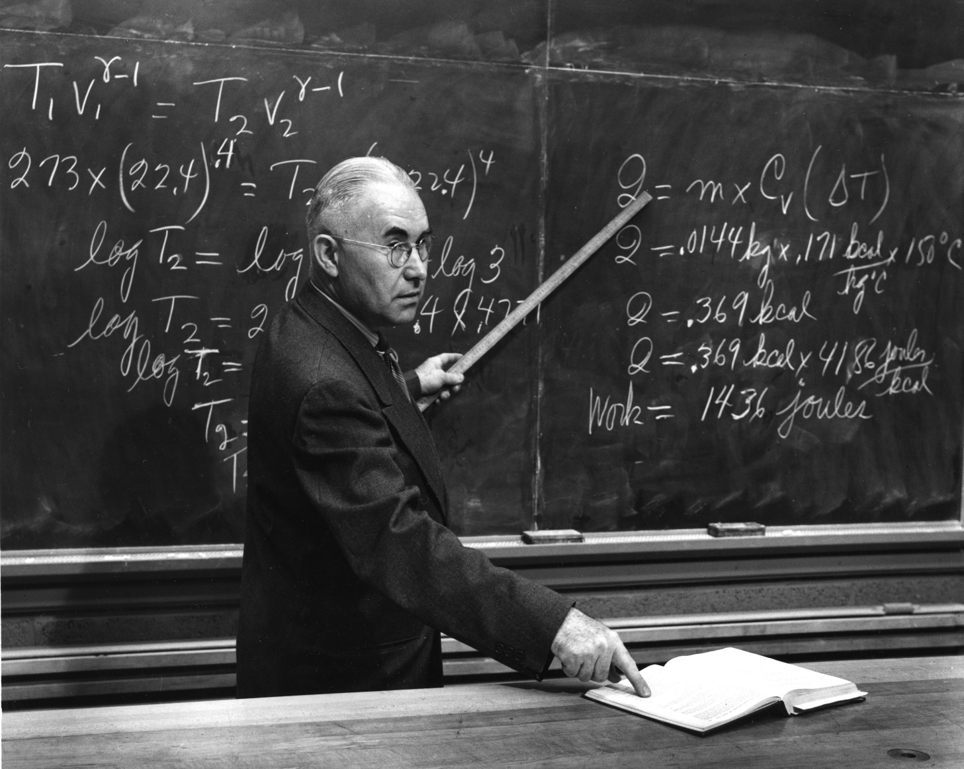
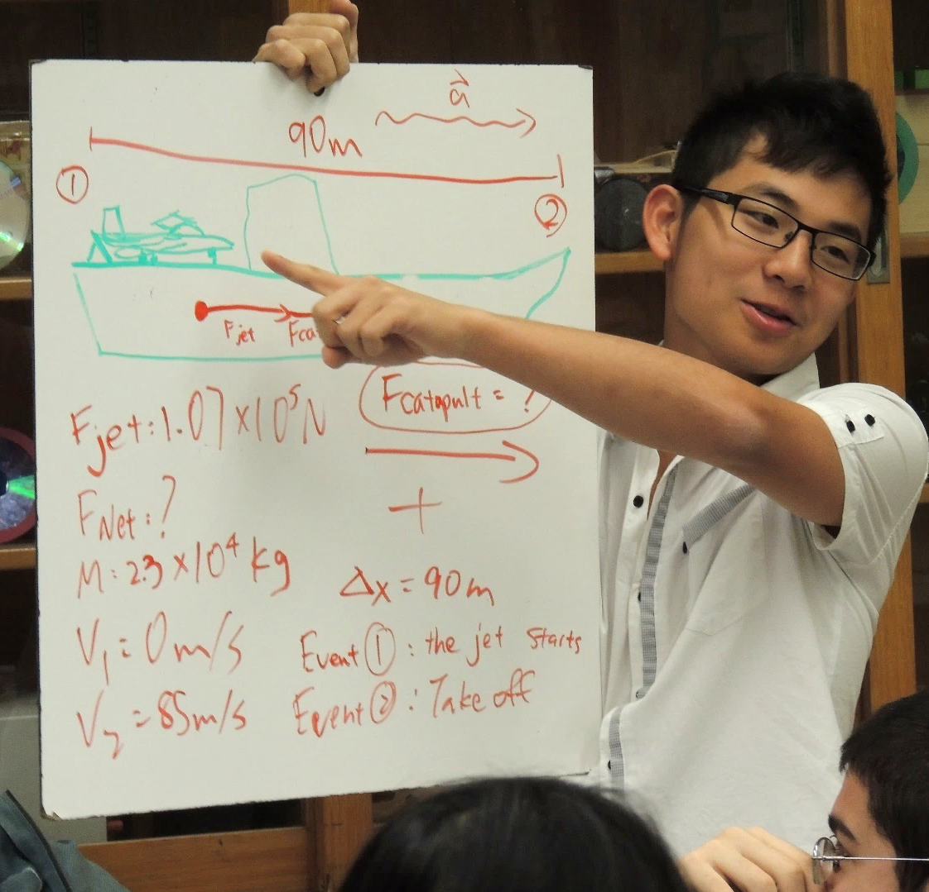
Good Teaching?
How well is the material presented?
How well are students learning?
Internal logic = Aristotelian
Empirical results = Galilean

Slide 19
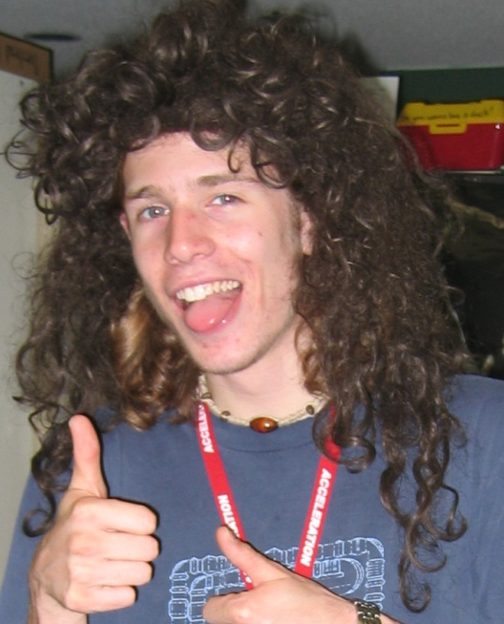
Distilled Physics Wisdom
?
Typical Student

Slide 20
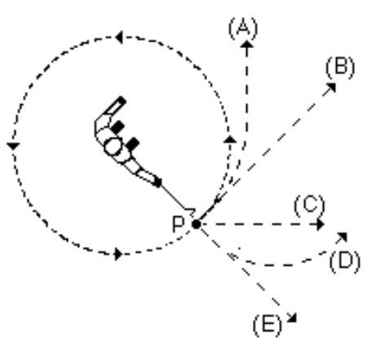
Question Time!
A ball on a string is swung in a horizontal circle.
At point P, the string breaks.
Which path would the ball most closely follow, observed from above?
A
B
C
D
E
Hestenes, D., Wells, M., & Swackhamer, G. (1992). Force concept inventory. The physics teacher, 30(3), 141-158.

Slide 21
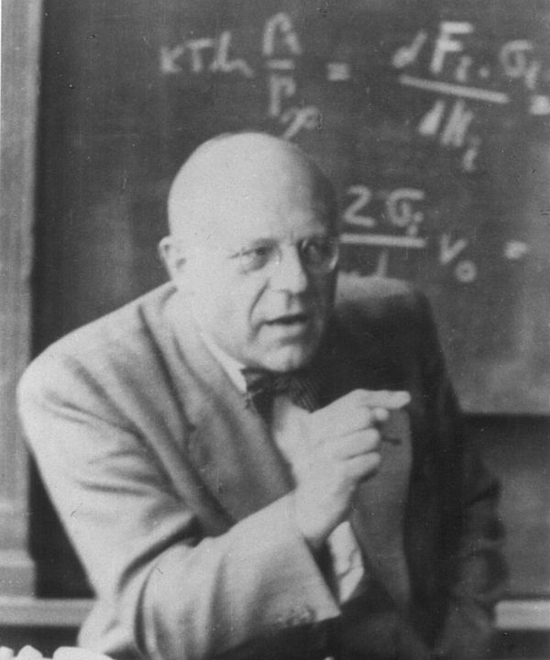
Way too easy!
Harrumph!
Notes:
And if you give them to a cranky expert, they will growl with disdain:
But they provide a revolutionary window into our students understanding and the effectiveness of our instruction.

Slide 22
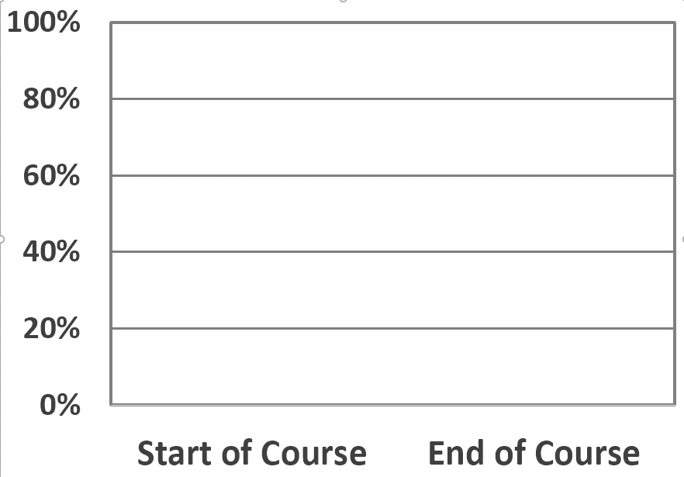
Force Concept Inventory Scores
Normalized Gain:
16.2% _{= 25%}
64.6%
Room for improvement:
64.6%
Actual Improvement: 16.2%
Test Score 51.6%
Test Score 35.4%
Milner-Bolotin, Marina, et al. "Attitudes about science and conceptual physics learning in university introductory physics courses." Physical Review Special Topics-Physics Education Research 7.2 (2011): 020107.

Slide 23
Distilled Physics Wisdom
25%
75% Scattered
Hake, Richard R. "Interactive-engagement versus traditional methods: A six-thousand-student survey of mechanics test data for introductory physics courses." American journal of Physics 66.1 (1998): 64-74.
Typical Student
Notes:
So now we have an answer: how much do students improve under the benefit of out wisdom?
And what happens to the rest? Why didn’t our carefully crafted wisdom stick?

Slide 24
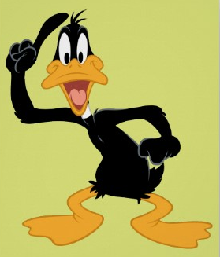

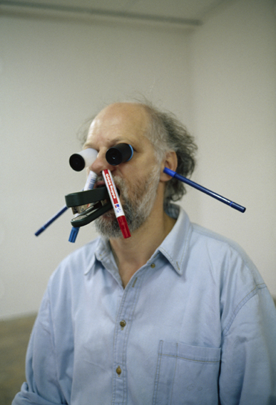
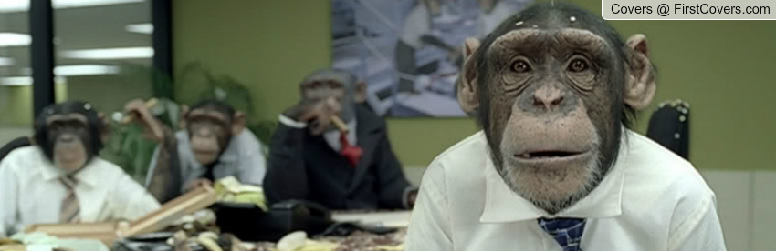
Best Lesson Ever
Notes:
All of us teachers have long sensed that this was the case. We have all had the experience …

Slide 25

25%

Slide 26
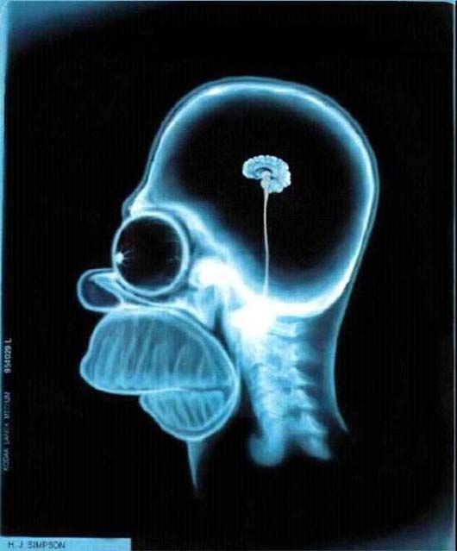
What’s Going on Upstairs?
Notes:
While we are left wondering:
… how did I get stuck teaching this course and when can I get back to my research.

Slide 27
I am doing my job: teaching
Anecdotes
Hunches
Why aren’t my students doing their job: learning?
Pedagogical Fads
Change the test

Slide 28
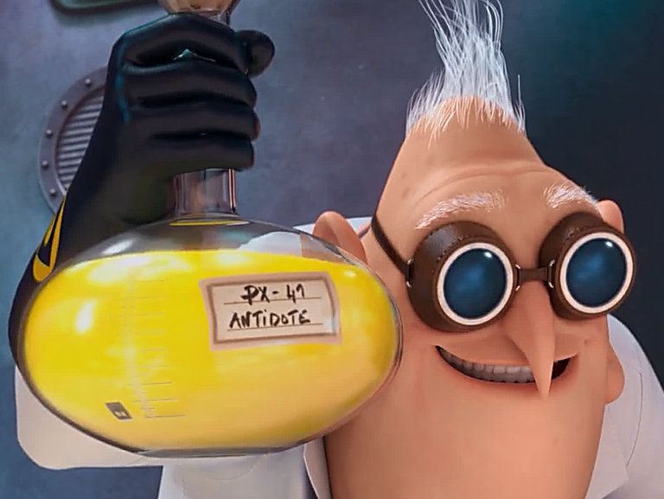
Science!

Slide 29
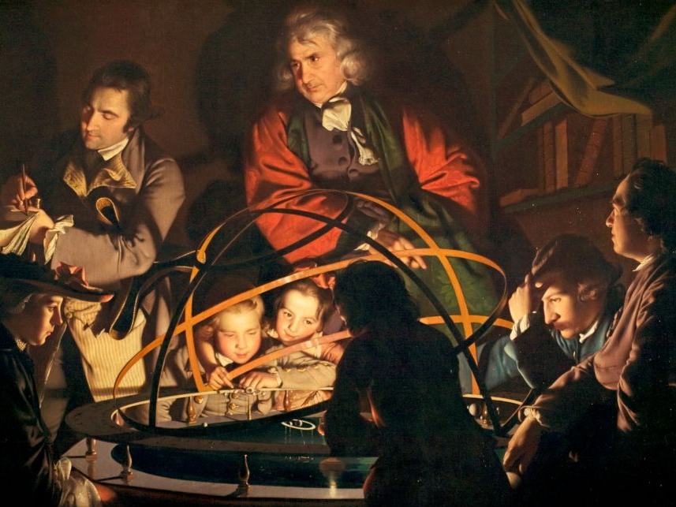
A Scientific Revolution for Learning
A Philosopher giving a Lecture on the Orrery in which a lamp is put in place of the Sun,
Joseph Wright of Derby, 1766
Notes:
The FCI was part of the early wave of research that began to transform teaching into an empirical science. Almost thirty years later, we are in the midst of a full scientific revolution for teaching. The excitement and great potential of this is what brings me here today. When we harness the powers of science, we can replace our instinctual reactions to our students’ learning difficulties:

Slide 30
What happens in students’ brains when they learn?

Slide 31
Neuroscience
+
Cognitive Psychology
+
Physics Education Research
+
Experience

Slide 32
Physical
Workings
Scientific
Model of Learning

Slide 33
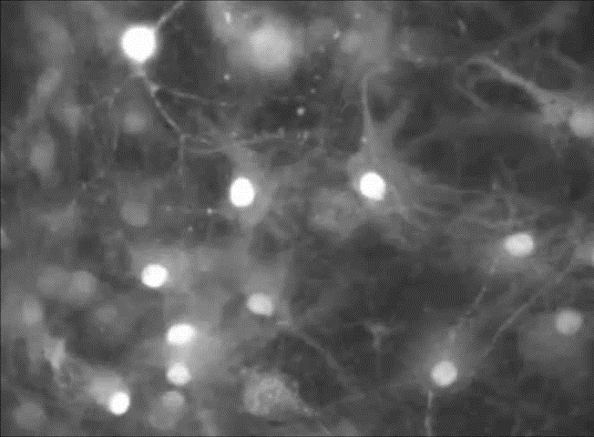
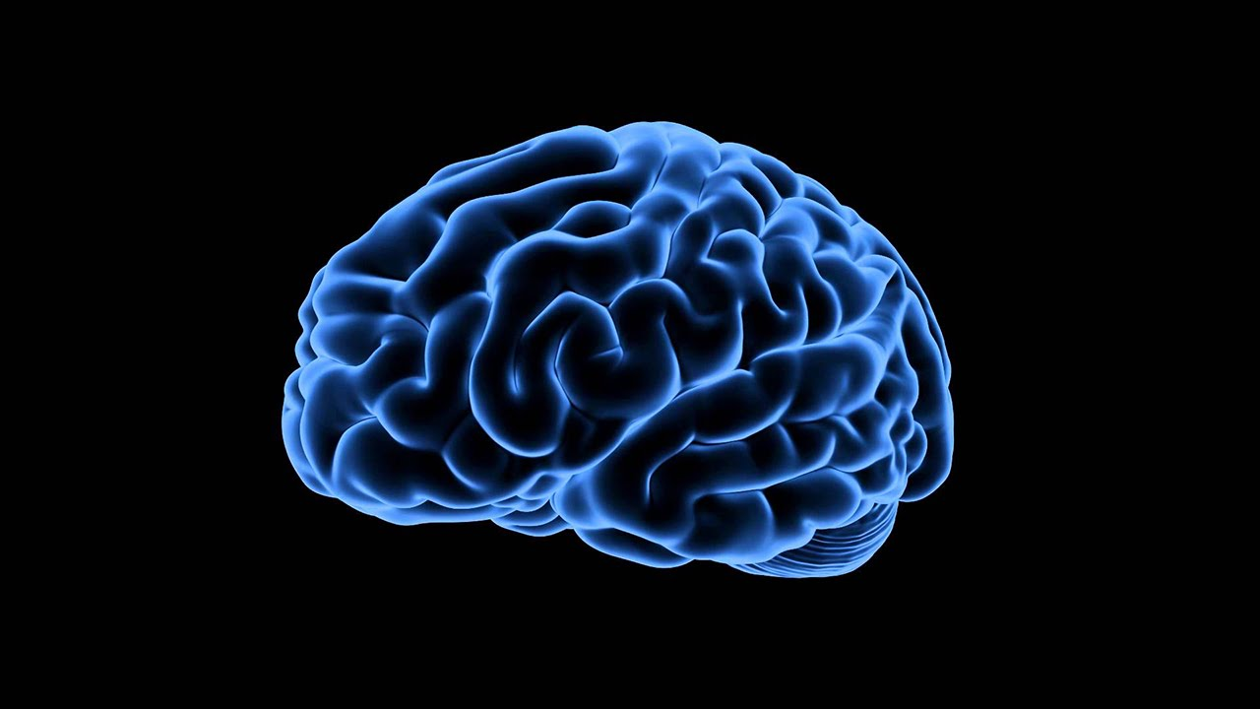
Notes:
Billions of neurons
10 000 connections per neuron
Learning takes place when neurons repeatedly fire together
Connections strengthen

Slide 34
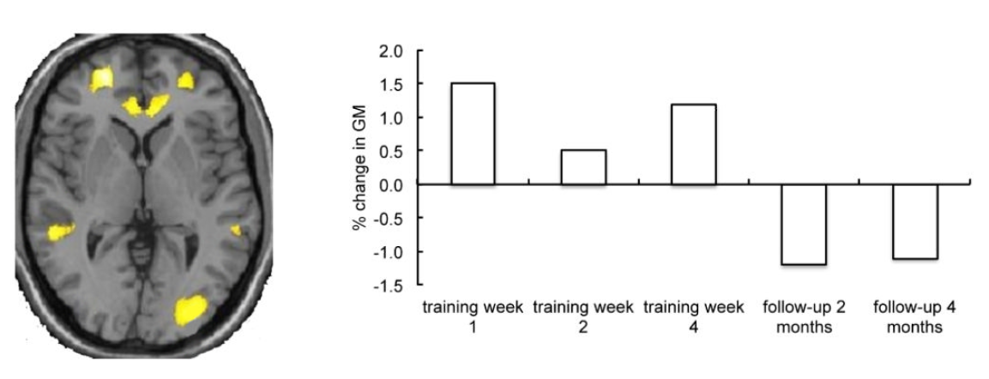
Grey Matter Grows with Learning
Zatorre, R. J., Fields, R. D., & Johansen-Berg, H. (2012). Plasticity in gray and white: neuroimaging changes in brain structure during learning. Nature neuroscience, 15(4), 528-536.

Slide 35
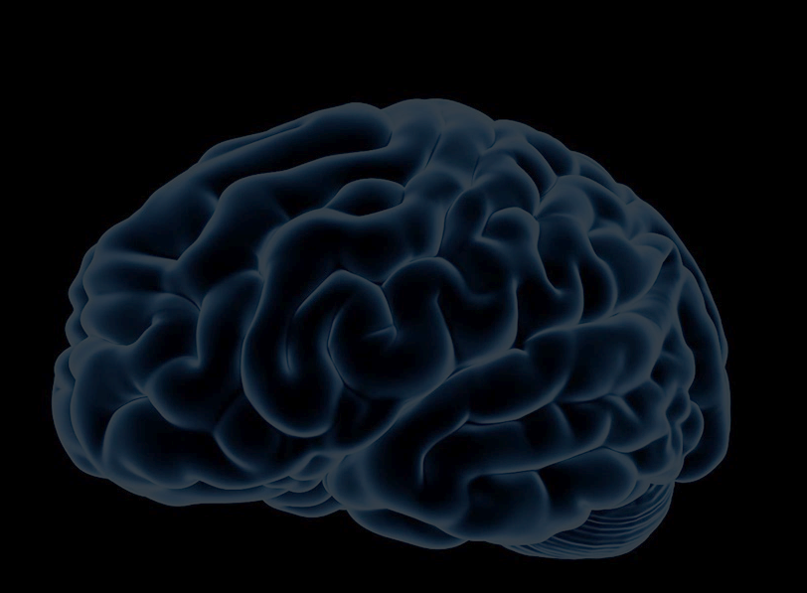
Learning =
Physical Process
Learning = Physics!

Slide 36
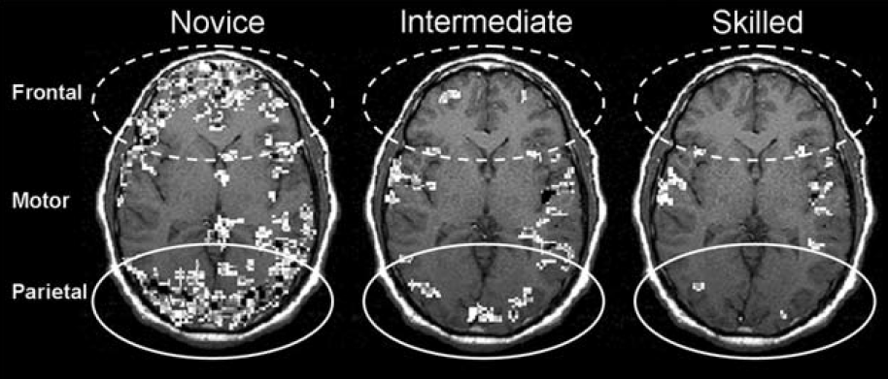
Brain Workload
What is happening in the brain?
How does this feel?
Hill, N. M., & Schneider, W. (2006). Brain changes in the development of expertise: Neurological evidence on skill-based adaptations. From: The Cambridge handbook of expertise and expert performance (pp. 653-683).

Slide 37
Brain Workload
60 minutes
later!
Learning something new is
energy intensive = tiring
Hill, N. M., & Schneider, W. (2006). Brain changes in the development of expertise: Neurological evidence on skill-based adaptations. In Cambridge handbook of expertise and expert performance (pp. 653-683).

Slide 38
Physical Workings
Emotion
Scientific
Model of Learning

Slide 39
Emotions and the Brain
Sensory and
Post-sensory
Executive Functions,
Focus
Amygdala

Slide 40
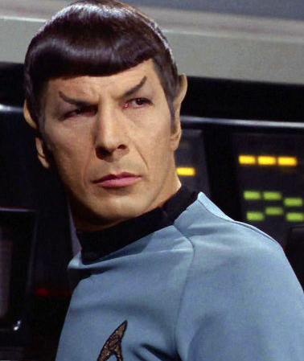
Emotion Can’t Be Separated from Cognition

Slide 41
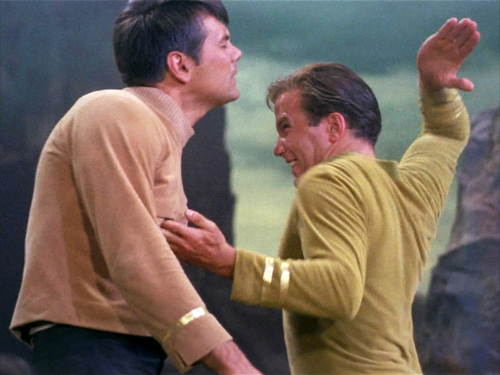
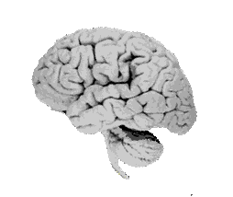
We get the humans

Slide 42
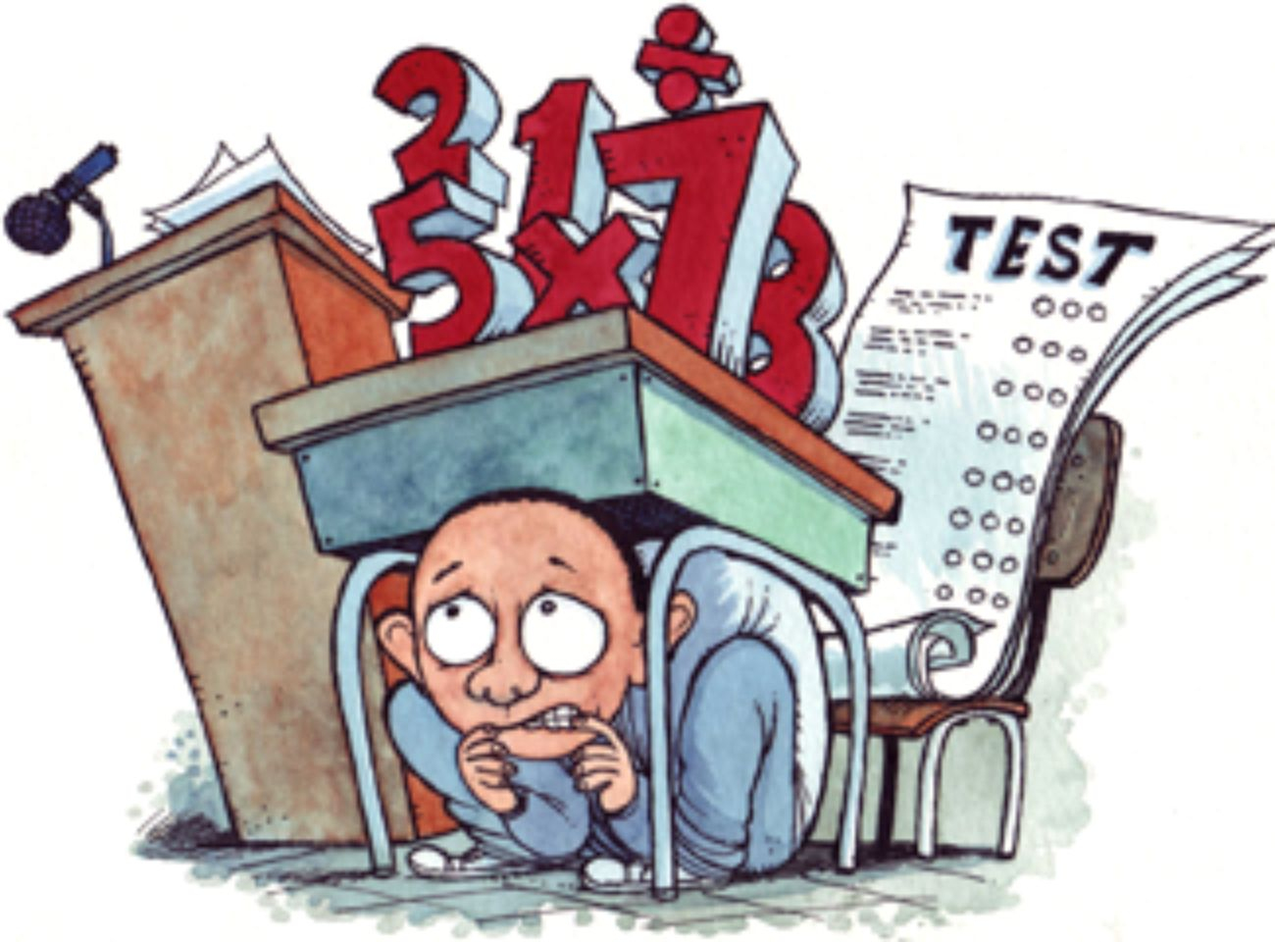
Anxiety!
Amygdala

Slide 43
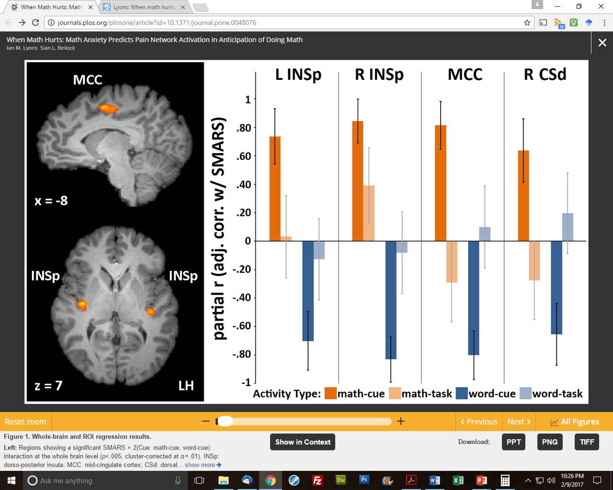
Anxiety!
Activation of brain regions associated with physical pain perception is strongest when anticipating a math task.
Lyons, I. M., & Beilock, S. L. (2012). When math hurts: math anxiety predicts pain network activation in anticipation of doing math. PloS one, 7(10), e48076

Slide 44

Anxiety!

Slide 45
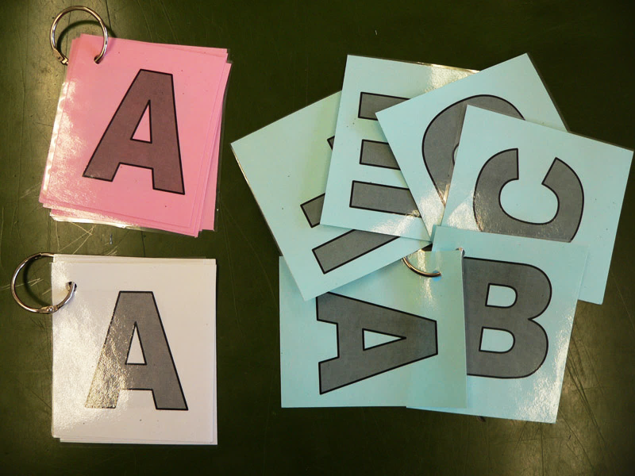

Slide 46
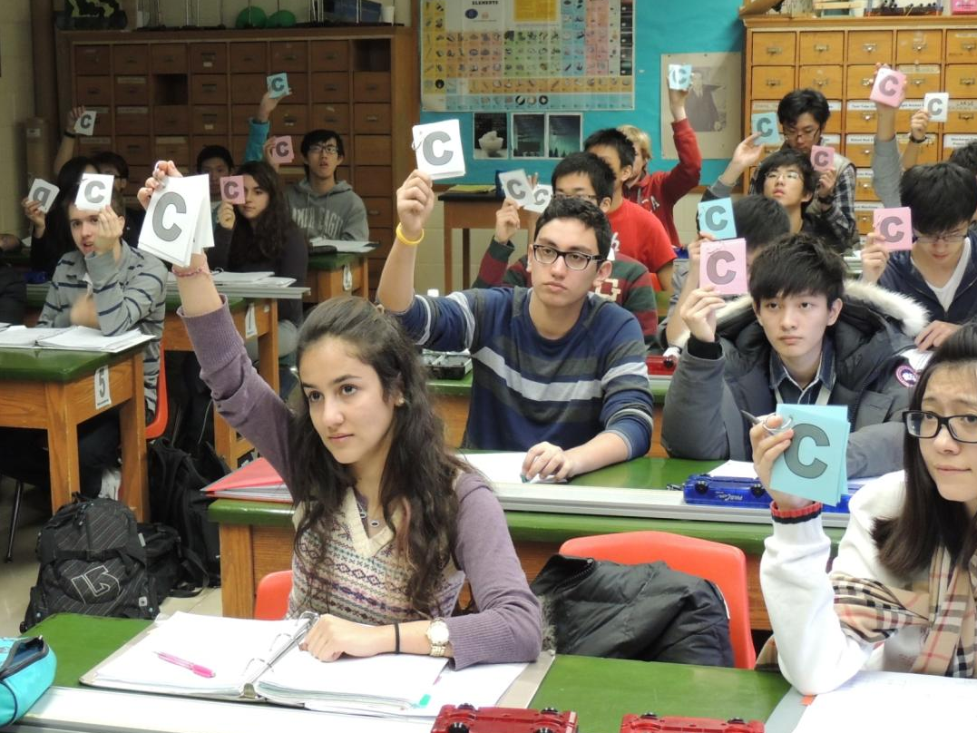

Slide 47
Learning Check-Up
How was your learning today?
A: I’m confident about what I learned. I can explain it well to my neighbours.
B: I’m pretty good with what I learned. I’m OK at explaining it.
C: I’m not too sure about what I learned. It would be tough to explain it!
D: I think I had difficulties with some of what I learned. I am not yet able to explain it.

Slide 48
How to Measure Learning?
Find the current
through the 2 ohm resistor and the potential difference between point a and b.
75%
Average =
Notes:
A few examples to help us compare the explanatory power of these two models.

Slide 49
How to Measure Learning?
When the switch is closed,
what happens to:
(a) the current through the battery
(b) the brightness of the bulbs
40%
Average =
Notes:
We cover this material …. Why does this happen.

Slide 50
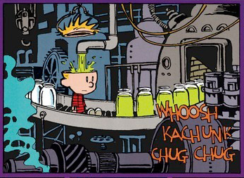
Traditional Learning Model
WholesomeKnowledge
Tight Seal

Slide 51
Cognitive Resource Model
DiSessa, A. A. (1993). Toward an epistemology of physics. Cognition and instruction, 10(2-3), 105-225.

Slide 52
Knowledge is built from primitive pieces
Increased resistance = less result
Force moves objects
Stronger influence wins
DiSessa, A. A. (1993). Toward an epistemology of physics. Cognition and instruction, 10(2-3), 105-225.

Slide 53
As we learn, connections grow
Increased resistance = less result
Force moves objects
Stronger influence wins

Slide 54
Networks of knowledge resources form
Force spins
Force deflects
Heavy things resist
R ↑, motion ↓
Motion dies away
Opposites cancel
F ∴ motion
Change takes time
Stronger wins
Objects squish with force
More effort = more resistance

Slide 55
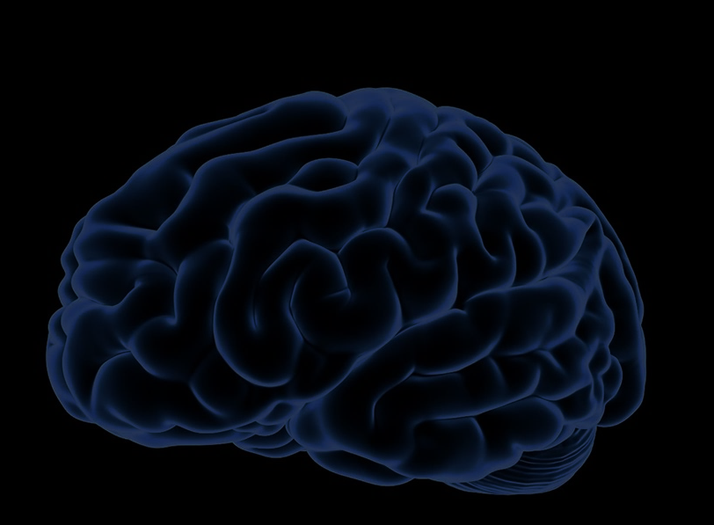
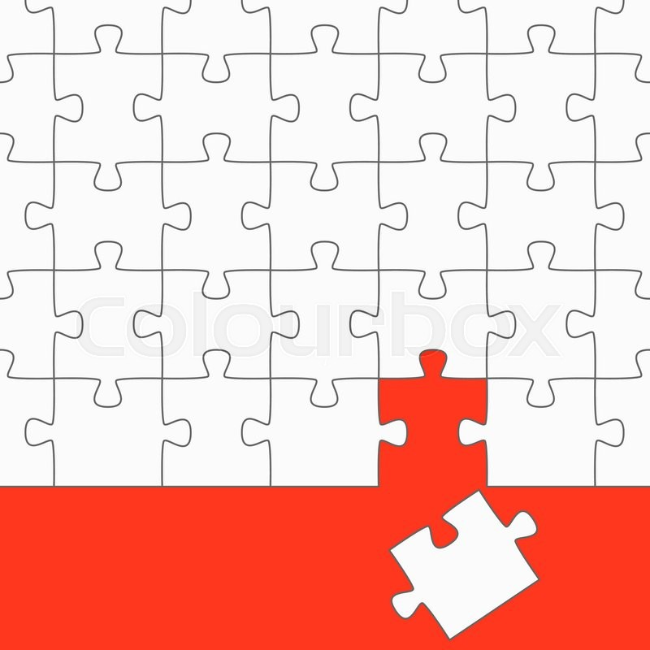
Prior Knowledge
We make sense of new ideas by making connections to our
prior knowledge
If prior knowledge
is not ready, students
cannot make use
of expert knowledge.

Slide 56
Brain Workings
Emotion
Scientific
Model of Learning
Prior Knowledge

Slide 57
How to make connections?
Force spins
Force deflects
Resistance
Current
Motion dies away
Opposites cancel
Voltage
Change takes time
Stronger wins
Objects squish with force
More effort = more resistance

Slide 58
Cognitive Learning Cycle
Premotor and Motor
Do,
Test
Sensory and Postsensory
Input
Frontal Integrative Cortex
Plan
Temporal Integrative Cortex
Assign Meaning
Zull, J. The Art of Changing the Brain. 2002
Notes:
Based on perception-cycle that brainy organisms use to interact with their environment.
When this cycle operates well, the brain makes rich sets of connections.

Slide 59
Brain Workings
Emotion
Scientific
Model of Learning
Prior Knowledge
Cognitive Learning Cycle

Slide 60
Use this model to evaluate:
Notes:
We can be pretty sure what doesn’t promote learning.

Slide 61
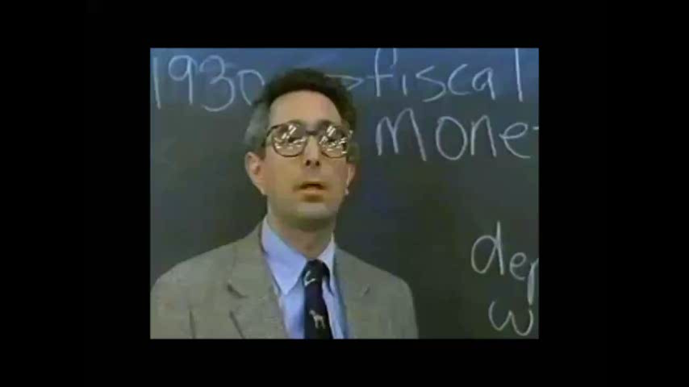
Notes:
In teaching, for hundreds of years …

Slide 62
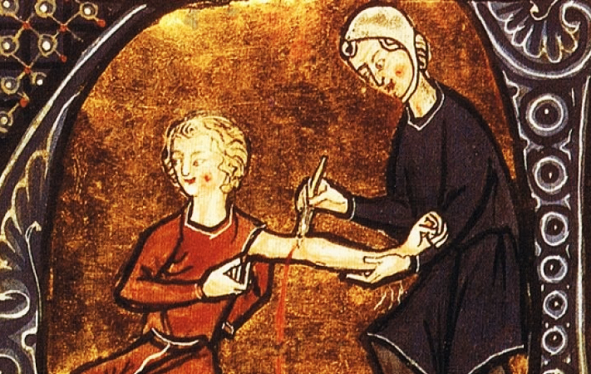
Why do old practices endure?
Notes:
In medicine for 100s of years, blood letting was common practice …

Slide 63
Which parts of the cycle does traditional instruction focus on?
Sample Circuits
Electric Concepts
Do,
Test
Input
Plan
Strategies/Tips
Assign Meaning
Zull, J. The Art of Changing the Brain. 2002

Slide 64
Which parts of the cycle does traditional instruction focus on?
Do,
Test
Little Active Testing
Input
Lots of Input!
Plan
Move info around,
math
Little Reflection to Assign Meaning
Assign Meaning
Zull, J. The Art of Changing the Brain. 2002
Notes:
Really messing with our students brains! Hitting the gas and putting on the brake at the same time! Their brains want to do the cycle!
Can I do anything useful with this information (other than pass a test)?

Slide 65
All steps need expert guidance
Do,
Test
Teacher
Student
Student
Input
Plan
Student
Student
Assign Meaning
Zull, J. The Art of Changing the Brain. 2002

Slide 66
All steps need expert guidance
Good teaching
↓
Creating a learning environment that leads students through
all four steps of the cognitive learning cycle
How?
Notes:
Now we can ask the question: “What should our instruction accomplish?” What type of experiences promote the re-wiring our students’ need?

Slide 67
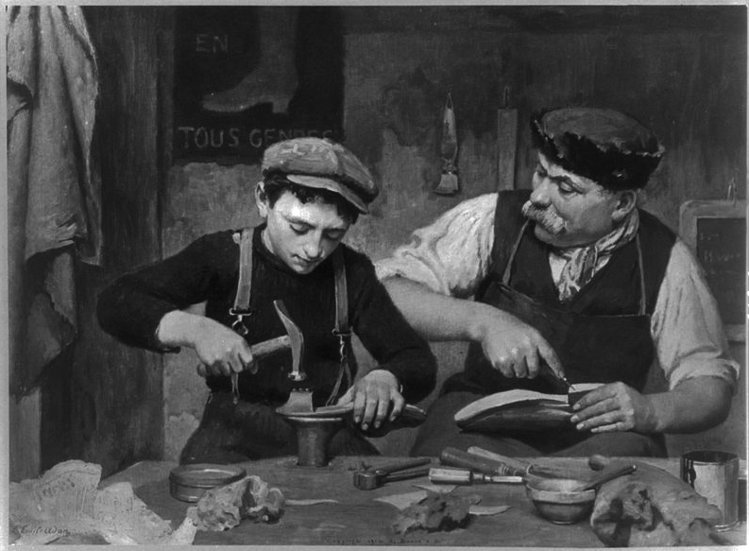
Apprenticeship
The Apprentice. By Louis-Emil Adan.

Slide 68
You are a master cobbler
What might be the first few tasks you assign an apprentice?
How might the apprentice know if they are on the right track?

Slide 69
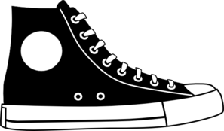
You are a shoe-ologist (Ph.D.)
What might your first few shoe construction classes be about?

Slide 70
Apprenticeship
Learning cobbling is learning a process for making a shoe, a combination of knowledge and skills
Complex tasks broken down into sub-tasks
Relevance of sub-tasks is clear
Immediate feedback from master and peers

Slide 71
Cognitive Apprenticeship
Learning [science] is learning a process for creating and testing knowledge about [nature], a combination of knowledge and skills.
Need to simulate the “workshop” of the [scientist] for our students.
Collins, Allan, John Seely Brown, and Susan E. Newman. "Cognitive apprenticeship: Teaching the craft of reading, writing and mathematics."
Thinking: The Journal of Philosophy for Children 8.1 (1988): 2-10.

Slide 72
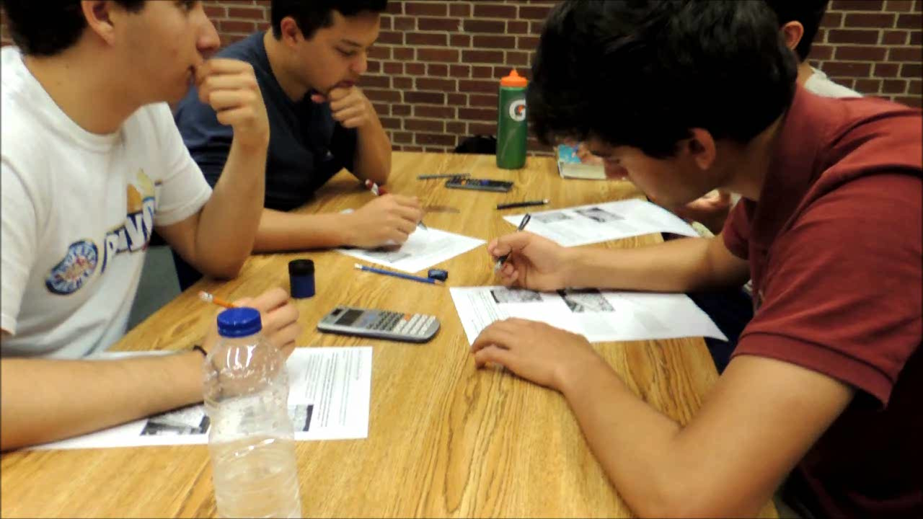
York Mills Students

Slide 73
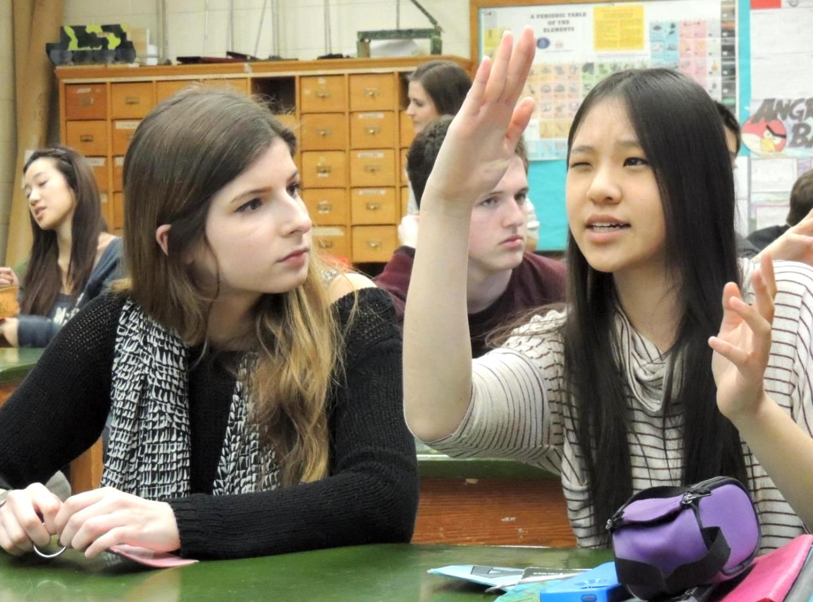
Secret Ingredient = Active Learning!
York Mills Students
Notes:
This is the game changer!

Slide 74
Active Learning
Emphasizes
discussion
higher-order thinking
and often involves
group work.
Freeman, Scott, et al. "Active learning increases student performance in science, engineering, and mathematics." Proceedings of the National Academy of Sciences (2014): 201319030.
Notes:
This is the game changer!

Slide 75
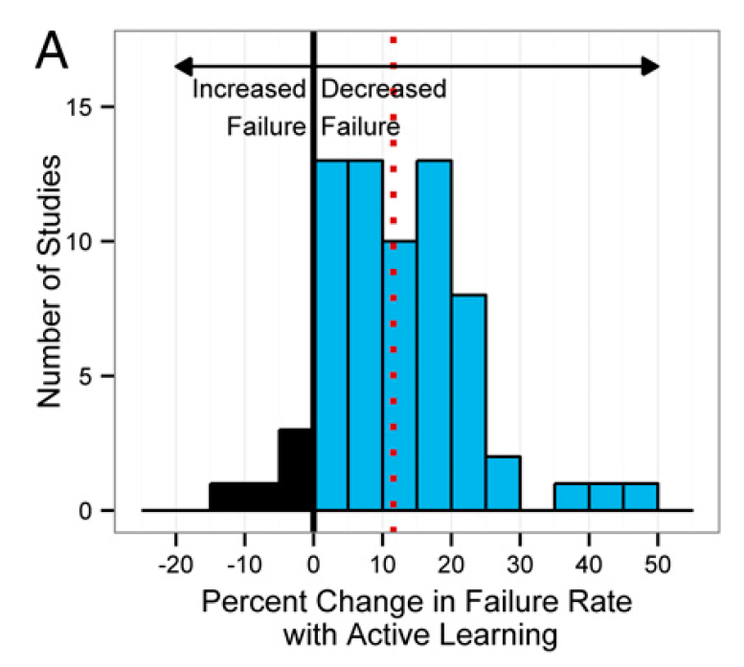
Active Learning Reduces Failures
Freeman, Scott, et al. "Active learning increases student performance in science, engineering, and mathematics." Proceedings of the National Academy of Sciences (2014): 201319030.

Slide 76
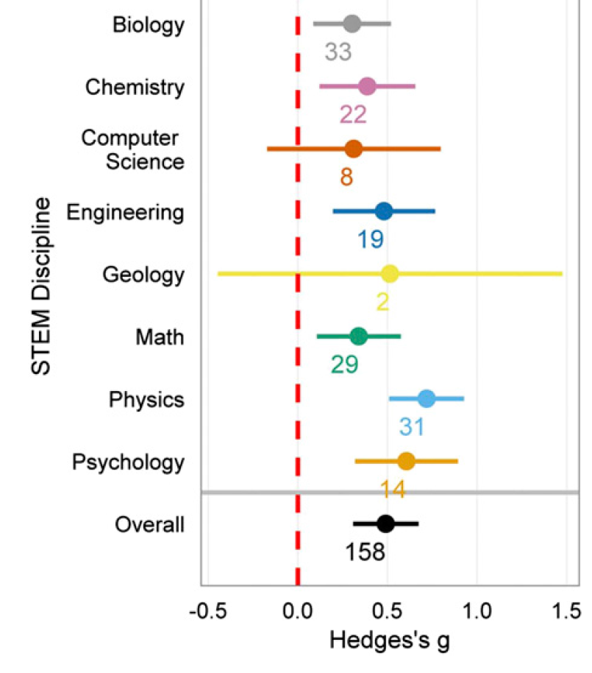
Improves Course Performance

Slide 77
Force Concept Inventory Scores
Normalized Gain:
16.2% _{= 25%}
64.6%
York Mills
Normalized Gain = 58%
Room for improvement:
64.6%
Actual Improvement: 16.2%
Test Score 51.6%
Test Score 35.4%
Milner-Bolotin, Marina, et al. "Attitudes about science and conceptual physics learning in university introductory physics courses." Physical Review Special Topics-Physics Education Research 7.2 (2011): 020107.

Slide 78
Change is Necessary
Traditional Instruction
Active Learning
Passive, low-engagement
Active, high-engagement

Slide 79
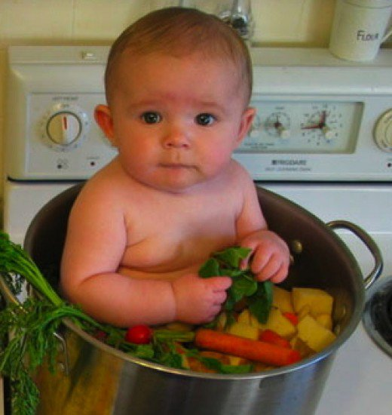
A Modest Proposal
Promote education as a research topic for upper-year and grad students

Slide 80
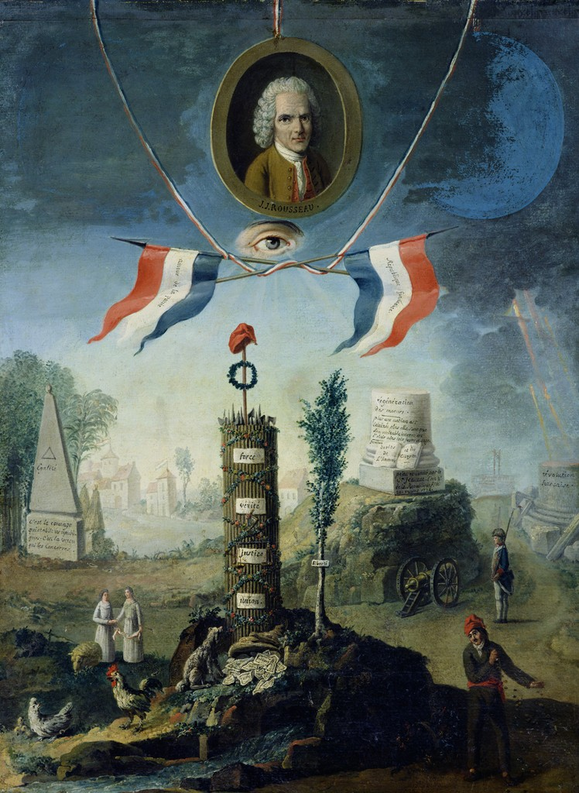

The Social Contract of Teaching
Teach Our Kids Well ...
An Allegory of the Revolution (1794),
Nicolas Henri Jeaurat de Bertry
Notes:
You might not recall signing this contract, but it exists and the legalese goes something like this:

Slide 81

… Do Your Crazy Academic Stuff
Notes:
The public asks that we:

Slide 82

The Enlightenment Can Be Reversed
Notes:
We just need another government unfavourable to academic research …

Slide 83
A New Paradigm
What matters most in education
is what goes on in
each student’s head.
Notes:
Now we can ask the question: “What should our instruction accomplish?” What type of experiences promote the re-wiring our students’ need?

Slide 84



Embrace the Scientific Revolution for Learning!
Notes:
I encourage you to join the …
with the hope that this will help start a new chapter in your teaching careers and also provide well-deserved bragging rights, so that you might tell your great-grandchildren, who will take this way of learning for granted, that you were part of the great teaching revolution of the first half of the 21st century.

Slide 85


Learn More!
Free pdf book from the National Research Council
Google:
“How People Learn”
Thanks!
www.meyercreations.com/physics

