Slide 1
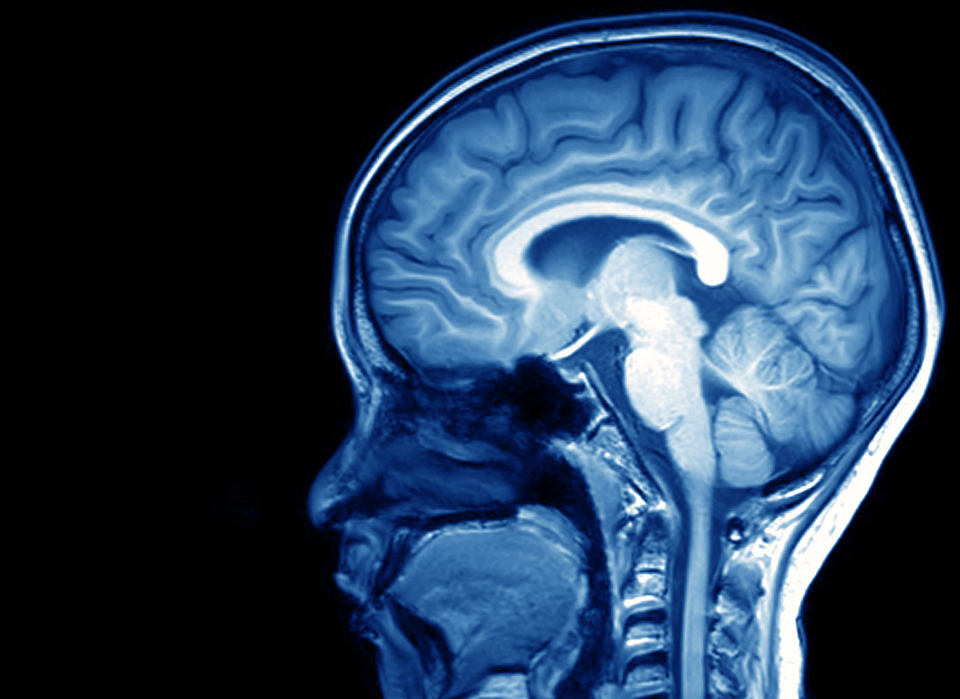
Your Brain: A User’s Guide

Slide 2
Brain Lessons
Diversity in Thinking | Learning from Evaluations
Neurons and Muscles | Give me lots of practice!
Habits | Changing Habits
How Learning Feels
Finding the Growth Zone | Fast vs. Slow Thinking
Sense-Making | Executive Function
Attention / Focus | Intelligence
Why Sleep? | Grit
Good Sleep Habits | Anxiety
Taking Tests | Cognition Hierarchy – from effortful to automatic

Slide 3
Neurons and Muscles

Slide 4
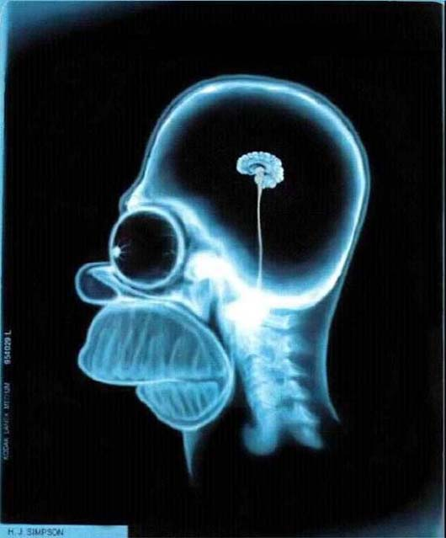
Look Inside!

Slide 5
Notes:
Billions of neurons
10 000 connections per neuron
Learning takes place when neurons repeatedly fire together
Connections strengthen

Slide 6
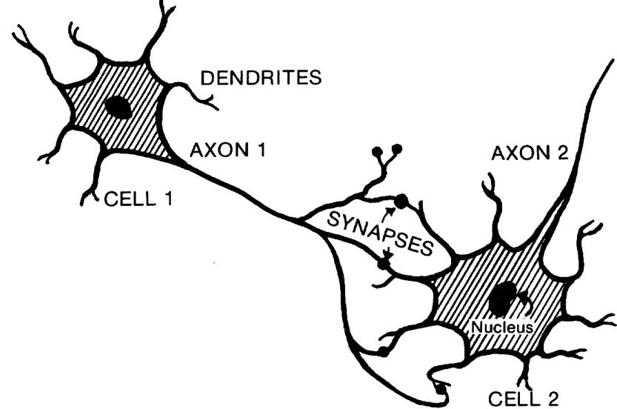
Brain Wiring
Notes:
Here is a picture of a couple nerve cells. You already have billions of these and you may have heard that you cannot grow new nerve cells, which is correct. That is why it is so important to protect your head! But take a look at the parts of the cells. There are these things called dendrites and axons.
When you give yourself a mental workout, two things happen. The number of connections between neurons increases and each connection becomes stronger. Scientists have measured the resulting increased thickness of brain tissue after learning.
The dendrite of one nerve cell is connected to the axon of the next.

Slide 7
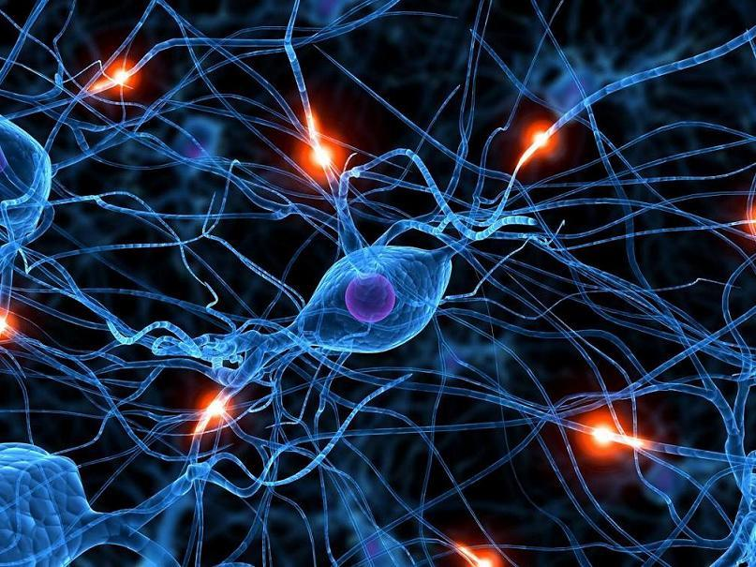
Brain Wiring
Fundamental Rule of Brains:
Neurons that fire together, wire together

Slide 8
You are your brain’s wiring
All your memories, skills, habits, and thoughts are a result of the connections in your brain.

Slide 9
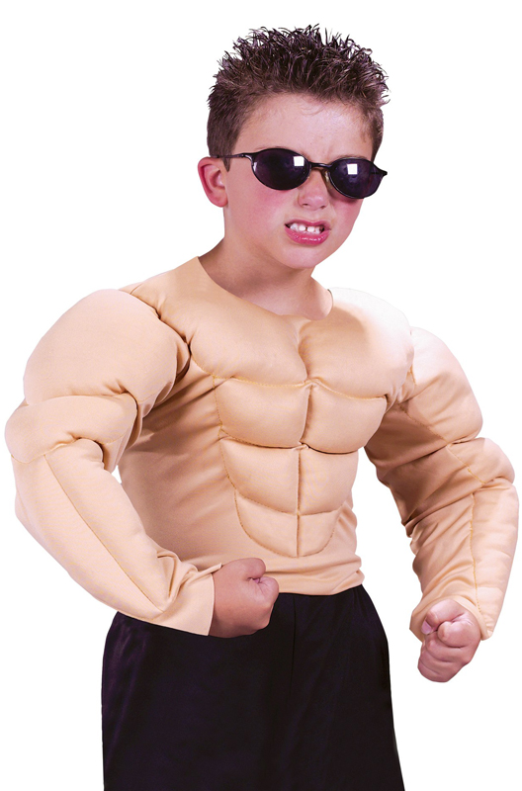
Muscles!
When you work vigorously, what happens to your muscles?
Discuss with your group. Be prepared to share.

Slide 10
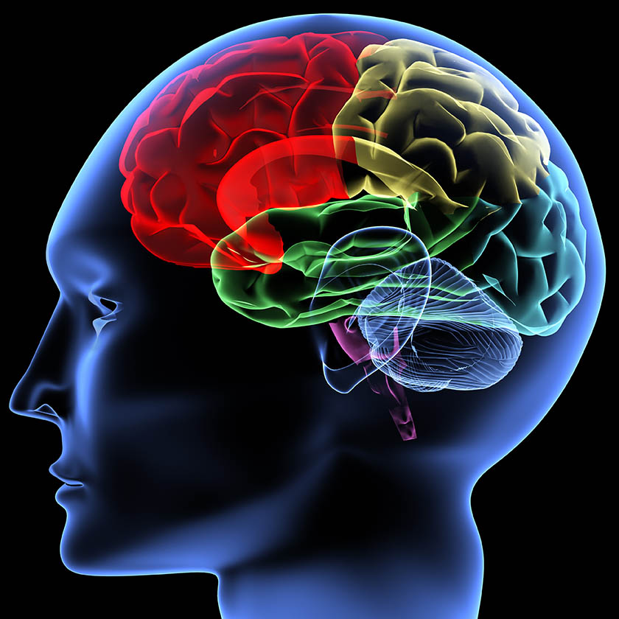
Brain!
When you work vigorously and
learn new things, what happens to your brain?

Slide 11
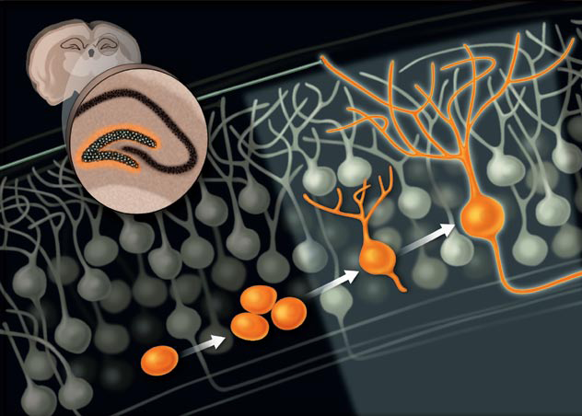
Brain Growth!
Saving new brain cells. T. Shors, Sci. Amer. Mar 09
Notes:
Your brain is made up of brain cells – neurons. The well-used neurons in you brain have many little tentacles called dendrites.

Slide 12
More connections
Better connections

Slide 13
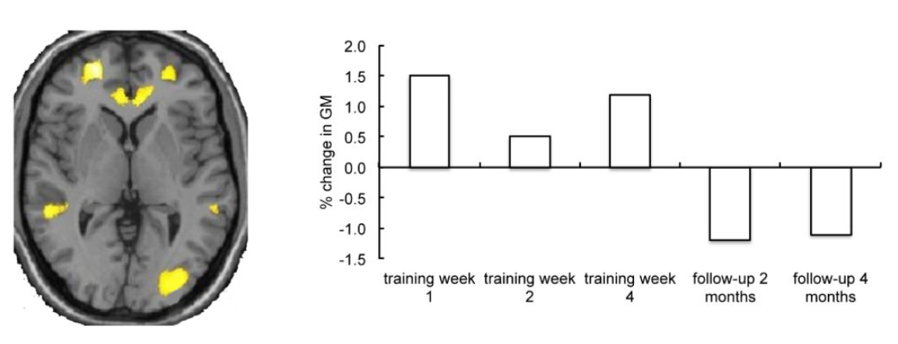
Grey Matter Grows with Learning
Zatorre, R. J., Fields, R. D., & Johansen-Berg, H. (2012). Plasticity in gray and white: neuroimaging changes in brain structure during learning. Nature neuroscience, 15(4), 528-536.

Slide 14
Grey Matter Shrinks Without!
Zatorre, R. J., Fields, R. D., & Johansen-Berg, H. (2012). Plasticity in gray and white: neuroimaging changes in brain structure during learning. Nature neuroscience, 15(4), 528-536.

Slide 15
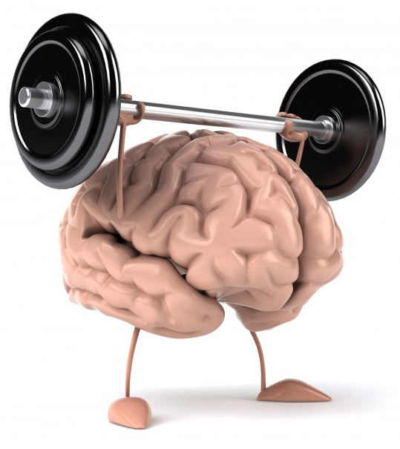
Use it or Lose it!
Build those mental muscles through vigorous work!

Slide 17
Student asks:
“What is the homework for tonight?”
Teacher replies:
“Please check your syllabus”
Why do teachers do this? It’s so annoying!

Slide 18
Habits!
What is a habit?
Discuss in your groups
Be prepared to share

Slide 19
What’s the homework?
Check with teacher
Large collections of neurons!
Want to strengthen this!
Look in syllabus

Slide 20
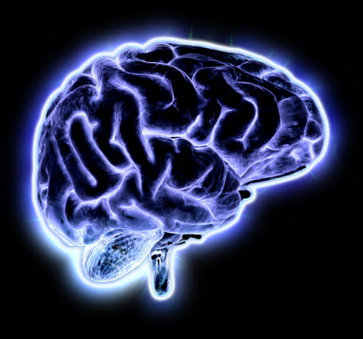
Habit = Efficiency!
“I don’t need to figure this out any more.”
Powerful!
Saves time and energy
Happens automatically

Slide 21
Our Daily Work Creates Habits
High-quality or Sloppy work reinforces different brain connections
High Quality Work Find the displacement of the falling pebble. Δy = v₁Δt + ½aΔt² = 0 + ½ (9.8 m/s²)(1.76 s)² = 15.18 m The pebble falls 15.2 m, which gives the height of the bridge. | Sloppy, Incomplete Work Calculate Δy = 0 + ½ x 9.8 x 1.76² = 15.17824 It is 15.2 m.

Slide 22
Very strong connections
Solve the problem
Sloppy work
Signal!
Large collections of neurons!
High quality work

Slide 23
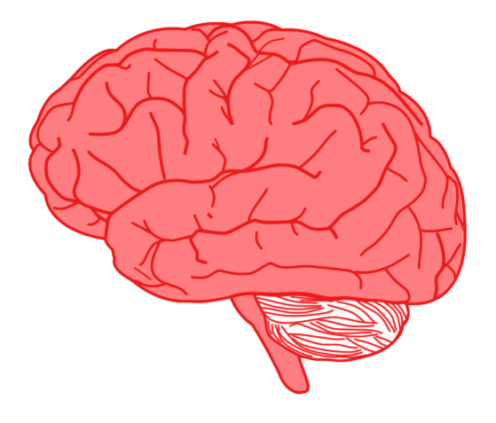
“I slacked off last year, but this year will be different!”
Solve the problem
Sloppy work
Large collections of neurons!
“I want a high mark, so I will work hard.”
High quality work

Slide 24
What happens?

Slide 25
Very strong connections
“I just don’t have time today.”
“I don’t feel like it.”
“I need to check the updates on my wall.”
Solve the problem
Sloppy work
Signal!
Large collections of neurons!
Excuses!
You try to convince yourself that you couldn’t use the better habit.
High quality work

Slide 26
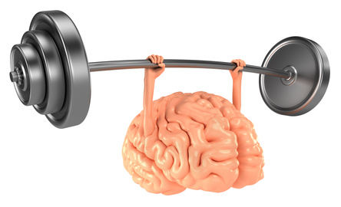
Changing habits requires persistence and hard work

Slide 27
Don’t reinforce unhelpful habits!
Use the best habits from the start!

Slide 29
How Learning Feels

Slide 30
MRI Brain Scan
Measures Brain Activity
Scan shows higher than normal blood flow
Blood flow increases to supply more energy (glucose) to neurons
Demand for energy increases due to more neuron firing

Slide 31
Brain Workload
What is happening in each brain?
Discuss with your group. Be prepared to share.
Hill, N. M., & Schneider, W. (2006). Brain changes in the development of expertise: Neurological evidence on skill-based adaptations. From: The Cambridge handbook of expertise and expert performance (pp. 653-683).

Slide 32
Brain Workload
How does this feel? Novice vs. Skilled?
Discuss with your group
Hill, N. M., & Schneider, W. (2006). Brain changes in the development of expertise: Neurological evidence on skill-based adaptations. From: The Cambridge handbook of expertise and expert performance (pp. 653-683).

Slide 33
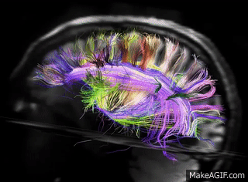
The Novice Brain
Working very hard to find the right connections to use

Slide 34
How Learning Feels
Easy, Sleepy
Tiring,
Hard Work
Anxious,
Discouraged,
Lost

Slide 35
Greatest Learning?
Little Learning
Maximum Learning
Little Learning

Slide 36
The Growth Zone!
Comfort Zone
Growth Zone
Panic Zone

Slide 37
Challenges of Learning
Mistakes!
Hill, N. M., & Schneider, W. (2006). Brain changes in the development of expertise: Neurological evidence on skill-based adaptations. From: The Cambridge handbook of expertise and expert performance (pp. 653-683).

Slide 38
Challenges of Learning
Comfort Zone
Growth Zone
Mistakes
Panic Zone
Mistakes

Slide 39
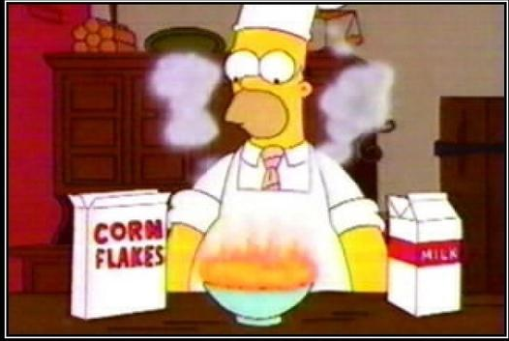
Mistakes and Failure
are part of learning

Slide 40
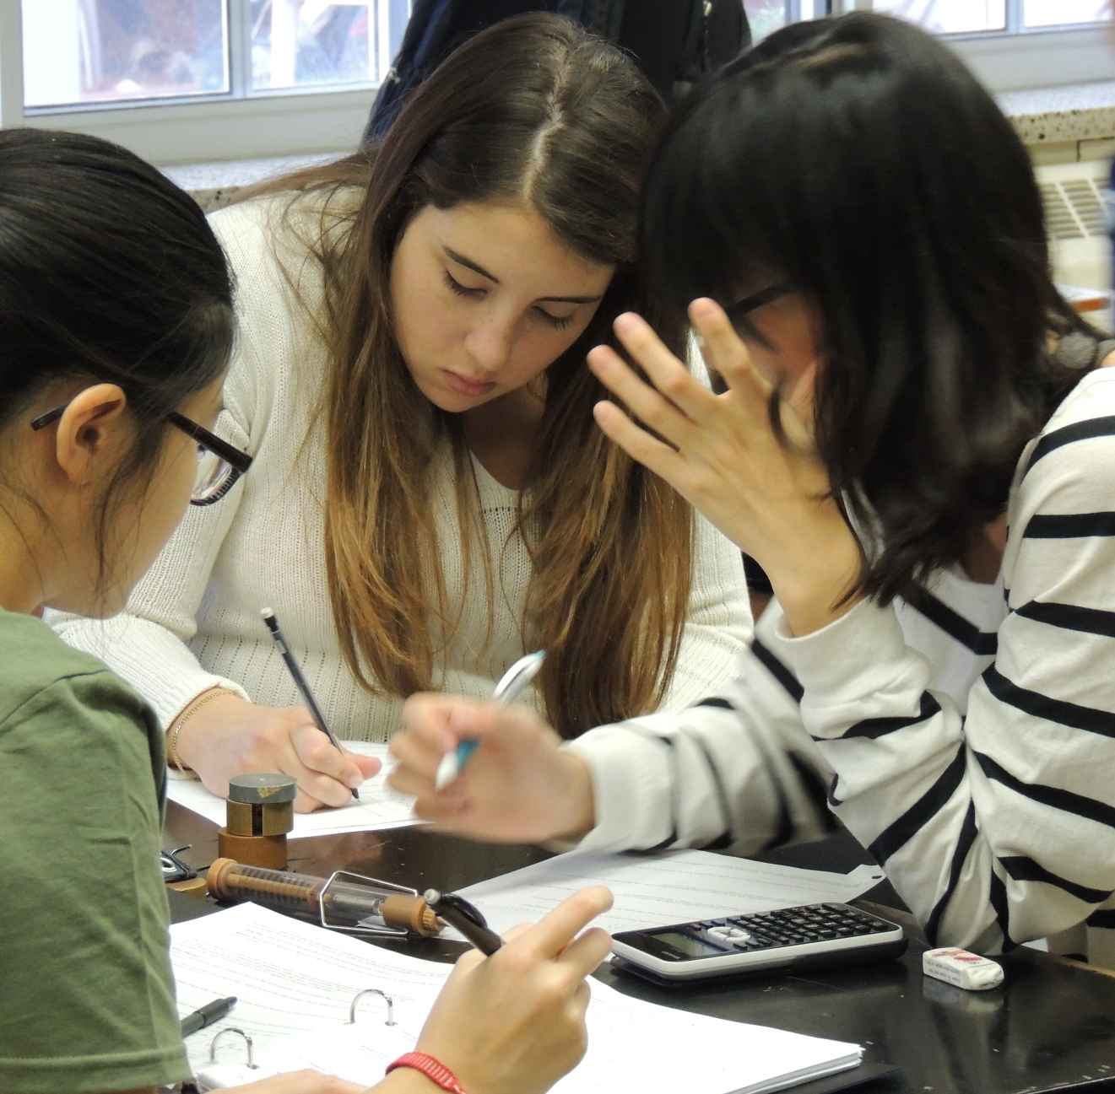
Train Your Brain!
Don’t react negatively to mistakes
Don’t avoid mistakes
Learn from mistakes

Slide 41
Train Your Brain!
Be patient
Persist through difficulties
Stay in the …

Slide 42
In the Growth Zone
Comfort Zone
Growth Zone
Stay!
Panic Zone

Slide 43
Challenges of Learning
Mistakes Required!
These scans:
60 minutes of careful practice!
Hill, N. M., & Schneider, W. (2006). Brain changes in the development of expertise: Neurological evidence on skill-based adaptations. From: The Cambridge handbook of expertise and expert performance (pp. 653-683).

Slide 44
Challenges of Learning
Mistakes Required!
Other skills might take
6 hours, 6 days, depends!

Slide 45
Challenges of Learning
Stuck here?
Learning always feels
hard or stressful

Slide 46
Find Your Growth Zone!
Growth Zone

Slide 48
Learning from Evaluations

Slide 49
Your recent evaluation
How do you feel it went?
A: I feel it went quite well
B: I feel it went OK
C: I’m not too sure how it went
D: I feel it did not go well

Slide 50
What does it mean?
Quiz or test results often have a strong emotional effect on students. Why?
Discuss with your group.
Be prepared to share.

Slide 51
What does it mean?
How much progress?
Evaluations give feedback on your skills and understandings.

Slide 52
What does it mean?
A high mark means your brain is becoming skilled.
A lower mark means your brain is searching for the right connections to use.

Slide 53
What does it mean?
“Good” Student?
Evaluations do not make a judgement about the person

Slide 54
We are just people trying to learn
Don’t judge yourself or others

Slide 55
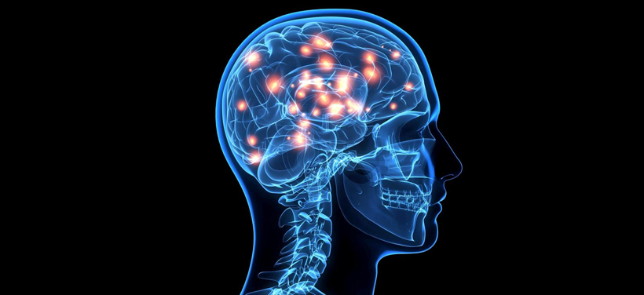
The human brain has an unlimited capacity to make connections and learn
Fuster, Joaquin M. Cortex and mind: Unifying cognition. Oxford university press, 2003.

Slide 56
What does it mean?
The difference between
a “good” mark and a “bad” mark is often just
a few days of careful practice.

Slide 57
You have learned a lot!
Progress!

Slide 58
Your recent evaluation
What are you most likely to do with the feedback from your evaluation?
A: Keep it in mind when I do my new work
B: Go back to those lessons and review the ideas
C: Do some extra practice or re-do some old questions
D: Ask a friend or teacher for help
E: I will just move on – I have other things to worry about.

Slide 59
Learn
Motion Diagrams
Position Graphs
Velocity Graphs
Velocity Vector Arrows
Physics Descriptions
Conversion Ratios
Feedback
Improve

Slide 60
The Improvement Deal
(1) Present evidence of improvement
(2) Teacher decides
if student is ready
(3) Re-write the evaluation

Slide 61
Advice
The improvement deal works best for students scoring < 80%
Requires time and effort.
No instant redo.
Rewritten evaluation
always counts.

Slide 62
Acceleration!
You are here!
Get ready to learn!

Slide 64
Finding the Growth Zone

Slide 65
Finding the Growth Zone
How?
How to quickly go from novice to skilled?
Hill, N. M., & Schneider, W. (2006). Brain changes in the development of expertise: Neurological evidence on skill-based adaptations. From: The Cambridge handbook of expertise and expert performance (pp. 653-683).

Slide 66
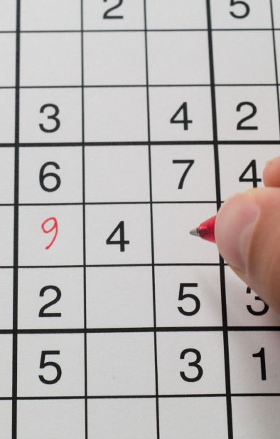
Sudoku Anyone?
Bad Drivers
Sudoku will not help improve your math. Why?
After years of driving, people don’t improve. Why?
Discuss in your group
Be prepared to share

Slide 67
In the Growth Zone
Comfort Zone
Growth Zone
Sudoku!
Panic Zone

Slide 68
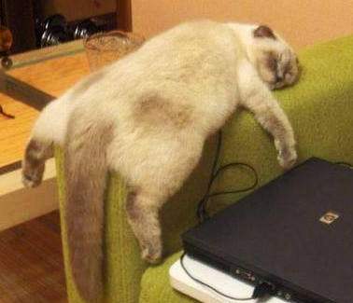
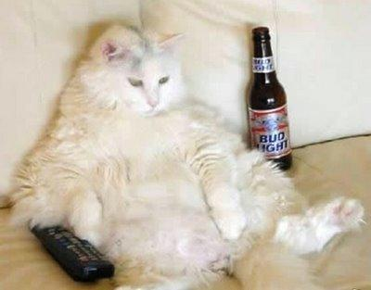
Comfort Zone!
Lack of challenge!

Slide 69
Comfort Zone!
Connection shrink!
Zatorre, R. J., Fields, R. D., & Johansen-Berg, H. (2012). Plasticity in gray and white: neuroimaging changes in brain structure during learning. Nature neuroscience, 15(4), 528-536.

Slide 70
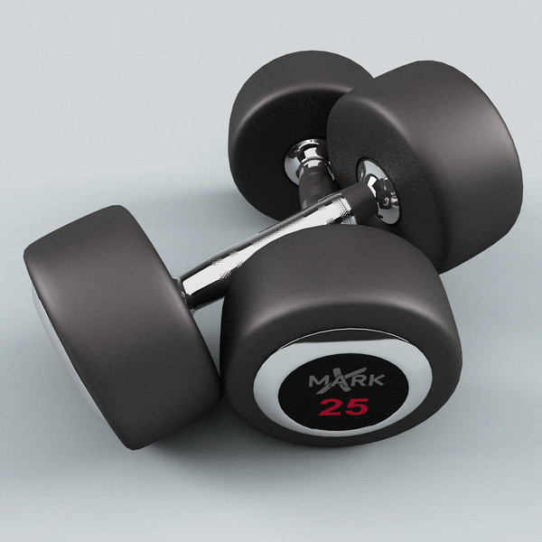
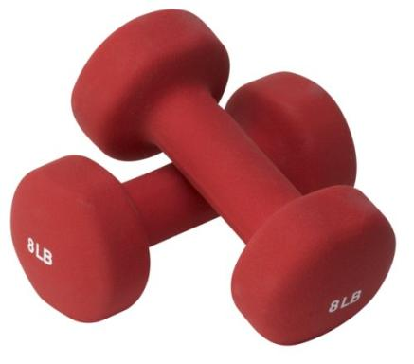
Growth Zone = Challenges
When a task is too easy, move up!
You need to be working hard to improve.

Slide 71
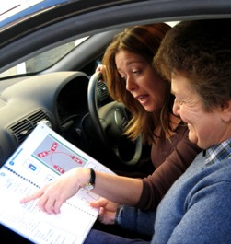
Need Careful Feedback
Need to use regular, careful, targeted feedback
Listen to group members
Focus on teacher comments

Slide 72
Finding the Growth Zone
Careful Feedback
Comfort Zone
Growth Zone
Thoughtful Practice
Panic Zone

Slide 73
Leaving the Growth Zone
Comfort Zone
Growth Zone
Shortcuts
Panic Zone
Shortcuts

Slide 74
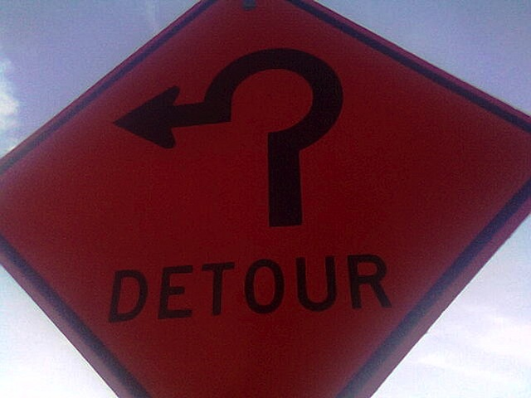
Leaving the Growth Zone
Short cuts make learning needlessly harder or longer.

Slide 75
Leaving the Growth Zone
Letting others tell you the answers.
You must do the thinking to make the connections.
Finn, Emily S., et al. "Disruption of functional networks in dyslexia: a whole-brain, data-driven analysis of connectivity." Biological psychiatry 76.5 (2014): 397-404.
Notes:
Would your only training for the big race be other people telling you how they swim?

Slide 76
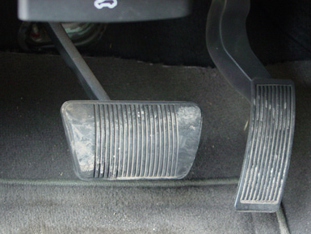
Leaving the Growth Zone
Not asking questions right when they arise
?
?
Notes:
Would you wait until you are on the 401 before asking which is the brake and accelerator?

Slide 77
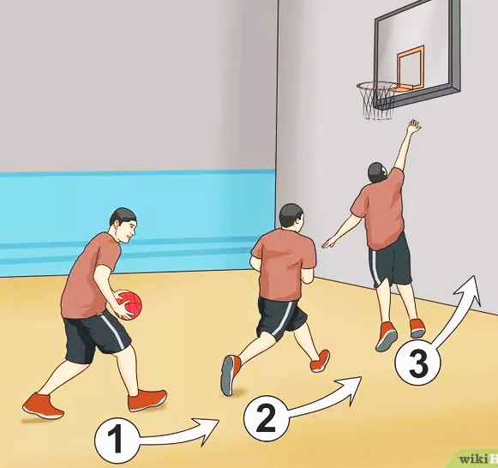
Leaving the Growth Zone
Not practising new skills the regularly and thoughtfully.
Notes:
What happens when you do your homework on the weekend, five days after the class?

Slide 78
Finding the Growth Zone
Careful Feedback
Comfort Zone
Growth Zone
Thoughtful Practice
Thoughtful Practice
Frequent Practice
Frequent Practice
Panic Zone

Slide 79
Follow Your Training Carefully!
Serve you well it will.

Slide 80
Follow Your Training Carefully!
As you master it, you won’t notice the effort anymore.

Slide 82
Give me lots of practice!

Slide 83
Practice is Needed to Improve
Careful Feedback?
Comfort Zone
Growth Zone
Thoughtful Practice
Thoughtful Practice?
Frequent Practice
Frequent Practice?
Panic Zone

Slide 84
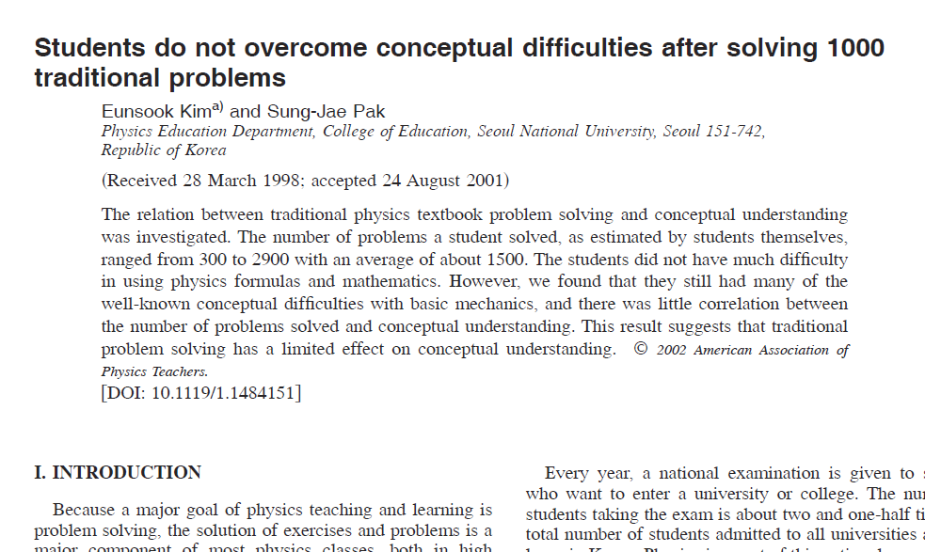
Lots of Practice?

Slide 85
Lots of Practice?
Famous Korean cram schools!
Students do practice problems
Researches gave them simple questions based on ideas (no math)

Slide 86
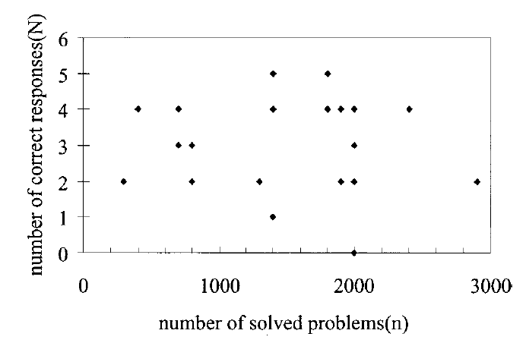
Discuss patterns in this data. Why does this happen? Be prepared to share.
Number of correct questions
Number of completed practice problems

Slide 87
Not in Growth Zone!
Careful Feedback?
No critical feedback
Comfort Zone
Growth Zone
Rushed Practice!
Thoughtful Practice?
Thoughtful Practice?
Thoughtful Practice
Thoughtful Practice?
Frequent Practice?
All at once!
Frequent Practice?
Frequent Practice
Frequent Practice?
Panic Zone

Slide 88
What is the best way to practice?

Slide 89
Best Ways to Practice

Slide 90
Best Ways to Practice
Basic Skills:
Short, quick questions
Daily
Accuracy and speed
Happens early in the learning process
Goal: perform without thinking

Slide 91
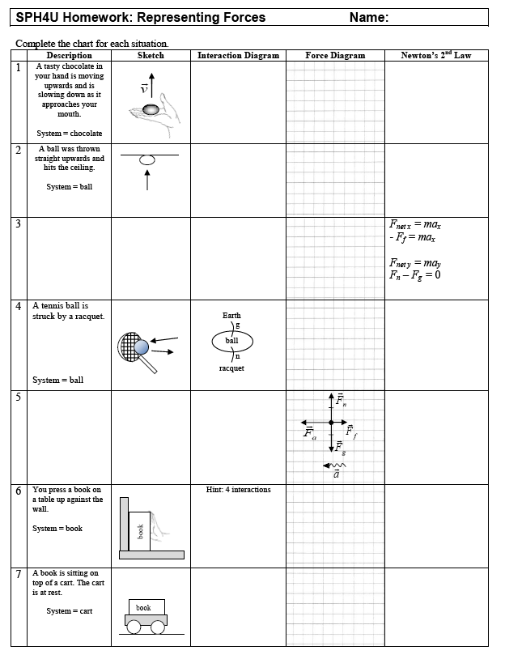
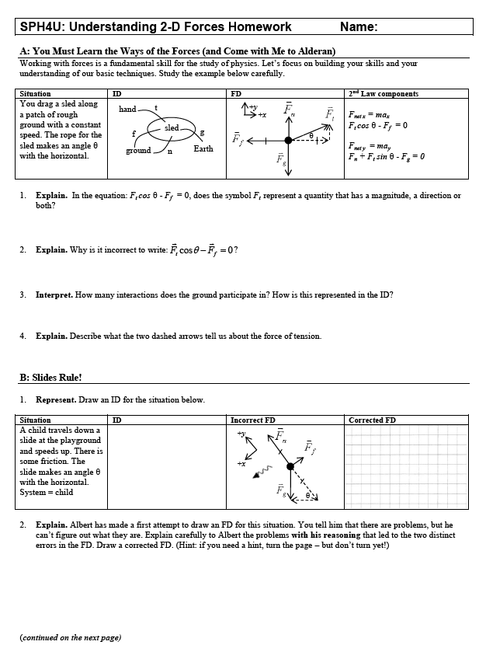

Slide 92
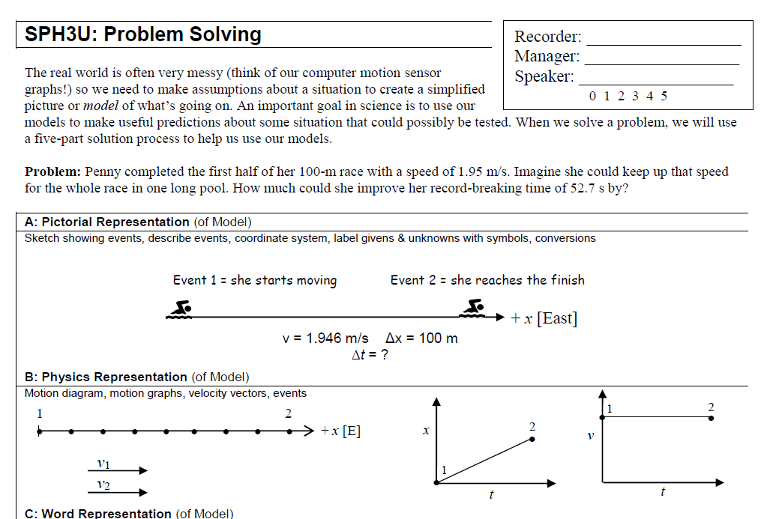
Best Ways to Practice?
What about these?

Slide 93
Best Ways to Practice
Deep Understanding:
Need fluent basic skills
Long, rich problems
Attention to detail and consistency
Thoughtful explanations of ideas

Slide 94
Lots of Practice?
Security blanket.
If I can do these,
I’m OK

Slide 95
Lots of Practice?
Students avoid actual studying
Carefully go through the unit and:
(1) Identify key ideas
(2) Explain key ideas
(3) Understand how to use key ideas in a variety of situations

Slide 97
Sense-Making

Slide 98
Has this happened to you?
Study
Study
Study
Test
Disaster!
Why?

Slide 99
Time for a Test!
Ready!

Slide 100
Study This – You Will Be Tested!
= 1
= 2
= 3
= 4
= 5
= 6
= 7
= 8
= 9
= 0

Slide 101
Test Time!
38
27
40

Slide 102
Discuss!
= 1
= 2
= 3
= 4
= 5
= 6
= 7
= 8
= 9
= 0
Discuss any patterns you find amongst the numbers and shapes.

Slide 103
The Pattern
1 | 2 | 3
4 | 5 | 6
7 | 8 | 9

Slide 104
Test Time!
23
48
15

Slide 105
Your Brain: A User’s Guide
Active Testing
(Doing)
Front
Back
Concrete Experience
(Input)
Reasoning Hypotheses
(Planning)
Reflective Observation
(Sense-making)
Zull, J. The Art of Changing the Brain. 2002

Slide 106
Deep learning occurs when this cycle is complete
Active Testing
(Doing)
Front
Back
Concrete Experience
(Input)
ReasoningHypotheses
(Planning)
Reflective Observation
(Sense-making)
Zull, J. The Art of Changing the Brain. 2002

Slide 107
Thoughtful writing and discussion make this process work.
ThoughtfulWriting,
Talking
Front
Back
Read question
Compose thoughts, response
Reflect on ideas
Zull, J. The Art of Changing the Brain. 2002

Slide 108
Thoughtful writing and discussion make this process work.
ThoughtfulWriting,
Talking
Front
Back
Group members talking and writing
Evaluate ideas
Improve ideas
Compare with your own ideas
Zull, J. The Art of Changing the Brain. 2002

Slide 109
So What?
Learning really begins with practice that connects ideas
Finn, Emily S., et al. "Disruption of functional networks in dyslexia: a whole-brain, data-driven analysis of connectivity." Biological psychiatry 76.5 (2014): 397-404.

Slide 110
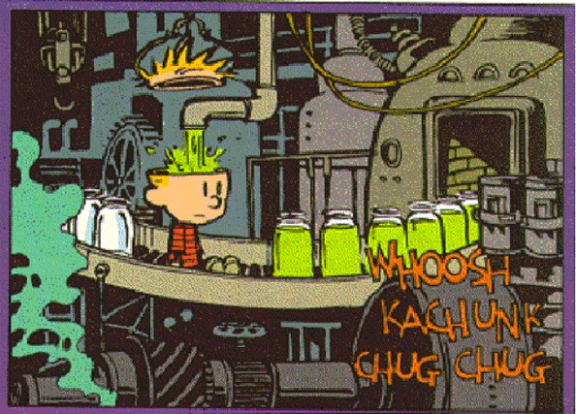
Memorization does not lead to understanding

Slide 112
Why Do We Sleep?

Slide 113
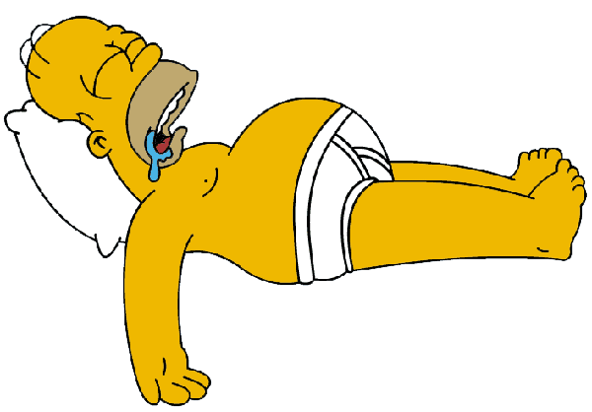
Why Sleep?

Slide 114
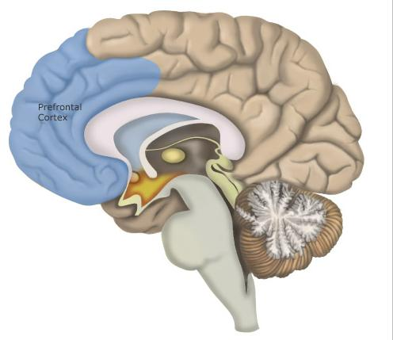
Sleep
The prefrontal cortex:
responsible for many higher-level cognitive functions
particularly vulnerable to a lack of sleep

Slide 115
Sleep

Slide 116
Sleep
Research strongly suggests:
students at all levels are chronically sleep deprived and suffer from daytime sleepiness

Slide 117
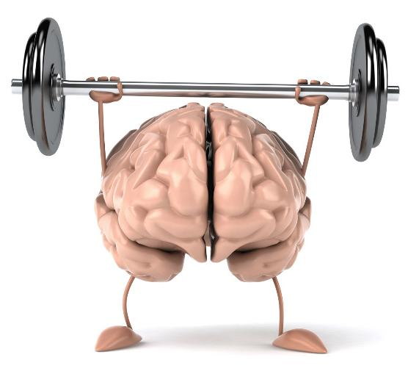
Sleep
Research strongly suggests:
Sleep has a role in the consolidation of memory, which is essential for learning new information.

Slide 118
Sleep
Research strongly suggests:
Sleep quality and quantity are closely related to student learning capacity and academic performance

Slide 120
Good Sleep Habits

Slide 121
Sleep
How much do you like sleep?
A: Don’t
B: Fairly neutral
C: It’s OK
D: I quite like it
E: One of my favourite activities!

Slide 122
Sleep
On a typical night, you get:
A: less than 5 hours of sleep
B: 5-6 hours of sleep
C: 7-8 hours of sleep
D: 9-10 hours of sleep
E: more that 10 hours of sleep!

Slide 123
Animal | Average Daily Sleep Period
Giraffe | 0.5/1.9/4.6 hours (varied reports)
Horse | 2.9 hours
Donkey | 3.1 hours
Elephant | 3.5 hours
Sheep | 3.8 hours
Cow | 4 hours
Goat | 5.3 hours
Gray Seal | 6.2 hours
Pig | 7.8 hours
Human | 8 hours
Rabbit | 8.4 hours
Chimpanzee | 9.7 hours
Red Fox | 9.8 hours
Dog | 10.1 hours
Baboon | 10.3 hours
Bottle-nosed Dolphin | 10.4 hours
Duck | 10.8 hours
Rhesus Monkey | 11.8 hours
House Mouse | 12.5 hours
Cat | 12.5 hours
Rat | 12.6 hours
Lion | 13.5 hours
Platypus | 14 hours
Squirrel | 14.9 hours
Chipmunk | 15 hours
Tiger | 15.8 hours
Tree Shrew | 15.8 hours
Sloth | 14.4/16 hours
Python | 18 hours
Opossum | 18 hours
Giant Armadillo | 18.1 hours
Little Brown Bat | 19.9 hours

Slide 124
Sleep
Rate your level of daytime sleepiness:
A: Never sleepy during the day
B: Just a little bit
C: Occasionally do the head-bob in class
D: Regularly struggle to stay awake in class
E: Have woken up in class with mysterious things attached to me

Slide 125
Sleep
What are the reasons why you don’t get a regular full night’s sleep
(7.5+ hours)?
Each group member should:
have a different coloured marker
write at least one response on the whiteboard

Slide 126
Sleep
Advice:
Eliminate night time distractions
Keep to a regular sleep schedule
Work efficiently / manage awake time wisely
Begin work well in advance to avoid the all-nighters

Slide 128
Executive Function

Slide 131
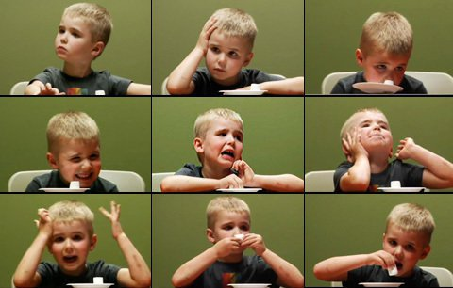
Eat one now, or get two later!

Slide 132
The Marshmallow Test
You have the option of eating one tasty treat now, or receiving two tasty treats later. You would probably:
A: Take the treat right now!
B: Think about it a bit and then take the treat
C: Think about it a bit and then wait for the two treats
D: Definitely wait for the two treats

Slide 133
Self-Regulation
Children who waited for the two treats possess a greater amount of self-regulation
What do you think self-regulation looks like in a classroom?
Write down your ideas on a whiteboard

Slide 134
Self-Regulation
Self-regulation means your ability to:
set goals for yourself
choose behaviours that help you achieve your goals
resist behaviours that hinder your goals
Self-regulation can be practiced and improved!

Slide 136
Diversity in Thinking

Slide 137
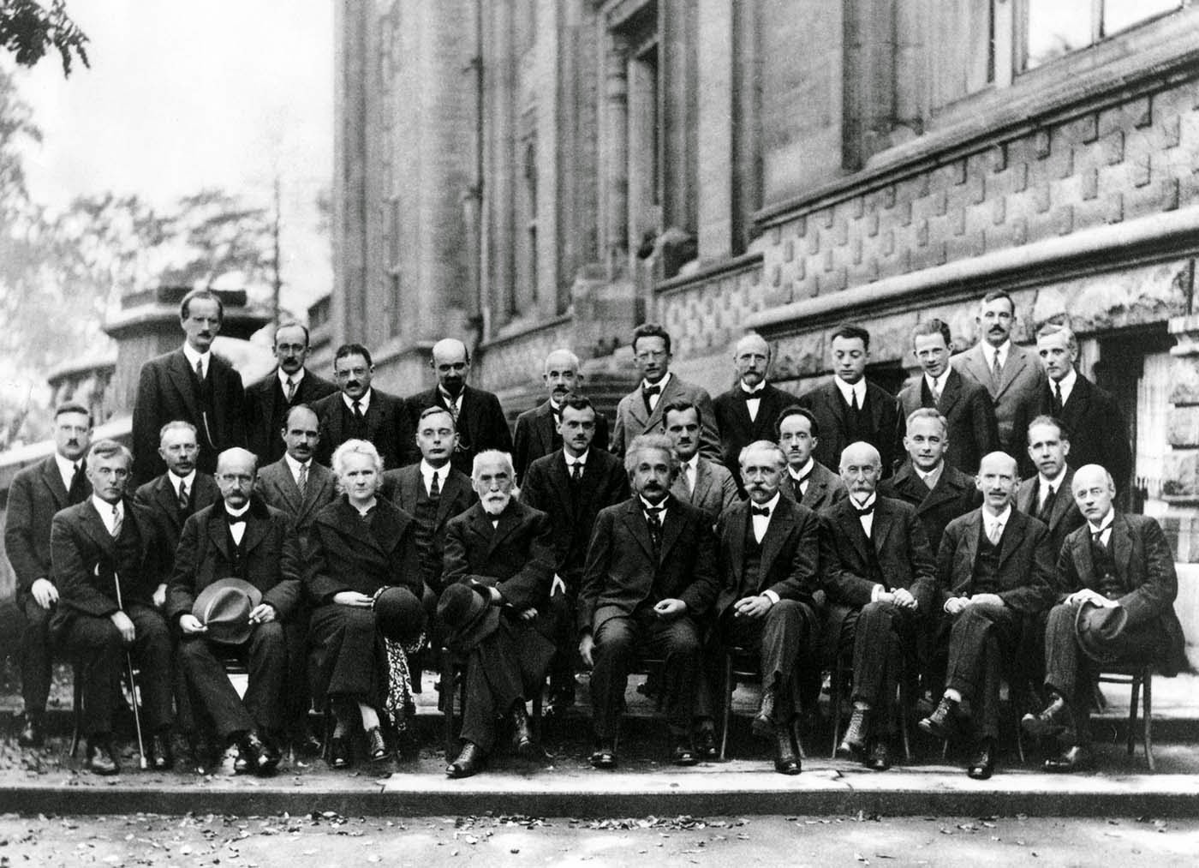
The Physics Community in 1927
Describe the “kinds of people”
who do physics

Slide 138
The Physics Community in 1927
Heisenberg
Curie
Bohr
Plank
Einstein

Slide 139
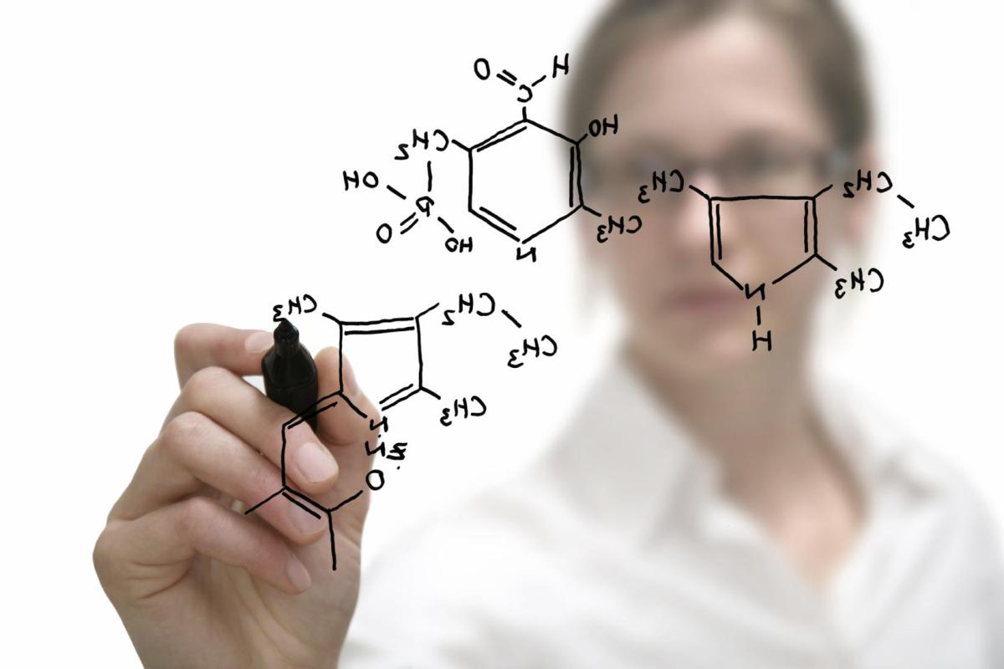
Diversity is Important
To find solutions to our world’s problems, we need
diversity of thinking:
Different life experiences
Different priorities and goals
= Different thinking

Slide 140
Gender Bias
Takes time to change:
Physics =
old white dudes

Slide 141
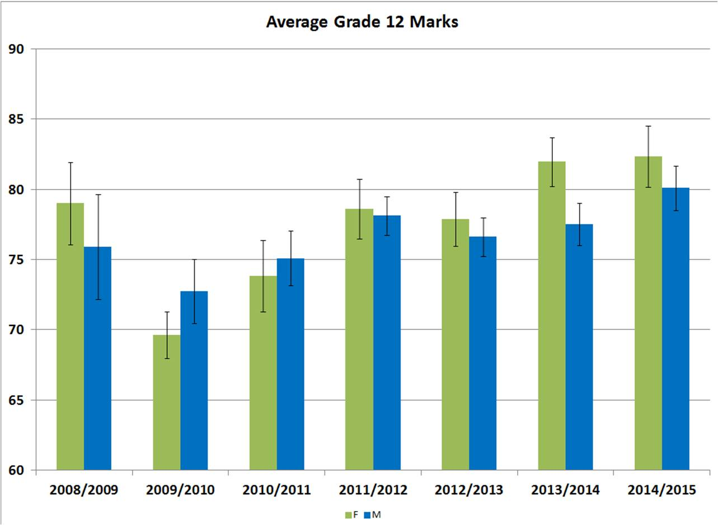
Solution: Undermine the Bias

Slide 142
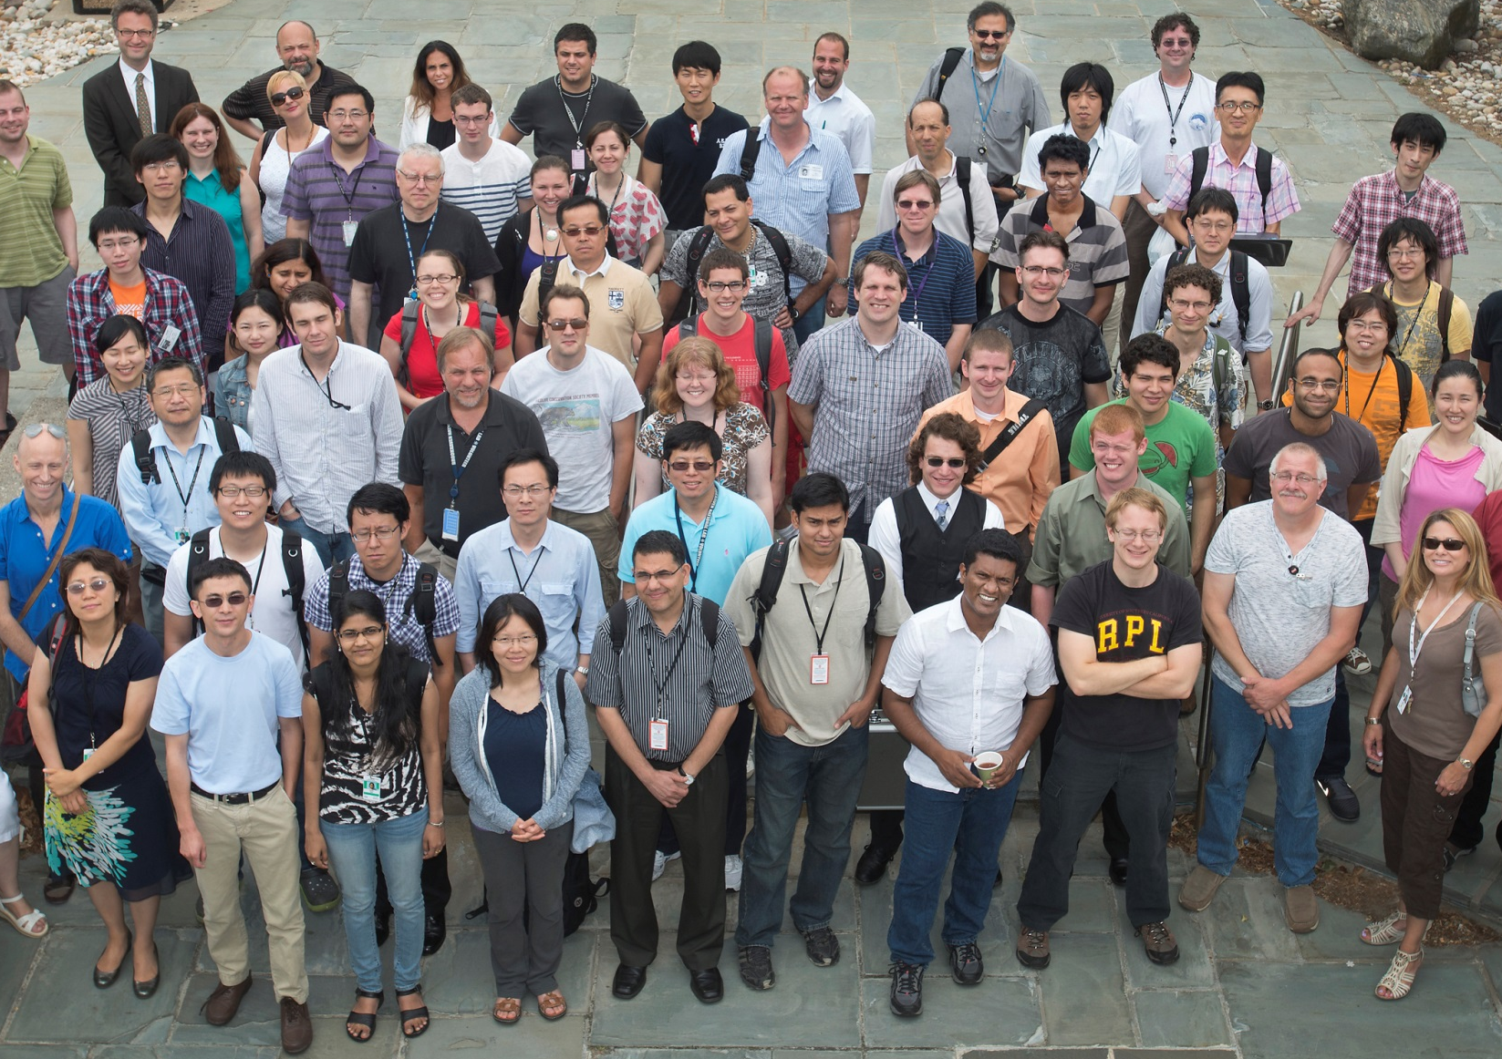
The Physics Community in 2017

Slide 143
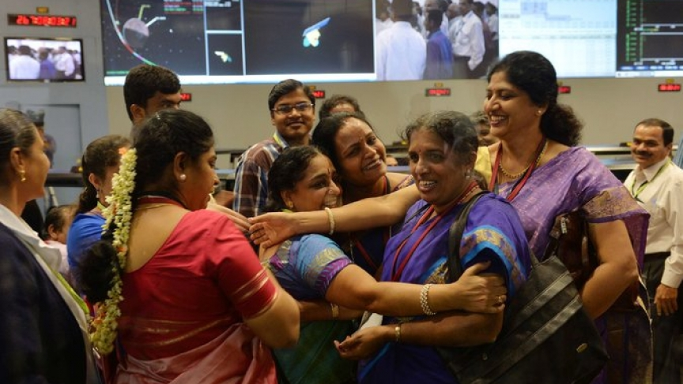
STEM Careers are Rewarding
Staff from the Indian Space Research Organization celebrate at the ISRO Telemetry, Tracking and Command Network in Bangalore after their Mars Orbiter spacecraft successfully entered Mars orbit on September 24, 2014.

Slide 144
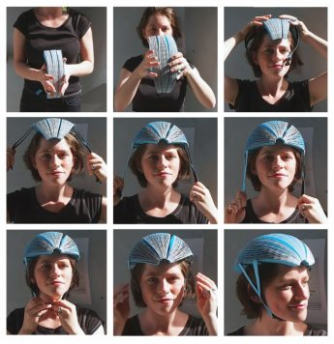
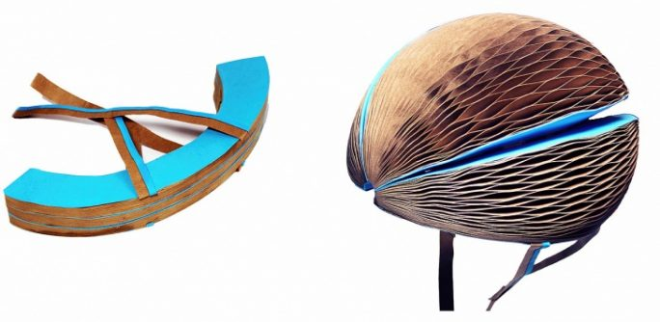
STEM Careers are Creative
Dyson Engineering Award Winner: ISIS SHIFFER

Slide 145
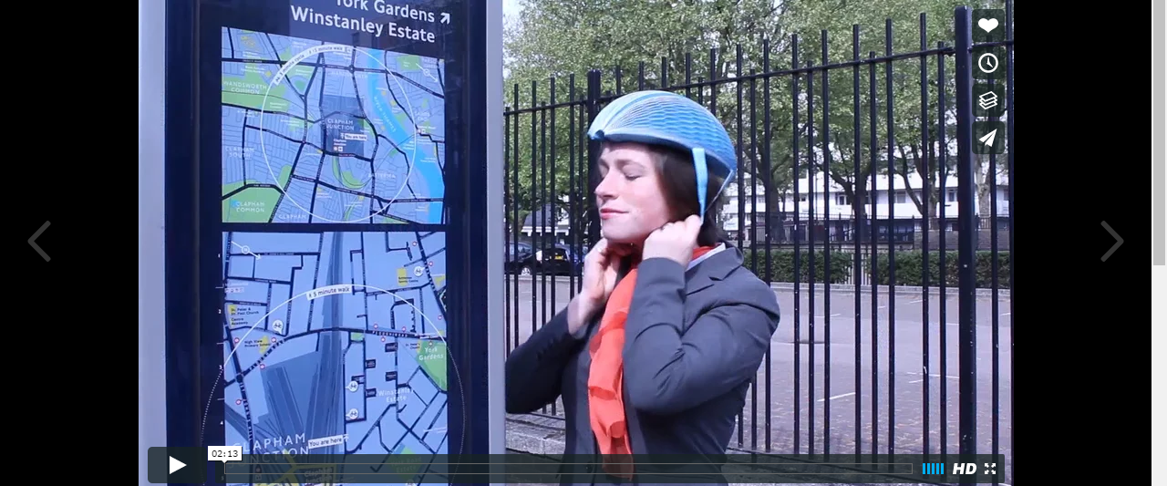
Dyson Award Winner Explains

Slide 146
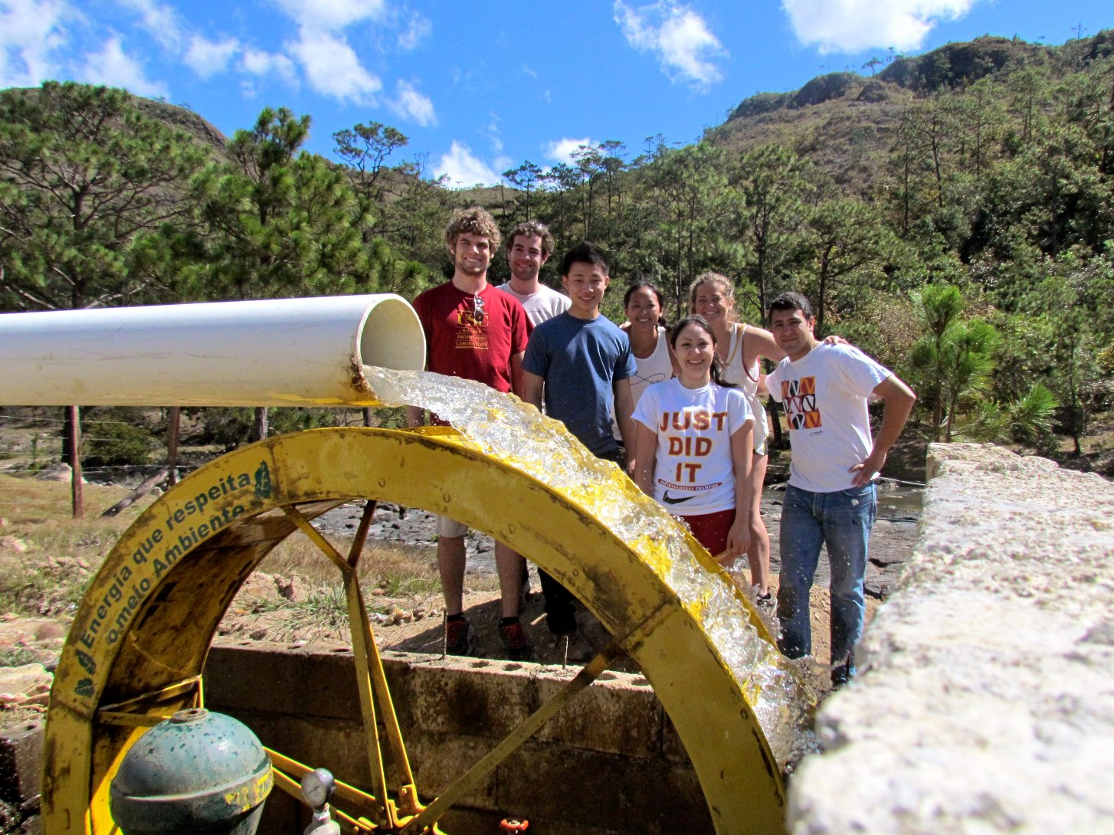
STEM Careers Can Help Improve Our World

Slide 147
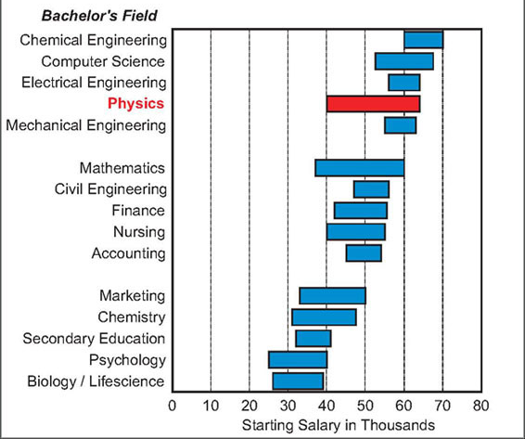
STEM Careers Pay Well
Especially Engineering

Slide 149
Anxiety

Slide 150
Emotions and the Brain
Sensory and
Post-sensory
Executive Functions,
Focus
Amygdala

Slide 151
Emotion Can’t Be Separated from Cognition

Slide 152
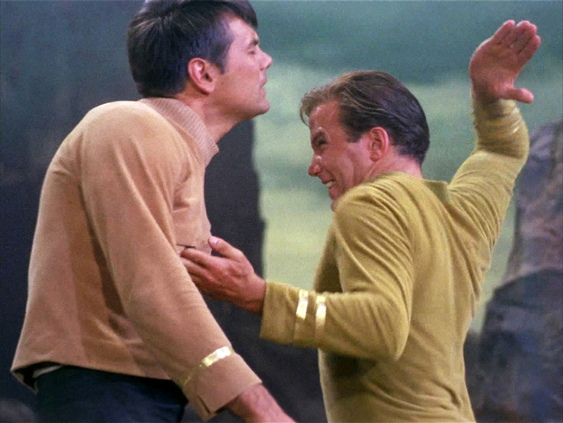
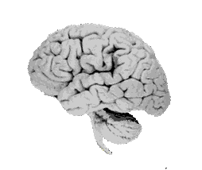
We get the humans

Slide 153
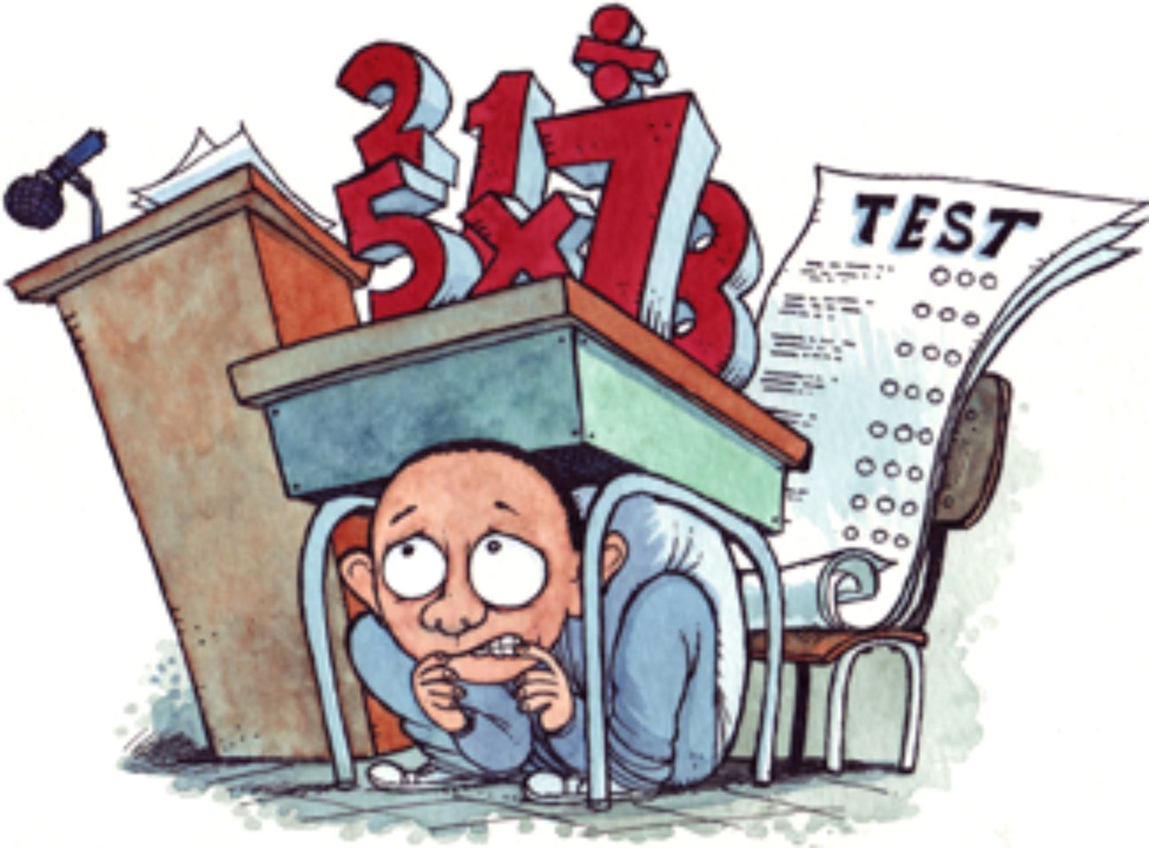
Anxiety!
Amygdala

Slide 154
Anxiety!
Activation of brain regions associated with physical pain perception is strongest when anticipating a math task.
Lyons, I. M., & Beilock, S. L. (2012). When math hurts: math anxiety predicts pain network activation in anticipation of doing math. PloS one, 7(10), e48076

Slide 155
Anxiety!

Slide 157
Physics Problem Solving

Slide 158
Remember Danielson!
There is no such thing
as studying for a test.
What you do each day in class
and at home makes the difference.

Slide 159
Changing Habits

Slide 160
You are your brain connections
All your memories, skills, habits, and thoughts are a result of the connections in your brain.

Slide 161
Habit = Efficiency!
“I don’t need to figure this out any more.”
Powerful!
Saves time and energy
Happens automatically

Slide 162
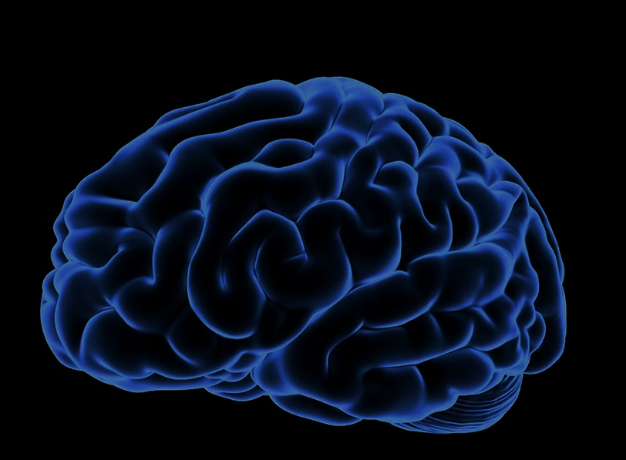
FEED Your Brain
To improve any habit, you need to change the connections:
F = Focus
E = Effort
E = Effortlessness
D = Determination

Slide 163
FEED Your Brain
Focus
Pay attention to your new or improved habit
Write notes or reminders
Do this now:
Use BIG letters to write one goal in your learning log

Slide 164
FEED Your Brain
Effort
Practice your new habit with focus and care
Your brain will work hard and feel tired
You are creating new connections in your brain
Find your motivation that will keep you practicing

Slide 165
FEED Your Brain
Do this now:
On a Post-It note write:
FEED (Focus, Effort, Effortless, Determination)
what you should do each day to reach your goal
Place this note where you will see it each time you need to use the new habit
Move the note each day if necessary

Slide 166
FEED Your Brain
Effortless
Stay with the new habit until it feels automatic
Your brain will adapt to work efficiently
You are solidifying the new connections in your brain
It will begin to feel effortless

Slide 167
FEED Your Brain
Determination
Once a habit becomes effortless, it is easy to forget it or move on
Don’t let yourself say: “Done! I don’t need to practice it now.”
Maintain your practice of the new habit through a regular routine. This shouldn’t be tough because it is effortless now.

Slide 170
Intelligence

Slide 171
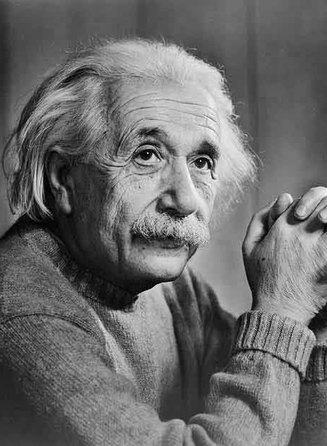
Intelligence

Slide 172
Intelligence
A person’s intelligence is a fixed thing and essentially does not change.
A: Strongly Agree
B: Agree
C: Neutral
D: Disagree
E: Strongly Disagree
F: Not sure

Slide 174
Intelligence
What’s the real story? Time for research!

Slide 175
Intelligence

Slide 176
Intelligence
Higher-level learning → brain development
Like muscle development!
Strenuous physical effort
= Thicker muscle tissue
Strenuous mental effort
= Thicker brain tissue, more connections
Saving new brain cells. T. Shors, Sci. Amer. Mar 09
Notes:
However, I want to remind you that, even though you have experience and comfort with “listening to lecture” and you may even feel like you learn from it, research shows that learning is not a passive process. Learning actually involves developing your brain, building new proteins, neurons, and connections in your brain. It’s a very PHYSICAL process. And one of the keys to this physical process is that it requires WORK on the part of the learner, for these physical changes to take place.
In fact, a lot like a training program for improving your physical, muscular abilities, where you would expect to need to put in repeated effort, going to the gym and working hard to build new muscle… to learn you have to YOURSELF put in repeated, strenuous effort in order to build new support in your brain for the new knowledge. So unfortunately, I can’t do the learning for you. You do have to do it yourself, and it takes serious effort. The reason we use Peer Instruction is to support you in efficient ways of accomplishing this learning

Slide 177
Intelligence
I like doing schoolwork best when I can do it perfectly without any mistakes.
A: Strongly Agree
B: Agree
C: Neutral
D: Disagree
E: Strongly Disagree
F: Not sure

Slide 178
Slide for growth zone vs. comfort zone

Slide 179
Slide showing growth / atrophy

Slide 181
Why Sleep?

Slide 183
Taking Tests

Slide 184
Reflection
During this unit, I feel that my skills drawing IDs and FDs, and my understanding of Newton’s Three Laws has:
(A) Improved a lot
(B) Improved a bit
(C) Stayed about the same
(D) Become a bit worse

Slide 185
Reflection
For this unit’s test, I feel:
(A) Quite confident and well-prepared
(B) OK and decently prepared
(C) Not sure and a bit worried
(D) Unprepared, I know my skills are not ready

Slide 186
Your Brain Protects You
Input
Decision Making
Amygdala
= serious mofo

Slide 187
Your Brain Protects You
Physics test prep.
“I’m not doing well”
“I feel anxious”
Amygdala

Slide 188
Your Brain Protects You
“I guess I’m actually doing OK!”
Group discussions✓
Homework problems✓
Physics challenges✓
Practice Tests✓
Amygdala

Slide 189
Your Brain Protects You
Our amygdala causes us to focus on
the bad things and to forget the good things
Amygdala

Slide 190
Test Time!
Put away books and notes
Only need pencil and calculator
Sit in group work positions

Slide 191
Group Discussion
Did you participate enough in the group discussion to feel confident about your understanding of the questions?
(A) Yes, quite confident
(B) I think so, fairly confident
(C) Maybe, I’ll need to see how the rest of question goes
(D) No, I’m still unsure about important parts of the question

Slide 192
Mental Focus
So far during the test, my mental focus has been:
(A) High – I thought very productively and almost all about problem
(B) Medium – I thoughts were mostly helpful and often about the problem
(C) Low – My thoughts were mostly about other things: my mark in physics, how well prepared I feel, when I will find time to study, what I will eat tonight …

Slide 193
Negative “Self Talk”
I am not doing well
This is going badly
I can’t figure this out
The others are getting it, but I’m not
This is going to sink my physics mark
I feel dumb

Slide 194
Feelings About Yourself
So far during the test:
(A) I feel good about myself – very little negative “self talk” in my head
(B) I feel OK about myself – only a bit of negative “self talk” in my head
(C) I feel unsure about myself – some negative “self talk” in my head

Slide 195
Mental Strategies for Tests
Coach yourself into a productive mindset:
Direct your mind towards productive thoughts, ignore any negative self talk
Focus on showing the best of your skills. Don’t be angry with yourself for lack of preparation or having self-doubts.
You have learned and improved a lot during this unit. You have a lot to show!
You are young! Life is good!

Slide 196
Mental Strategies for Tests
When stuck:
Draw pictures about everything you can
Explain to yourself, as if you were talking about the problem with a friend.
Keep your focus. Close your eyes, take a 20 s break, deep and steady breathing
Ask yourself, “what would my teacher say to help me if this was not a test and I called him over for help.”
Move on to the next part! Don’t bog down!

